Slide 1
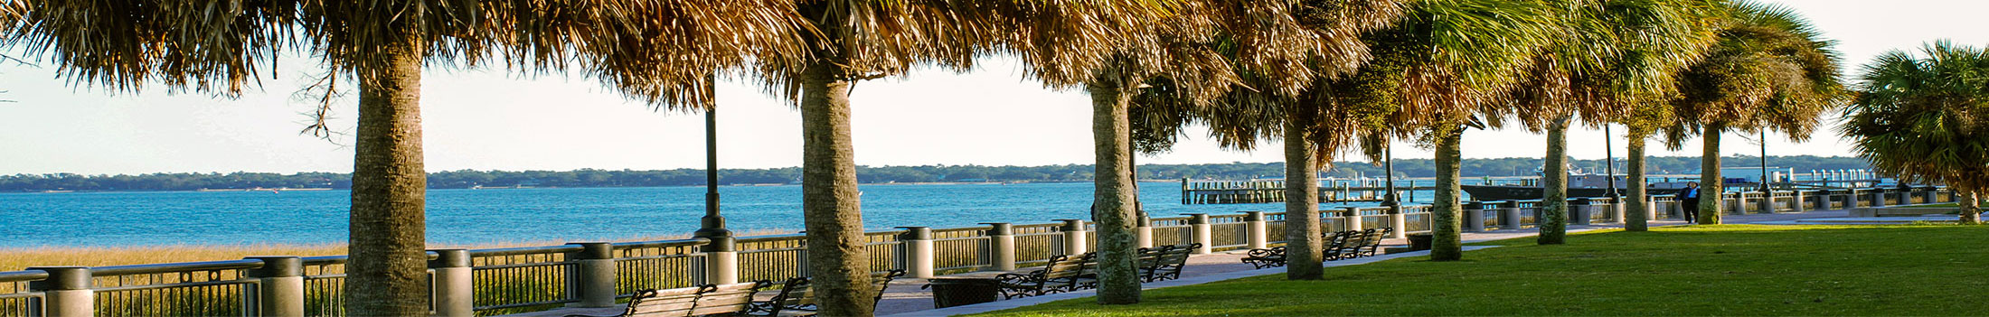







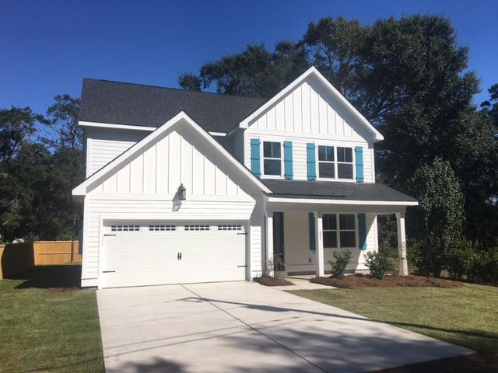



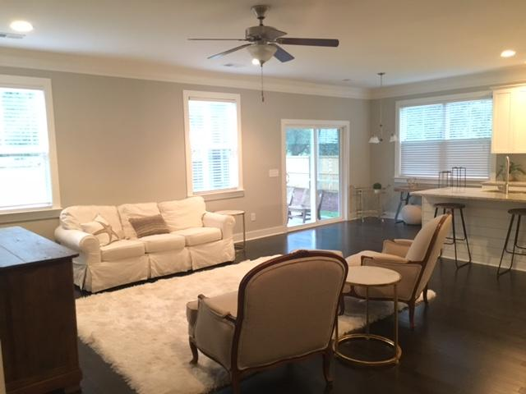
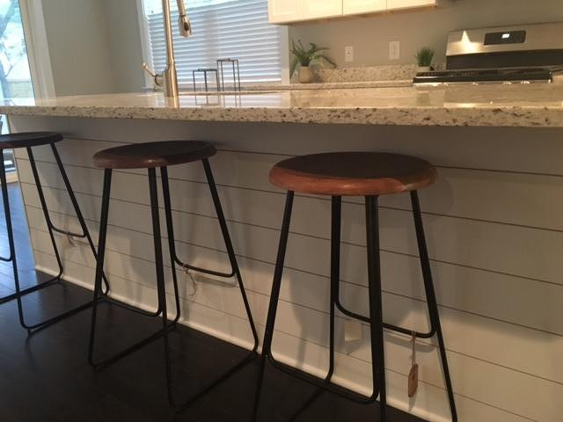
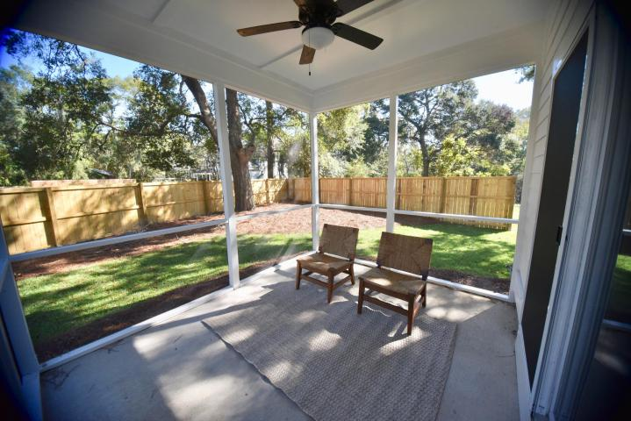
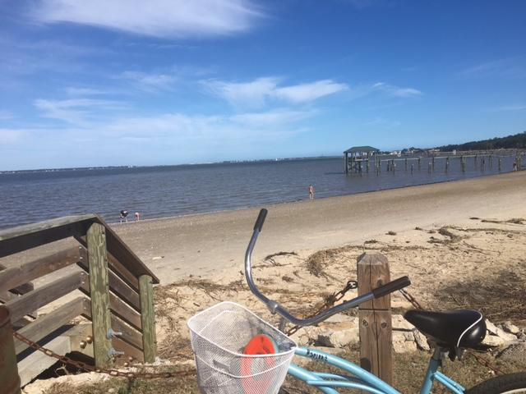
Fort Johnson Estates Holiday Drop-in Today from 5:30-7:30
Lennie Woods
843-864-6760 lenniewoods@gmail.com
1771 Sq Ft
Open Floorplan
Totally New Kitchen
Huge Screened Porch
Updated Bathrooms
Solid Hardwood Floors
X Flood Zone
Walk To Stiles Point Elementary
Come by 481 Fort Johnson this evening!
Enjoy some catered delights and wine and tour three model homes that will be available soon!

