Slide 1
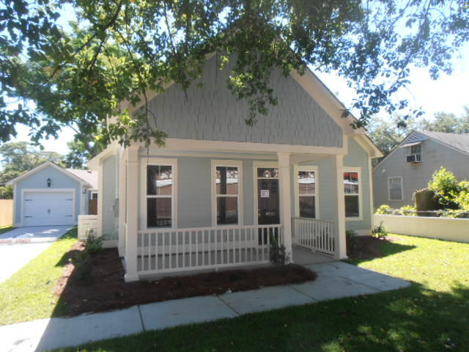
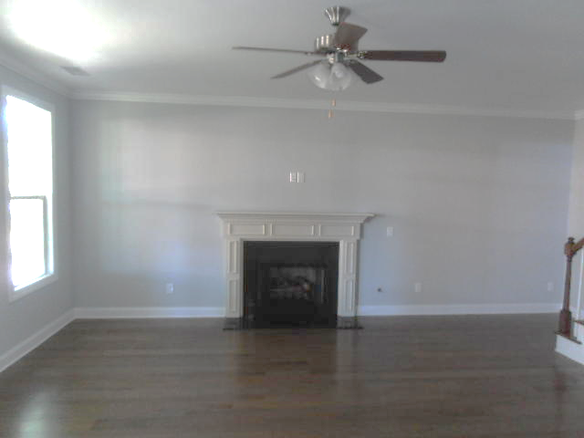
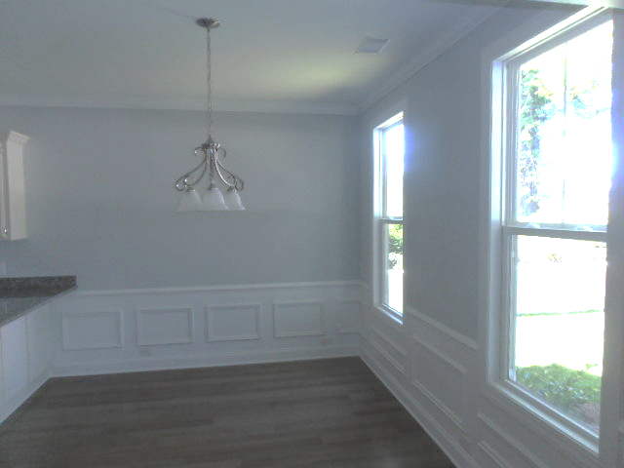
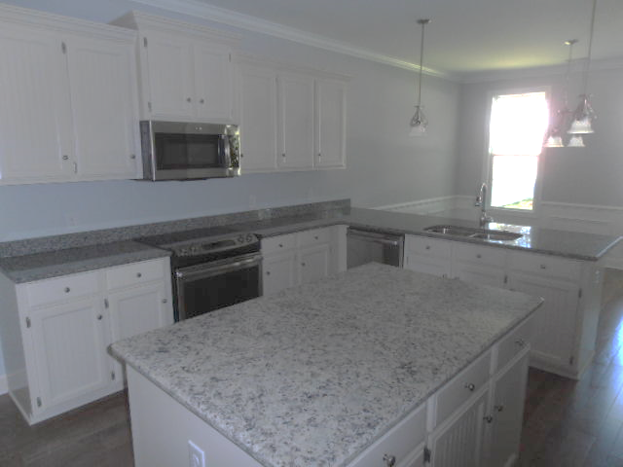
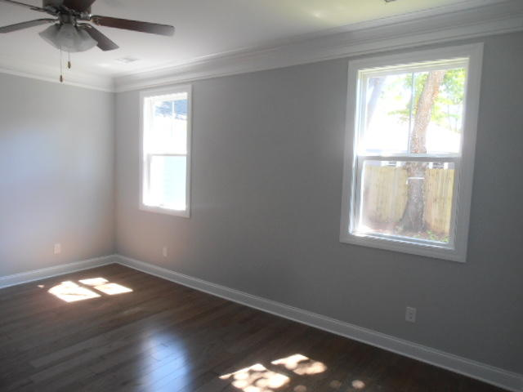
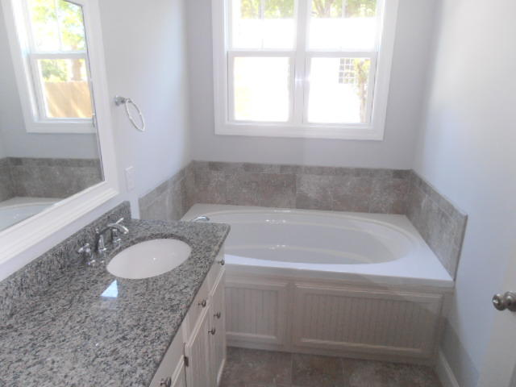
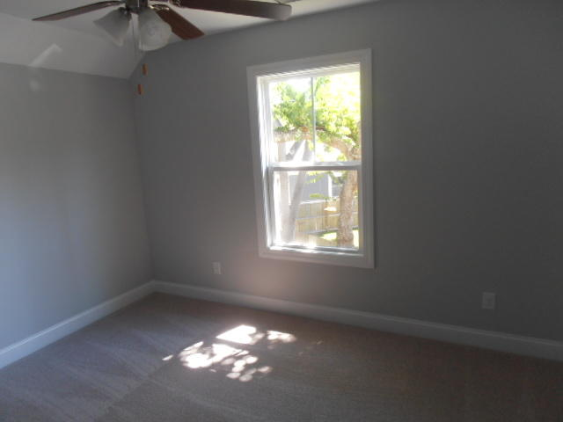
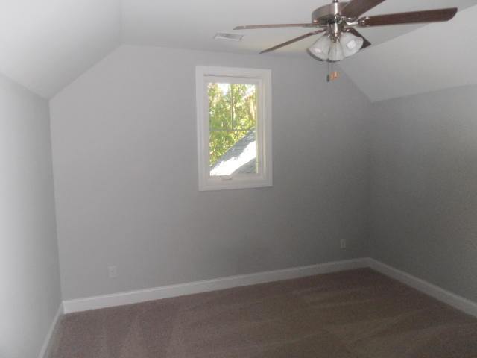
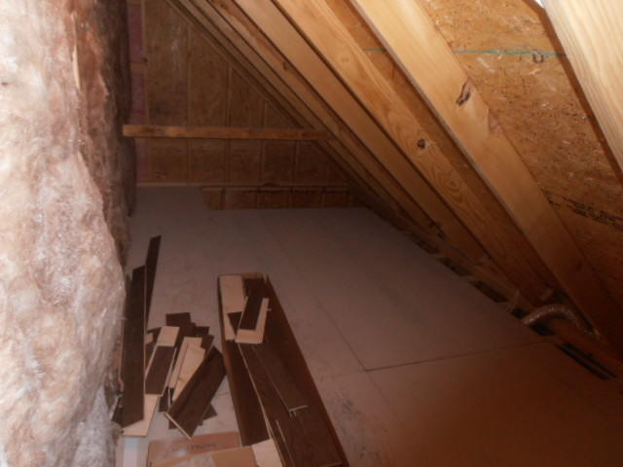
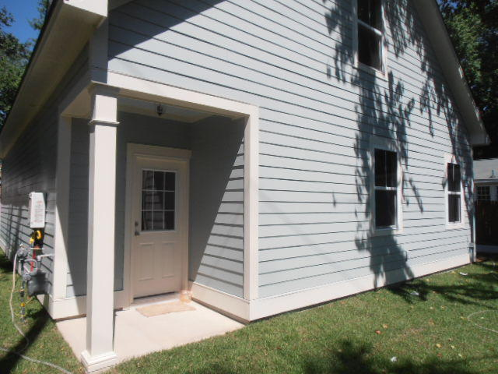
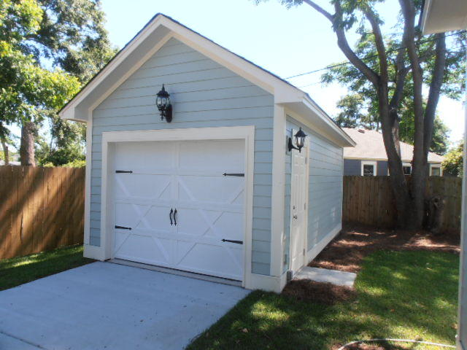
New Construction ~ Price Reduced
Owner is Motivated
4820 Mixson Avenue
North Charleston | MLS# 17014744 | $309,900
Brand new construction in Park Circle built by Vaughn Homes, close to restaurants, shopping, schools, & employment. Home features 3 bedrooms, 2.5 bathrooms, 1 car detached garage, granite kitchen & bathroom counter-tops, stainless steel kitchen appliances, & crown moulding, tiled bathroom flooring, & washer & dryer.
Charles Salmonsen
M (843) 224-0300 | O (843) 388-6613 | charles@salmonsen.com
Salmonsen Realty | 864 Lowcountry Blvd Ste B | Mt Pleasant, SC 29464

