Slide 1
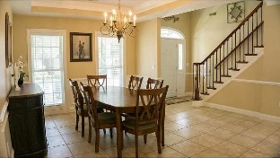
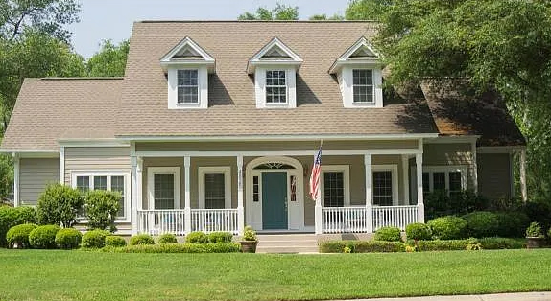
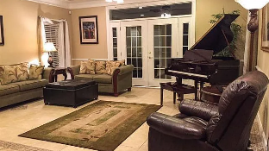
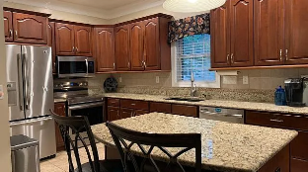
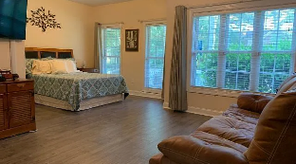
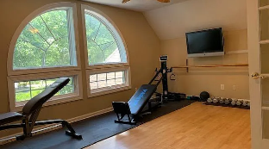
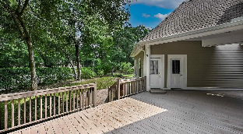
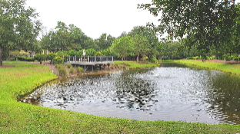
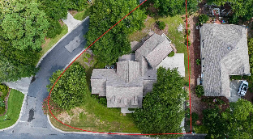

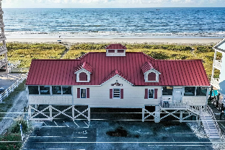



BIG 5 BD/4.5 BA CAPE COD BEAUTY AND AT BIG VALUE!
4825 Bucks Bluff Dr
The Bluffs of Tidewater Plantation | North Myrtle Beach, SC 29582 | MLS# 2418665 | $734,000
This eye-catching home, reminiscent of charming Cape Code, has an incomparable location in prestigious Bluffs of Tidewater Plantation Resort: It is a 14,816 sq.ft. corner lot, with no other homes in between and within easy walking distance of the beautiful Bluffs pool and other upscale amenities there such as hot tub, grilling area, kiddie pool, large dressing rooms with showers, screened cabana and more, all exclusive to Bluffs' residents. There is even a lakeside picnic area, bocce and much more, as Tidewater itself is one of the most amenity-rich communities on the East Coast and at low HOAs and taxes. In 2022, world-class Tidewater Golf Course was named best in the nation; the Tidewater owners' beach cabana is located on the white sands of Cherry Grove Beach just minutes away and which is one of the top beaches in the U.S.; and safe, affordable North Myrtle Beach was named a Top-5 Beach Town in the U.S. Add on-site restaurant, tennis, pickle ball, fitness, additional pools, amenity center and 24-hour manned, gated security and there would still be more to appreciate and to see and to do. Tidewater neighborhoods are on a raised peninsula stretching from the Intracoastal Waterway to where the Atlantic Ocean rolls into the Cherry Grove Marsh. But no flooding and great, easy living. This home is architecturally designed to invite creativity and the outside inside. Windows are large and catch natural light, both up and downstairs in this large, two-story home. Mature exterior landscaping with decorative paths and front and rear porches and decks maximize continuous, comfortable indoor-outdoor living space. The home sits on a large, third-plus-acre lot with long driveway and a set-back oversized, double-car garage. Upstairs in the garage is a unique en suite with a private entrance, bed- and sitting-room, nice closet and fabulous balcony overlooking the backyard landscaping and toward the pool area. The fifth bedroom and fourth bath (a shower) are in this thoughtful en suite. There are four en suites in the house. Accordingly, the square footage in the heart of the home is impressive. Enter to the foyer from the front door, and choose to go up the stately, dark-cherry stairs to the second-story to the three bedrooms or forward to formal dining on the right and to a magnificent great room straight ahead. To the left is a half-bath for guests and then the grand master suite with well-planned master bath: two large closets, one room-sized and the other walk-in, organized for much storage, including linens; the main comfortable bedroom area and that large bath with two separate vanities and a large shower with bench and double-shower head. Directly across the hall to the right of the Great Room is a large kitchen with build-in seating, granite and primarily newer appliances and major home systems. There is also a pantry and ease of access to the dining room and the back deck also nearby for entertaining. Old Republic Platinum coverage is offered. However, many major items in the home are modified or newer: New roof with 6 inch gutters fall of 2023; Garage is oversized has sink and is 23x26; Bedroom over garage mini split is 2 years old; Range is one year old; Microwave 2; Dishwasher is two years old; Real hardwood floors in the dance studio/4th bedroom upstairs; Advantage pest control contract; Ac unit upper zone replaced in 2020; Ac unit bottom zone 3 years old. TIDEWATER PLANTATION IS BEING RAPIDLY BUILT OUT. Do not miss this rare opportunity for a PERFECTLY SIZED AND PRICED FOR PERSONALIZATION, upscale, highly sought-after home with a premium private location. Architecturally designed windows for interior light and backyard views, nice landscaping and walk to pool. Oversized garage with 5th bedroom. Entry staircase to the second floor leads to more never-ending storage space, secret enclaves and 3 more bedrooms, one a converted dance studio with hardwood floors. Tour today and enjoy your Tidewater home soon!
Connie Ross-Karl
Realtor Broker SC/NC
702-306-2643
conniesross@aol.com
Ronnie Nichols
Realtor / BIC
RonnieNichols8@icloud.com
Helen Ashby
Realtor Agent
804-426-7758
hhashby@gmail.com
NEW WAY PROPERTIES MYRTLE BEACH

