Slide 1
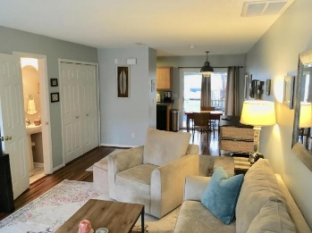
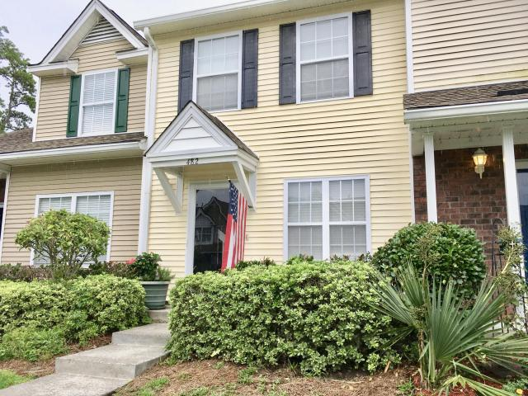
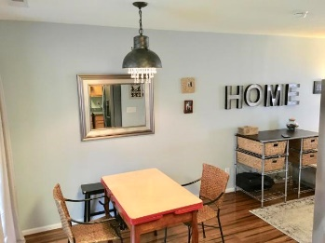
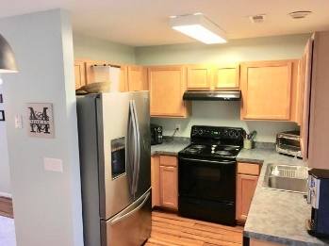
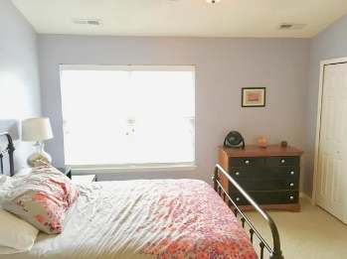
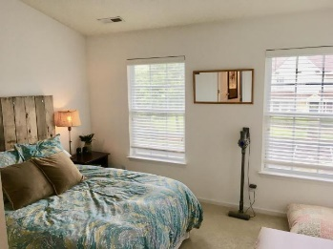
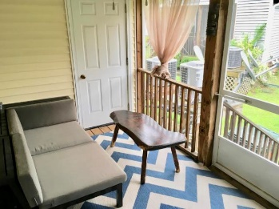


Price Reduced in Beresford Commons Vacant – Easy to Show – Make an Offer
482 Doane Way
Charleston, SC 29492
TOWNHOME FOR SALE
A reasonable seller, fairly priced and ready to close. This 2 bedroom, 1.5 bath townhome is cute, clean and efficient. From front to back, this unit is a home waiting to happen for anyone looking for a great location in a quiet spot. With an open floor plan downstairs and two bedrooms up sharing a bathroom, it would be a good idea to see this one soon!
MLS ID: | 18021169
Sale Price: | $155,000
Area: | 78 - Wando/Cainhoy
Bedrooms: | 2
Bathrooms | 1½
Apx. SqFt: | 1,100
Year Built: | 2006
Acreage: | 0.03
Sub-Type: | Single Family Attached
David H Seay
CCIM, BIC, CCIM, REALTOR
(843) 364-6720
david@seaydevelopment.com
Seay Development, LLC
3404-202A Salterbeck Street
Mt. Pleasant, SC 29466 www.seaydevelopment.com

