Slide 1
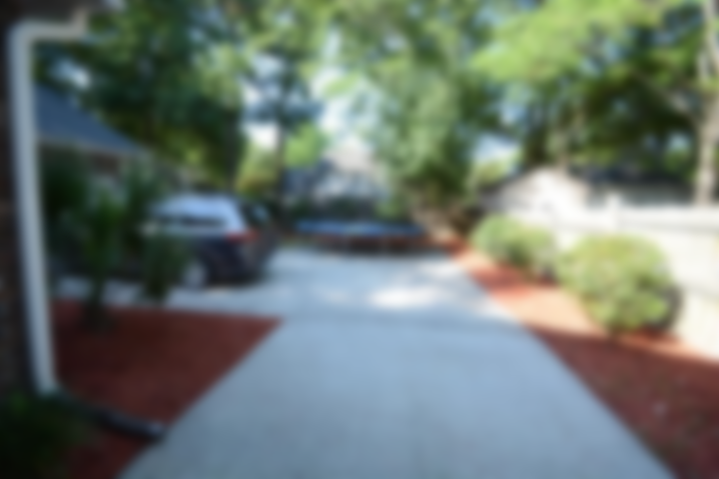
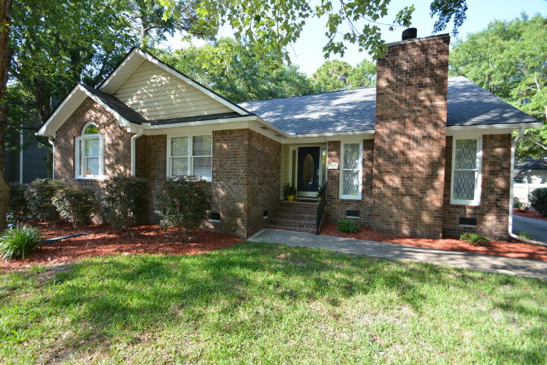
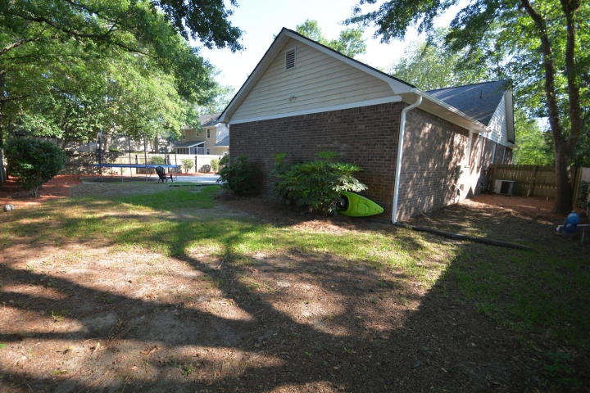
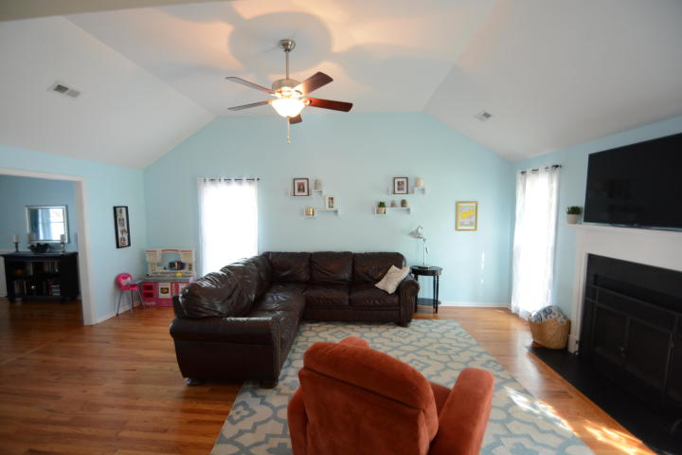
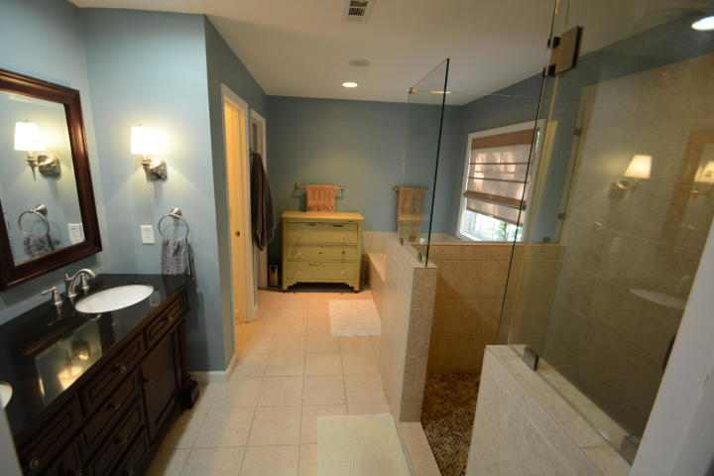
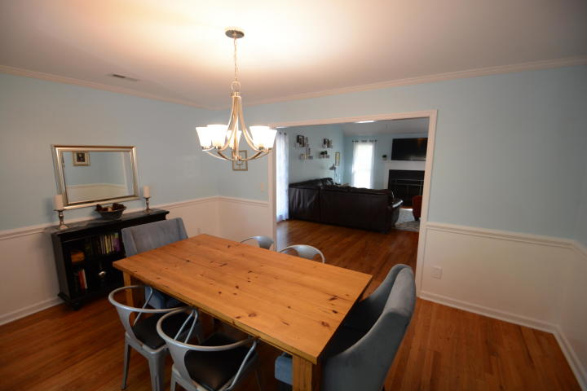
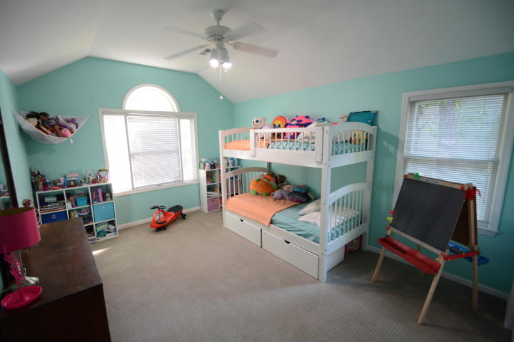
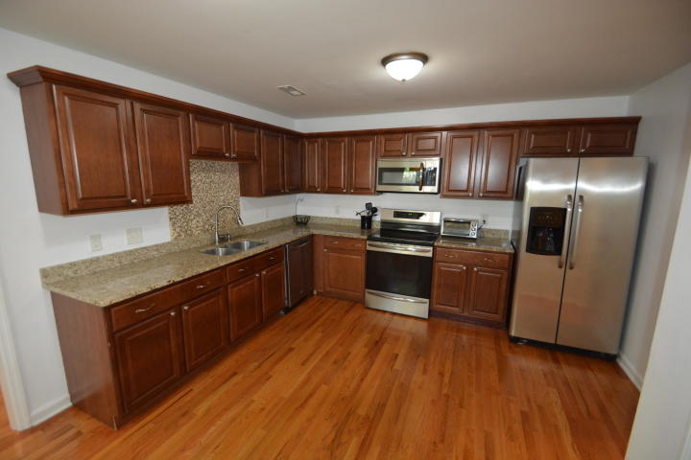
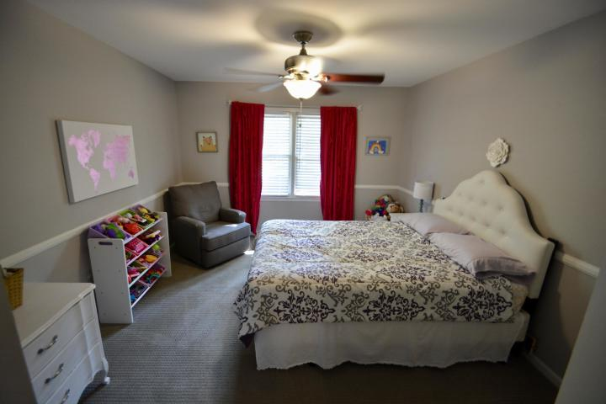
Move-In Ready Home in Longpoint Subdivision
482 Mount Royall Drive
Mount Pleasant, SC 29464 ~ MLS# 19017786 ~ $415,000
Beautiful four sided brick ranch sits on a large wooded lot! The home offers hardwood floors throughout the main living spaces.
Granite and stainless steel appliances in the kitchen. The master bedroom is spacious and has a private exit to the back porch. The master bath has been beautifully remodeled.
Without leaving the neighborhood you can enjoy the pool & tennis courts included as part of the HOA. The neighborhood is just outside the entrance of Palmetto Islands County Park, a 943-acre park. The park has bicycle paths, crabbing docks, kayak launch areas, and Splash Island Waterpark.
Minutes from shopping, dining, health care and the highway.
Patricia "Patti" Nickerson
(843) 312-7478
pattinickerson@hotmail.com
Brand Name Real Estate
4 Carriage Lane Suite 106
Charleston, SC 29407
Michael Albenesius
(843) 343-5870
m.albenesius@gmail.com

