Slide 1
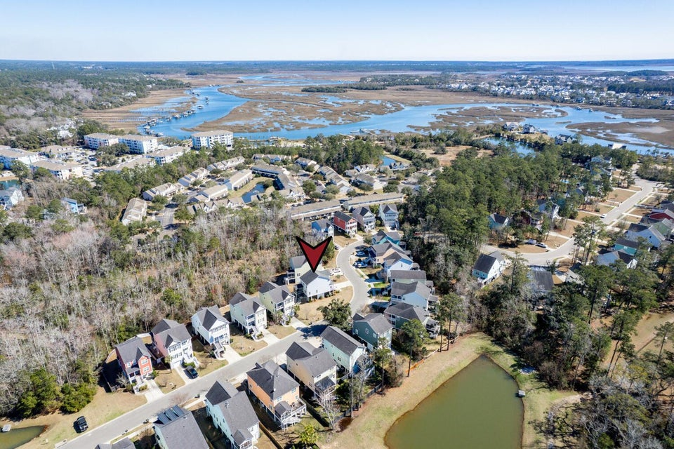

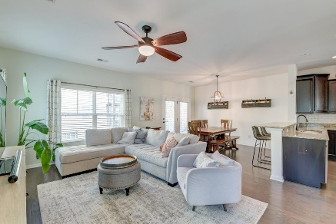
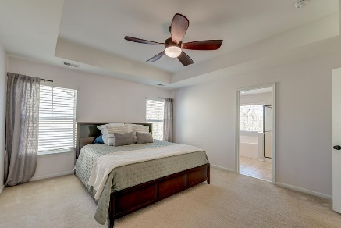
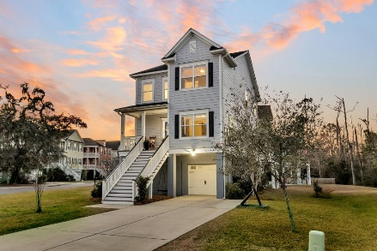
Open House Sunday 1-3
OPEN HOUSE
SATURDAY 12-3
Open House Saturday 12-3
482 Sanders Farm Lane
Retreat at Beresford | Charleston, SC 29492 | MLS# 25005025 | $674,000
ASK ABOUT THE POSSIBILITY OF RECEIVING
1% REDUCTION IN INTEREST RATE AND FREE REFI.
Nestled within the Retreat at Beresford, this remarkable home offers a perfect blend of charm, space, and modern convenience. Situated on a generous lot near serene wetlands, the striking exterior, spacious side yard, and beautifully maintained landscaping create an inviting first impression. A welcoming front porch leads inside, where an open floor plan is bathed in natural light, showcasing a dramatic open stairwell, elegant trim and molding, and gorgeous flooring throughout. To the right of the two-story foyer, the formal living/dining area features a tray ceiling, adding a touch of sophistication.
A stylish barn door connects this space to the well-appointed kitchen, complete with abundant cabinetry, sleek stainless steel appliances, granite countertops, a tasteful backsplash, and a convenient breakfast bar. The kitchen seamlessly flows into a casual dining area and a bright, airy family room. From here, step onto the screened porch and down into the backyard, where relaxation awaits. A powder room completes the main level for added convenience.
Upstairs, the spacious primary suite is a retreat of its own with a tray ceiling and an en suite bath featuring a dual sink vanity, a soaking tub, and a step-in shower. Two additional bedrooms and a full bathroom provide comfortable accommodations for family or guests. The backyard is designed for both relaxation and entertaining, with a partially covered patio, a pergola-shaded area with a privacy fence, and a built-in fire pit, creating the perfect outdoor oasis.
Additional highlights include exterior paint in 2021, a new HVAC system installed in 2024, and a two-car garage with ample storage space. Conveniently located just two miles from I-526, 3.6 miles from Daniel Island, under 5.5 miles from Phillip Simmons Elementary, Middle, and High School, and 14.1 miles from Isle of Palms, this home offers easy access to everything you need. Don't miss the opportunity to make this stunning home yours.
Book your showing today!
Melissa "Missy" Reid Missy@MattONeillTeam.com 864-934-5447

