Slide 1
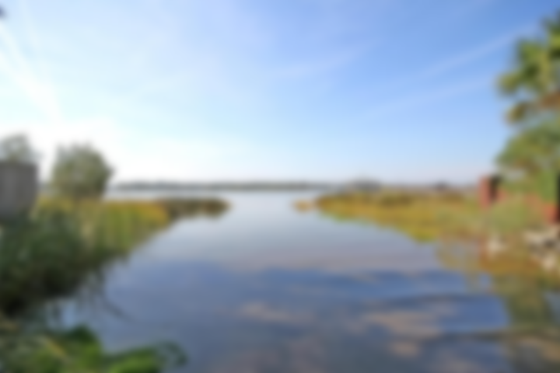
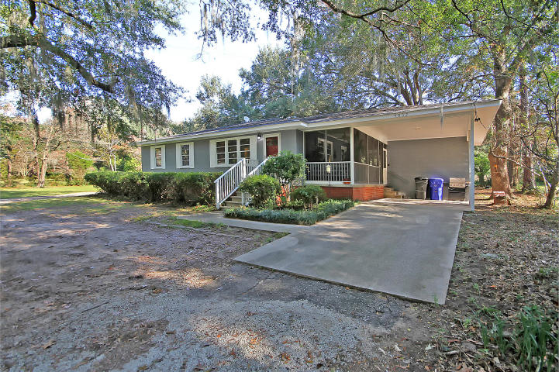
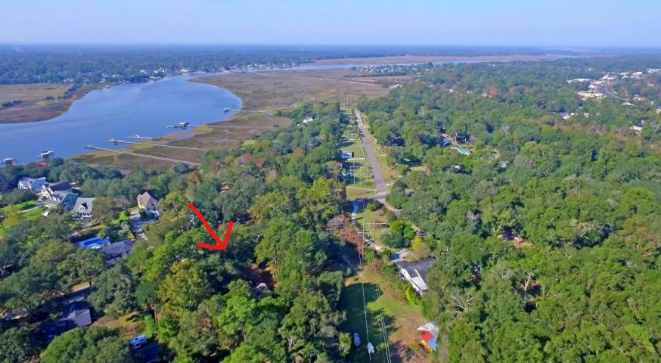
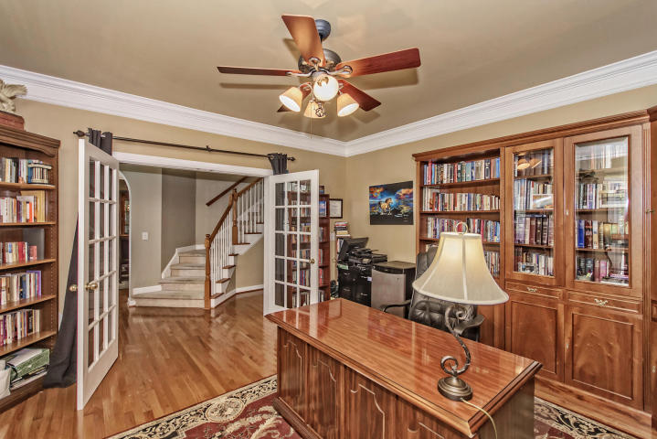
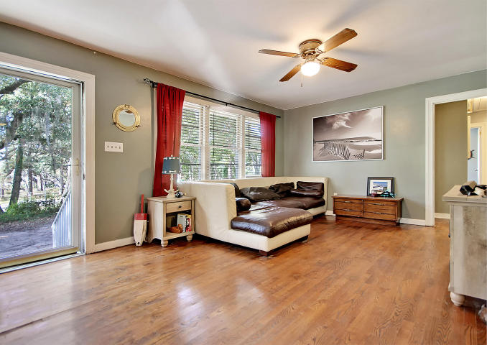
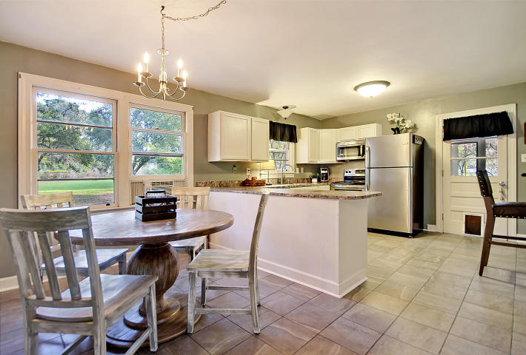
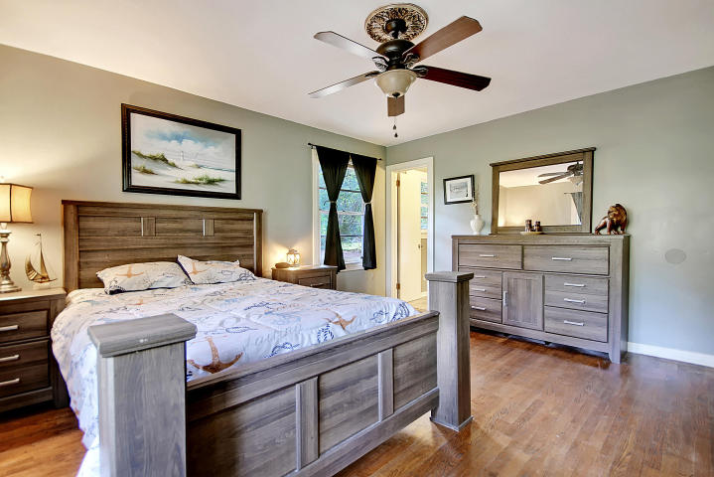
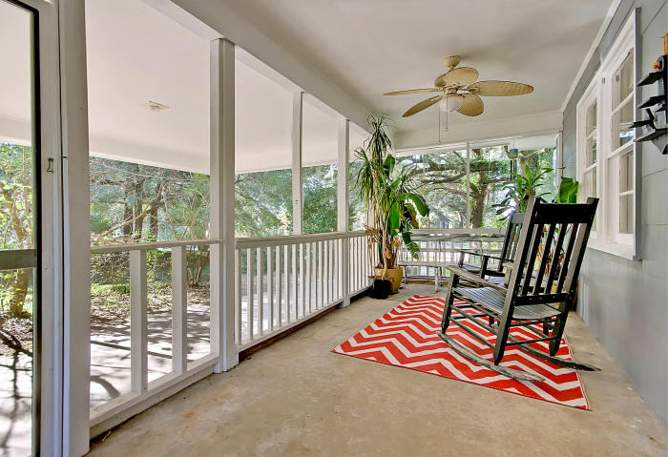
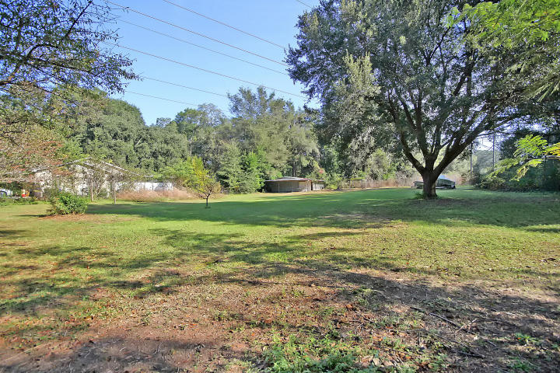

OVER 1 ACRE OF PARADISE 300 YARDS FROM DEEP WATER!
4832 Holbird Drive Wando Woods ~ N Charleston, SC 29405
MLS# 17030500 ~ $249,900
Completely refurbished 3 bedroom, 2 bath ranch in North Charleston. Private neighborhood boat ramp on the Ashley River less than a 1 minute drive away. No HOA. New kitchen. Most of roof brand new. Amazing wood floors. Screened in porch where you can soak up the Ashley River breezes. Outbuilding with electric and water was once an engine repair shop. Huge lot includes an orchard, oversized garden, vineyard, 200 year old oak trees, apple & persimmon trees. Large turn-around driveway. Located 2 minutes from Charleston city limits. Convenient to Tanger Outlets, Boeing, Airport, beaches.
All this can be yours for a SUPER VALUE PRICE!!
Chip Walsh
843-822-4663
chipwalsh@gmail.com
The Boulevard Company, LLC 35 Broad Street Charleston, SC 29401
www.TeamWalshRealEstate.com

