Slide 1
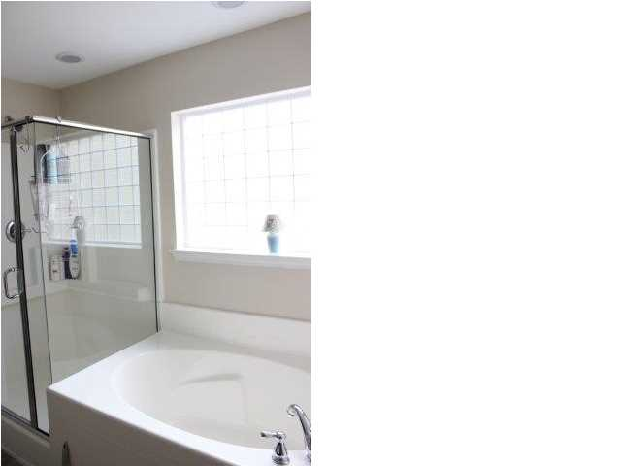
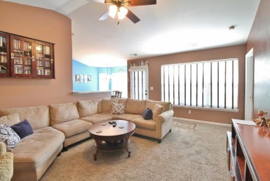
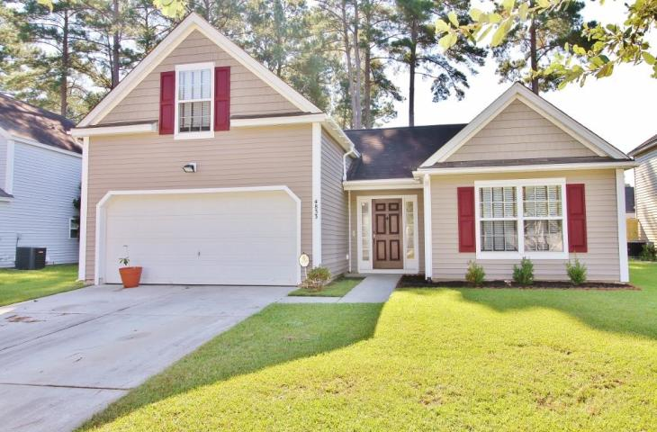
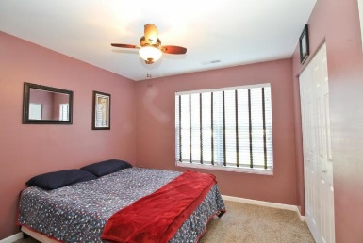
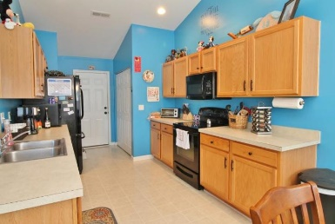
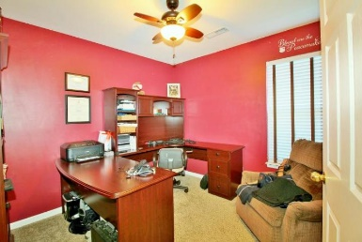
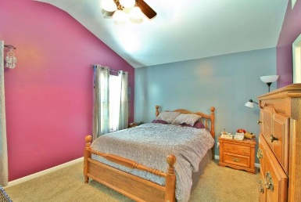
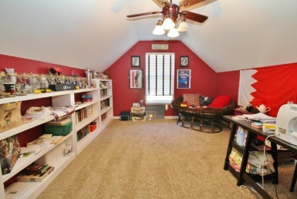
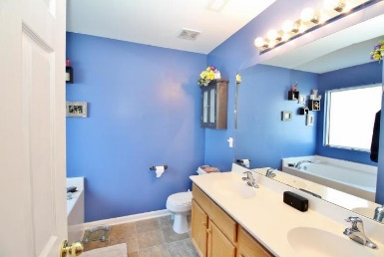
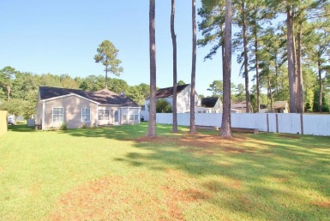

Motivated Seller in Wescott Plantation
$1000 Agent Bonus!!
Free Charleston Print to First 10 Visitors
Register for a Housewarming Gift Basket!
4833 Oak Leaf Road
Summerville, SC 29485
MLS# 18025775 ~ $210,000
Great opportunity in Wescott Plantation. Dorchester II Schools.
Large great room and master bedroom has walk in closets.
Backyard has large patio great for entertaining.
This 3 bedroom home has a large Frog area with a closet and window that would be a great 4th bedroom.
Do not miss out on this home
Joanie Rhoten
Office: 843-261-7166 | Mobile: 513-518-7475
joanie.rhoten@agentownedrealty.com
www.agentownedmainst.com
AgentOwned Realty Co. Premier Group | 141 A N. Main Street | Summerville, SC 29483

