Slide 1


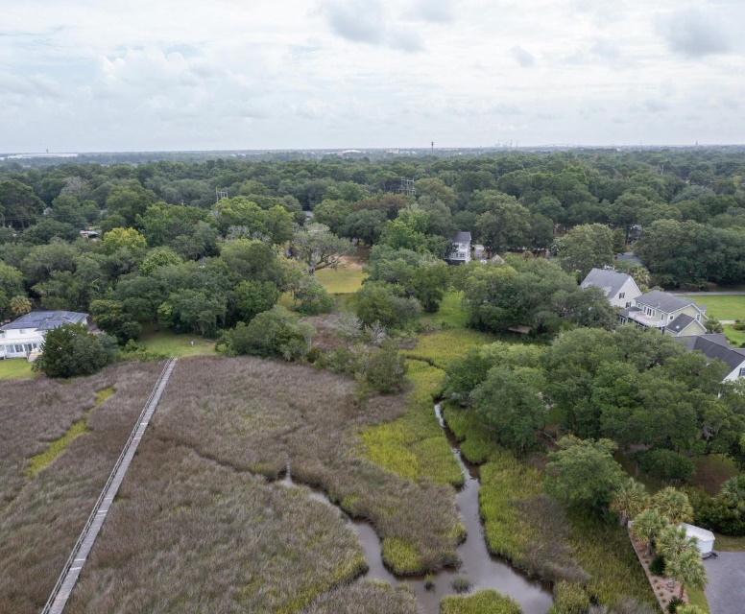
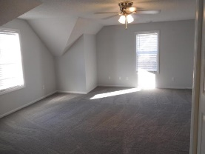
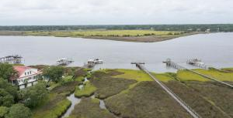
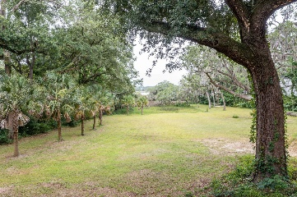
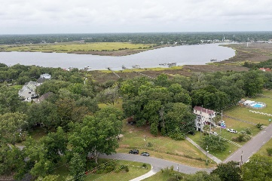
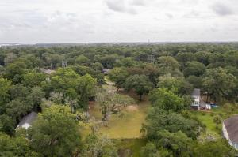
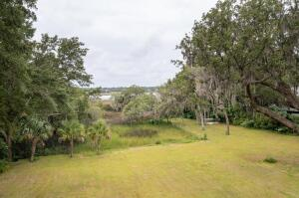
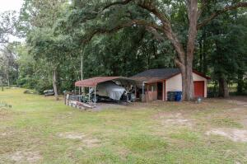
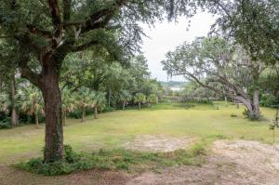
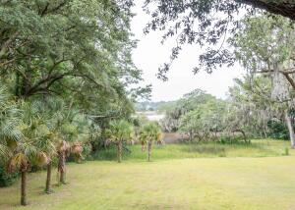
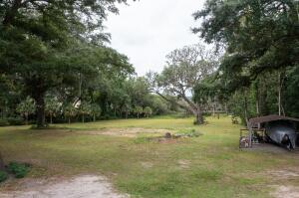
Kim Katich
(843) 754-8060
kimsellschs@gmail.com
Rare Opportunity!
3.19 Acre Waterfront Lot
4833 Holbird Drive
Wando Woods
North Charleston, SC 29405
MLS# 21018073
$850,000
Welcome to 4833 Holbird Rd this is a deep-water lot on the Ashley River in a quiet neighborhood (Wando Woods). A total of 3.19 acres with 1.52 acres highland. The property has several grand oaks, one maintained by the premier arborist in the Charleston area. Numerous palm trees were planted about five years ago and shrubs were planted along the property lines. A separate Garage remains on the property that can be used for access to utilities and construction storage. A dock permit, valid for 5 years was approved in May 2021. The property is perfect for a riverfront estate or could possibly be subdivided into 2-4 lots with a shared dock and access to the river. It has 344 feet of road frontage on Holbird up to the corner of Apple Street. There is approx 120 feet of river frontage, and also has a tidal pond fed by a creek that runs along one property line. A recent survey, dock survey and soil engineering studies are available. Two sets of house plans will convey with the property. The neighborhood boat landing is on Flynn Drive , two blocks away. The other landing is the Bridgeview Drive landing less that two miles away.
There are no HOA restrictions. Conveniently located off Paramount Drive with access to I-526, I-26 and West Ashley and downtown Charleston.
Real Estate Advocates LC
7613 Hwy 544 | Myrtle Beach, SC 29588
www.realestateadvocates.com

