Slide 1
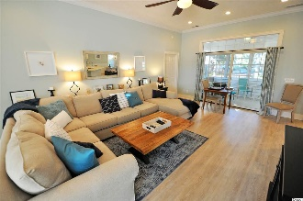
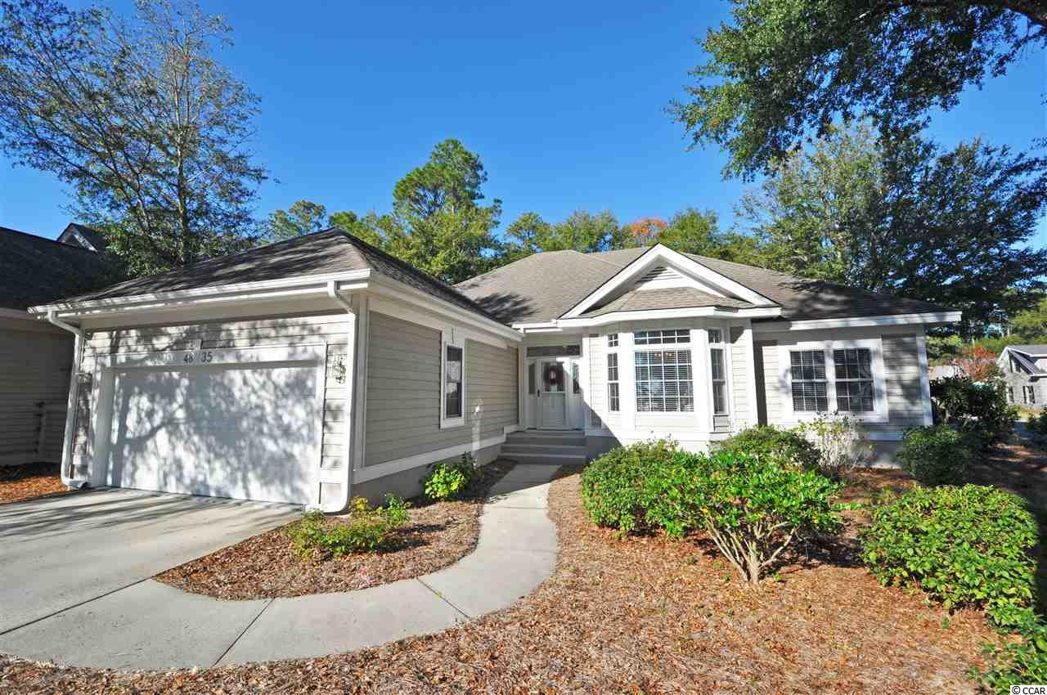
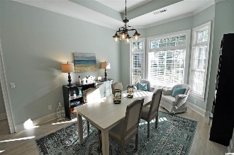
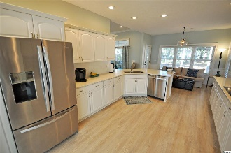
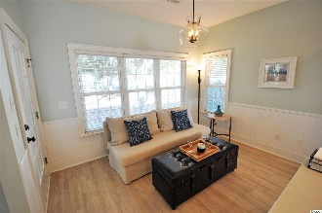
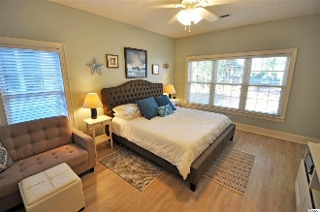
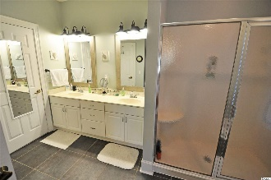
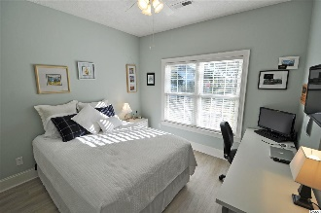
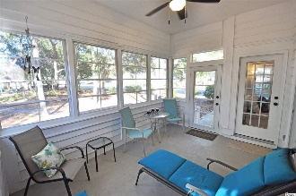
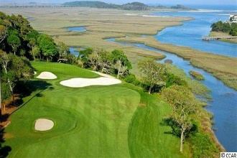
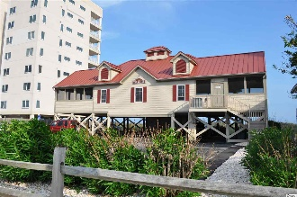


Tidewater Plantation
Simplicity & Perfection
4835 Buck's Bluff Drive
North Myrtle Beach, SC 29582
MLS# 1725676 ~ $349,900
Located in The Bluffs of Tidewater Plantation, this traditional-design home is well landscaped with open-to-the-marsh front yard and a lightly wooded backyard with nice walking path to The Bluffs private pool, pool cabana, grilling area, bocce courts and lake. It sits on a low maintenance large, deep, appealing corner lot. The interior of the home is fresh, flawless and fabulous. Everything is new or refreshed, open and chic, from the museum-quality sculptured ceilings throughout to the flexible floor plan with the pleasurable blend of just the right luxury vinyl plank and slate-inspired-tile flooring. All redone window coverings are pleasing 2" Levolor blinds. Quartz is so "in," too; and the roomy eat-in kitchen has plentiful, clean white quartz counter-tops with a hint of bling and lots of wonderful white cabinets, plus a pantry. Appliances are of course Whirlpool Gold gleaming stainless steel. The formal dining room has a tray ceiling and marsh view. Off of the dining area, two spacious bedrooms and a big hall bath compliment the split-bedroom plan. The infinity great room is open directly from the entry and kitchen onto the Carolina room/porch and the charming backyard nature enclave. There is also a patio from the kitchen which affords ease of outdoor grilling and alfresco dining. A huge master is so comfortable with soothing colors, lots of natural light, nature views, desk, sitting and storage space, his and her walk-in closets and en suite with irresistible walk-in shower and double-sink vanity. There's a good-size linen closet right in the bathroom. The laundry room can be conveniently accessed from the master bath as well as from the garage-entry foyer. There is an over-sized 2-car garage. The interior is simply splendid. Please notice all the upgraded, really cool light fixtures and mirrors...so subtle and well blended you might not see them...The home is uncluttered and impeccably organized to maximize square footage and the freedom of the casual beach-living lifestyle of this top-rated, amenity-rich golf resort community, boasting an owners' oceanfront beach cabana only minutes away on the wide, white sand beaches of this Cherry Grove neighborhood of popular North Myrtle Beach. North Myrtle Beach is one of the most well-managed cities in the Carolinas and has the lowest tax millage of any full-service city of its size in South Carolina. Tidewater Plantation Golf Course is one of the highest rated golf courses in the Carolinas. The resort features 24-hour gated, manned security. Amenities include that oceanfront beach cabana for owners' use with open/screened porches, bathrooms, showers and kitchen. Residents of the Bluffs enjoy the use of 3 pools/hot tubs - one of which is specific only to Bluffs residents. Other amenities include a driving range, golf shop, clubhouse with bar and dining facilities overlooking the 18th hole, clay and hard surface tennis courts, pickle ball court, fitness center overlooking a pool, bocce courts and amenity center for public/private events. Other group activities include an outdoor summer concert series, workout classes including water aerobics, weekly art classes, Happy Hours, dinner clubs, book clubs, bridge club, mahjong and holiday events, plus more! In addition, Tidewater boasts a gated storage yard for boats, jet skis, motorcycles and kayaks. Tidewater Plantation and its full range of things to do and to enjoy truly reflects a "way of life" where friendly neighbors welcome you to your new home in North Myrtle Beach.
Deborah Collins
843-424-9013
dctidewater@yahoo.com
Connie Ross-Karl
702-306-2643
conniesross@aol.com
NEW WAY PROPERTIES MYRTLE BEACH

