Slide 1
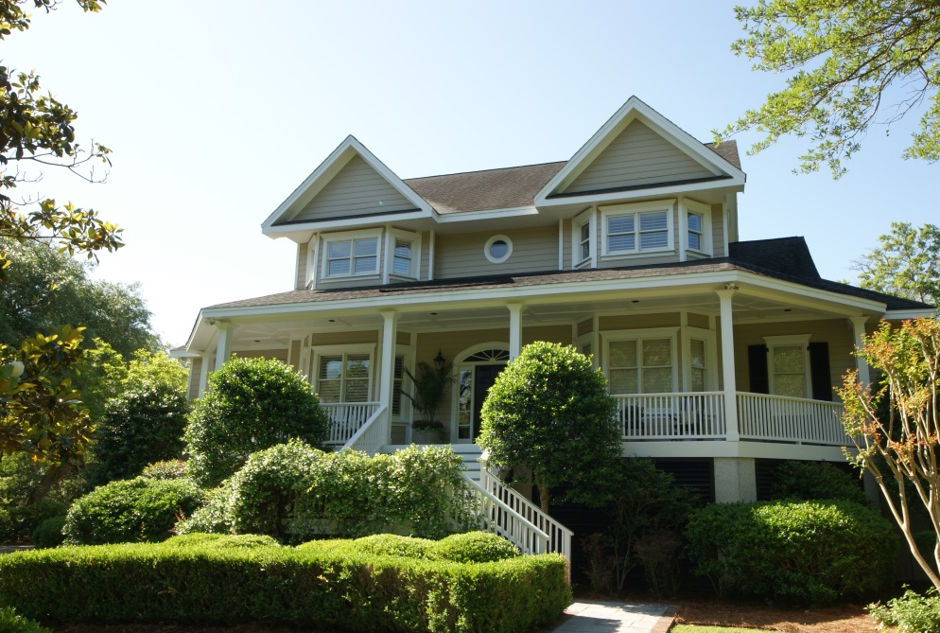
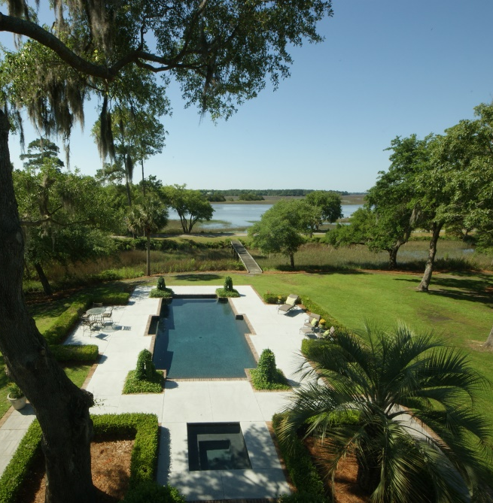
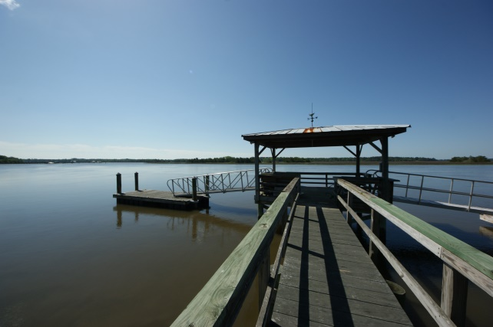
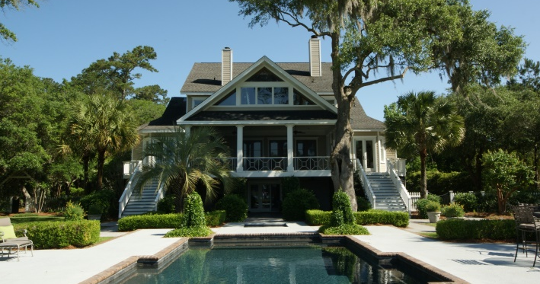
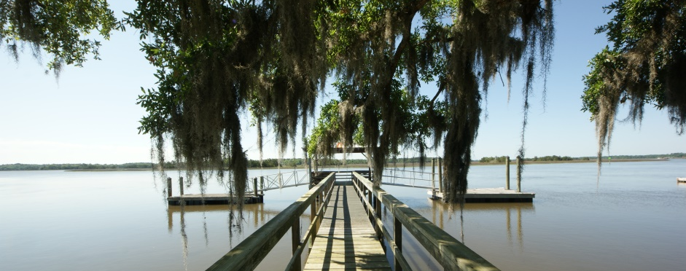
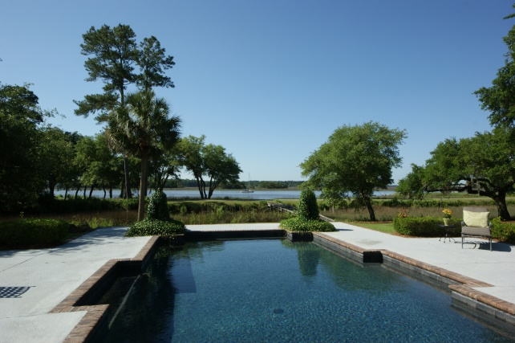
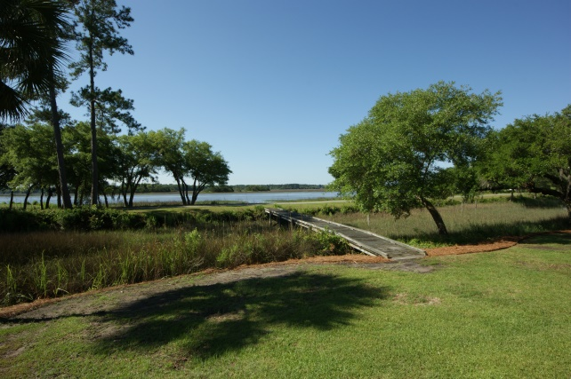

Along the Golf Course … Deepwater Dock on the ICW
4843 Marshwood Dr - Stono Ferry - Hollywood, SC
MLS# 1414215 - $1,395,000
Incredible home on the 13th fairway of The Links at Stono Ferry Golf Course. A deep water dock on The Intracoastal Waterway has a covered pier head and floater. The dock is shared with the adjoining vacant lot which can also be purchased as a package deal. Home has been tastefully updated over the years to create a stunning, move-in ready home. Professionally designed landscaping creates a beautiful setting. Antique heart pine flooring and crown molding are throughout the main level and upstairs. The main level features a master bedroom with fireplace, built-ins, walk-in closet and private deck. The master bath will impress. The kitchen has an eat-in area overlooking backyard and pool. A large island with granite countertops, professional Subzero and Dacor appliances, under cabinet lighting, pantry, wine cooler, ice maker, fireplace and built-ins outfit this special kitchen. A separate dining room off the kitchen features a hand painted mural of the Intracoastal. The main living area has built-in bookcases, fireplace and high end surround sound TV and audio equipment. Off the main living area are three double doors that open out onto a large screened porch, gas fireplace and flat screen TV. The impressive views from your porch include your salt water pool, dock, marsh, and Intracoastal. Upstairs features 4 bedrooms and 2 full baths recently renovated with granite, tile and travertine. Also included upstairs is a workout/ office/ playroom overlooking the pool with fabulous views of the Intracoastal and golf course. A large unfinished attic space is on the next level. A mother-in-law or guest suite on the ground level features a newly renovated kitchen with granite countertops and quality appliances. Kitchen area opens up to a nice living space that leads to the pool. There are 2 bedrooms (one currently being used as a game room), 2 full baths and a laundry room. The flooring downstairs is all ceramic tile. All heating and air units are less than 2 years old and windows and doors are Andersen. Stono Ferry is a gated community with an 18 hole championship golf course, lighted tennis courts, Jr. Olympic sized swimming pool and play area, and Equestrian facilities surrounded by the Intracoastal Waterway and Log Bridge Creek. A very unique and private setting with an abundance of wildlife and Grand Oaks make Stono Ferry a great place to call home. Bring your yacht or just sit and enjoy the beautiful sunrises and sunsets from your porch, pool or dock. Don't miss this very special property.
Rob Sturm
M 843-478-2404
rsturm@eratidesrealty.com
Bud Poston
M 843-697-3786
bposton@eratidesrealty.com
ERA Wilder Realty Stono Ferry | 4812 Stono Links Dr | Hollywood SC 29449

