Slide 1
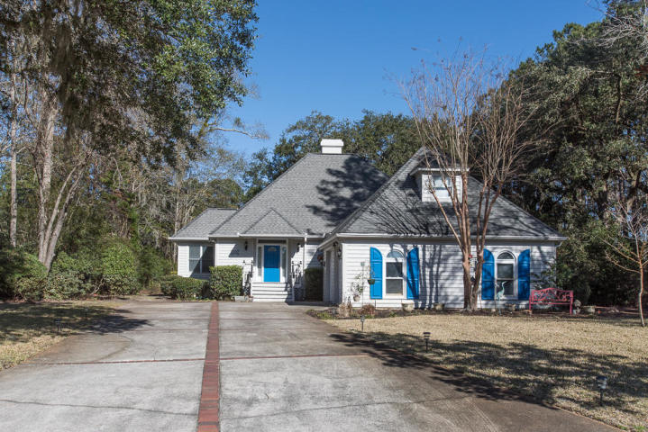
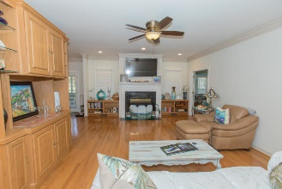
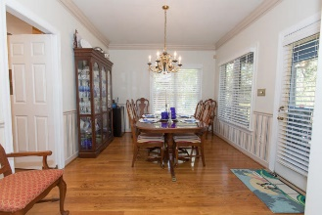
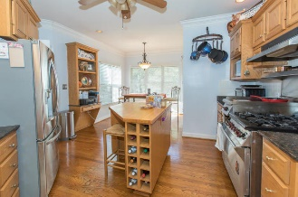
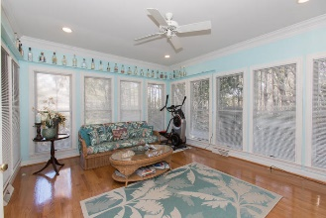
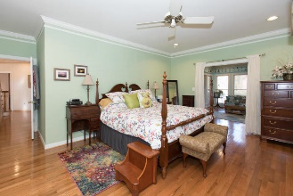
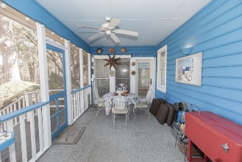
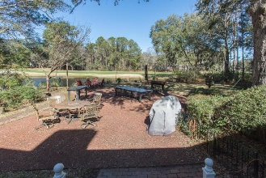
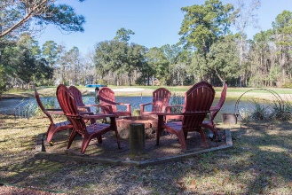
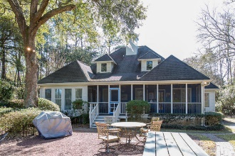


4850 Marshwood Drive Stono Ferry Hollywood, SC 29449 MLS# 19002128 $450,000
Turn-key golf course home in desirable gated community of Plantation at Stono Ferry. Great flowing floor plan and one of the best backyards overlooking pond and 16th hole. This house is built for daily living and entertaining, with Screened porch, Sunroom, Outdoor Bar and Dining, and Fire Pit. Freshly painted exterior and interiors. Wood floors down and new carpeting up. Large MBR down with updated bath and huge walk-in closet. Eat-in kitchen with commercial Wolf stove, granite countertops, large pantry. Two car garage with workshop features bonus room with HVAC split, perfect for a home office or man cave. New HVAC in main living area. Encapsulated crawl space with new dehumidifier. Irrigation system with well. Transferable termite bond. 30 mins to Downtown Charleston. Stono Ferry Amenities include pool, tennis, pickleball, playground and equestrian center. The links at Stono Ferry is semi-private golf club built on the site of revolutionary war battlefield on the Stono River.
Thank you for showing.
Open House This Weekend
Saturday & Sunday from 1-3pm
Cathy Rosenblum
843-817-7869
crosenblum@comcast.net

