Slide 1
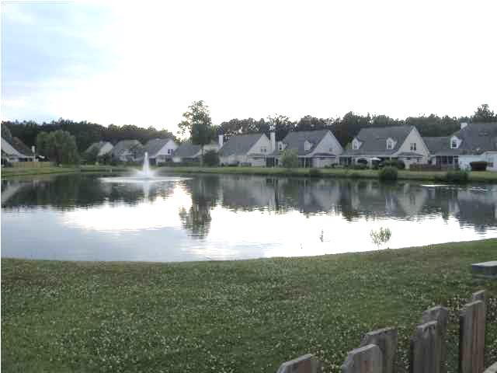
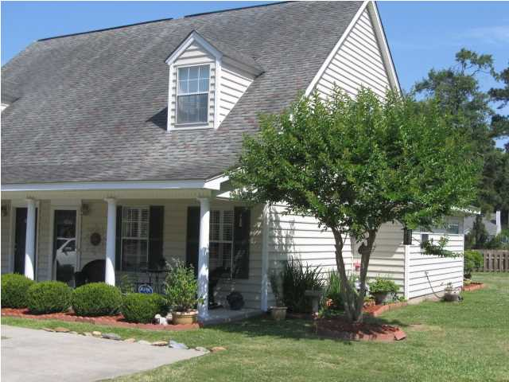
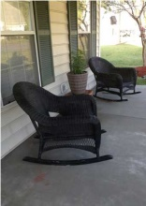
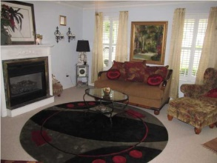
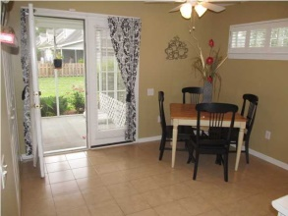
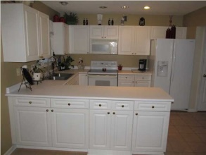
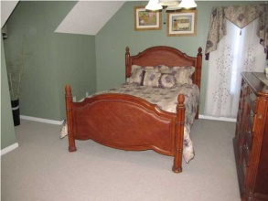
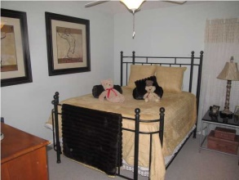
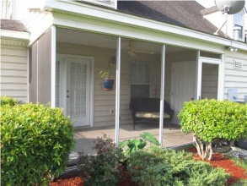
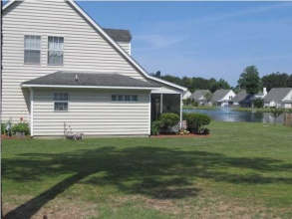
Just Reduced!
4860 Habersham Ln
Wescott Plantation
Summerville, SC
MLS# 1415513
$125,500
Must see and Move-in Ready! Immaculate and well maintained townhome in Wescott Plantation. This beautifully landscaped property sits on a corner lot next to addition green space. Sit outside on the covered screened-in patio under the ceiling fan and enjoy the peace and quiet as the property backs up to the pond. The kitchen has plenty of storage, a lazy susan and includes a Bosch dishwasher. There is crown molding throughout the living room which also has a gas fireplace. 2" plantation shutters throughout. Ceiling fans in all bedrooms. Master has tile garden tub with shower and large walk-in closet. Downstairs bedroom could be used as a master as well. Golf course community! Enjoy the clubhouse, swimming pool and play park! Located close to beaches, Boeing, JB Charleston! Dorchester District II schools!
David Hickman | 843.505.0456 | davidisyouragent@gmail.com | www.omnicarolinarealestate.com
Omni Carolina Real Estate | 126 Eston Dr | Goose Creek, SC 29445

