Slide 1
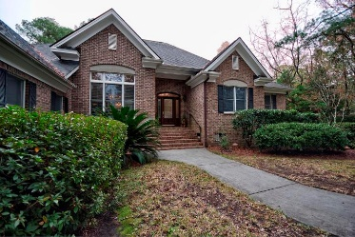
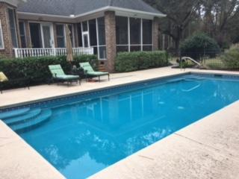
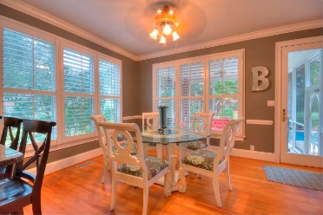
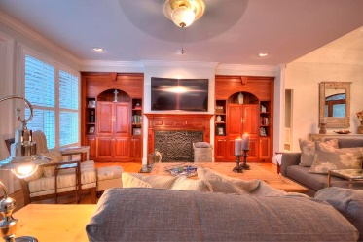
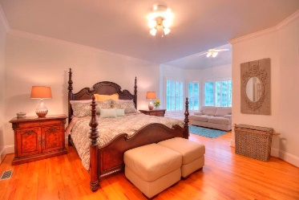
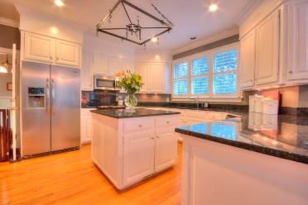
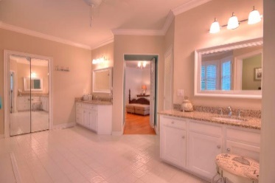
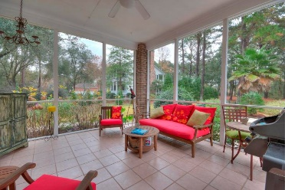
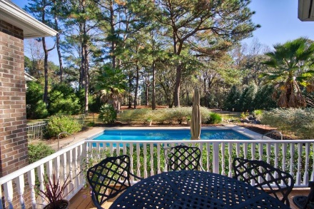
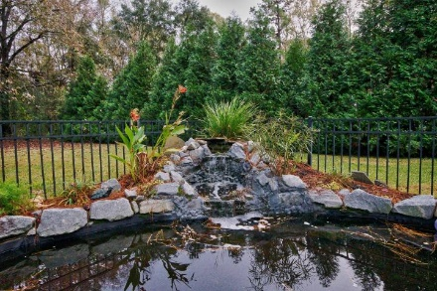



Priced Right at $700,000 In-Ground Pool In A Private Setting!
Starbucks card to first 10 agents
4860 Highlander Lane
Stono Ferry ~ Hollywood, SC 29449 ~ MLS# 17032561
Sunlit and beautiful, this one story brick home is breathtakingly comfortable! From the front porch enter a large foyer. To the left is the dining room with a spectacular chandelier. This takes you to bright open kitchen with a big island and eating area, the screened porch, patio, and pool. Take another left down into the separate laundry room; then through the garage to the FROG. Its own little world, the FROG is a fully finish great for in-laws or an au pair. Next, into the living room with its fireplace and built-in cherry cabinets. Lots of windows everywhere let in the outdoors! Enjoy the in ground pool and pond. The bedroom area has two secondary bedrooms and a huge master with sitting area. Fourth bedroom is FROG.
Susan Kraber
(843) 779-9655
susankraber1@gmail.com
AgentOwned Charleston Group | 902 Savannah Hwy | Charleston, SC 29407-7802

