Slide 1

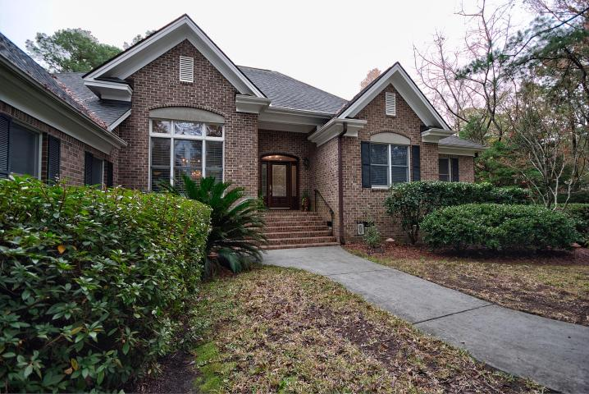
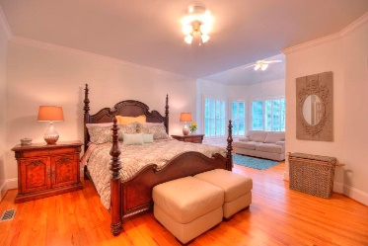
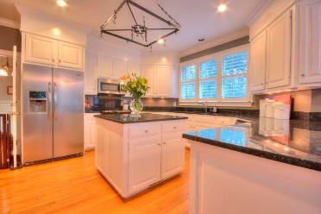
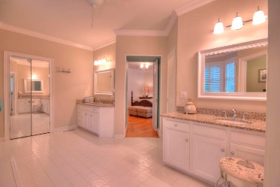
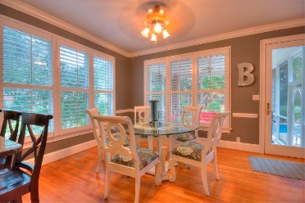
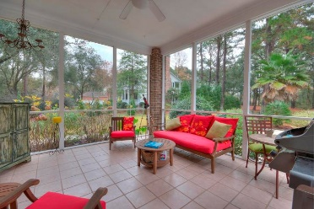
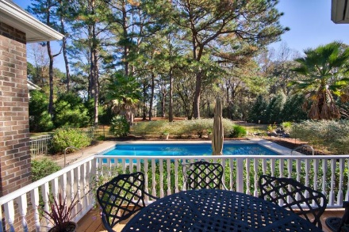
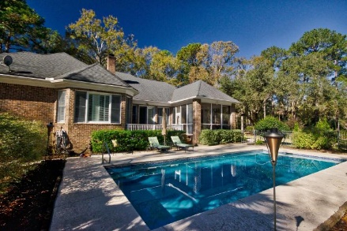
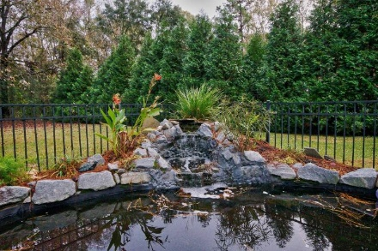
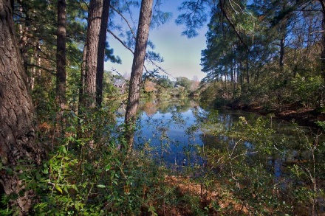


New Listing ~ In Ground Pool!
Starbucks card to first 10 agents
4860 Highlander Lane
Stono Ferry ~ Hollywood, SC 29449 ~ MLS# 17032561 ~ $710,000
Beautiful and immaculate, this one story brick spacious home is breathtakingly comfortable! From the front porch enter a large foyer. To the left is the dining room with a spectacular chandelier. Through the dining room is the kitchen with a big island and eating area. Take another left down into the separate laundry room; then the garage to the FROG. Its own little world, the FROG is great for in-laws or an au pair.
Go back through the kitchen to the screened porch and deck. Next, into the living room with its fireplace and built-in cherry cabinets. Lots of windows everywhere let in the outdoors! Enjoy the backyard's in ground pool and pond. Turn right from the foyer to enter the bedroom area with two secondary bedrooms and a huge master with sitting area.
Susan Kraber
(843) 779-9655
susankraber1@gmail.com
AgentOwned Charleston Group | 902 Savannah Hwy | Charleston, SC 29407-7802

