Slide 1
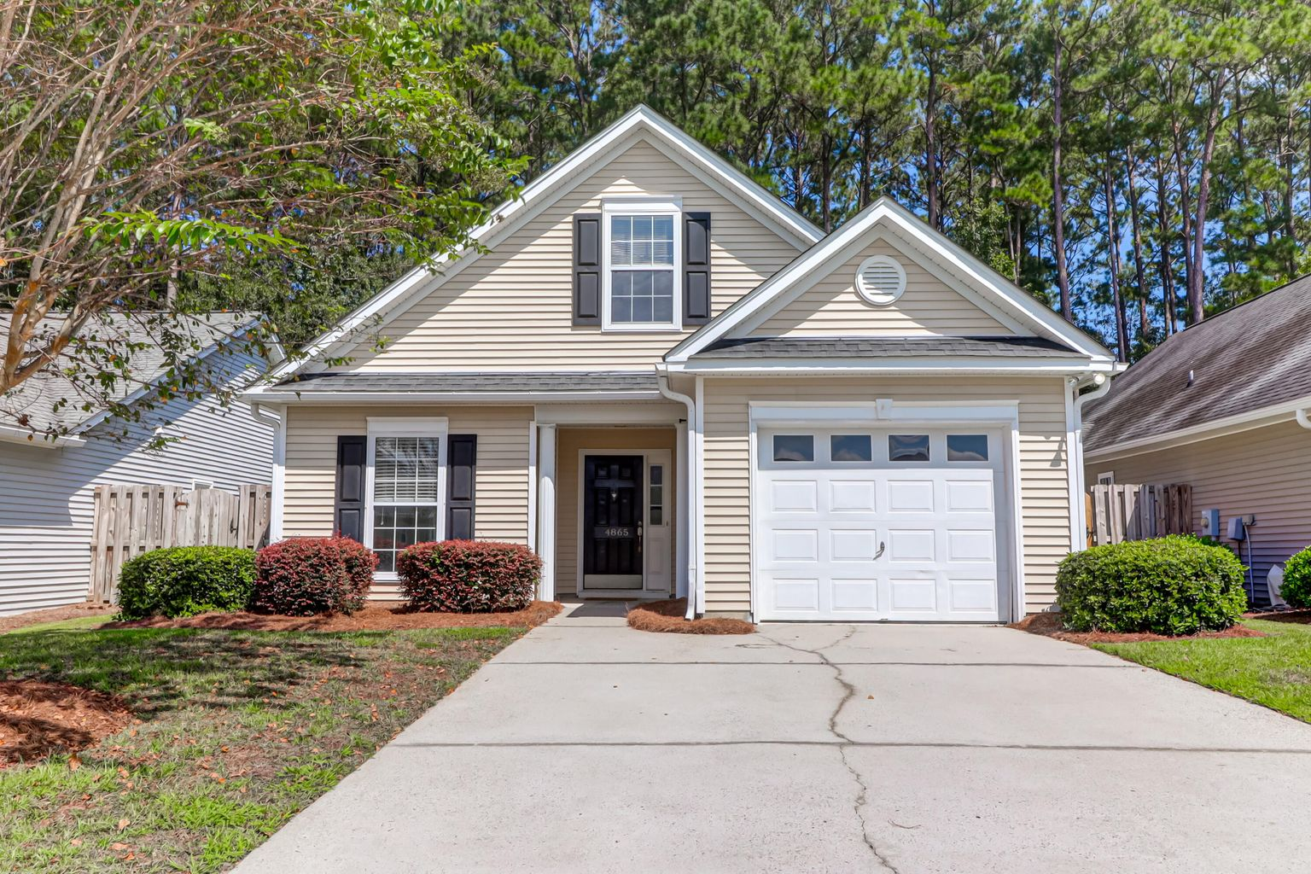
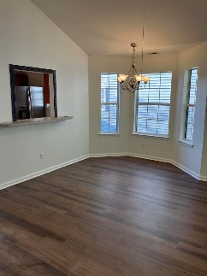
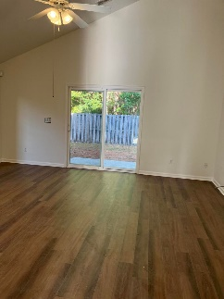
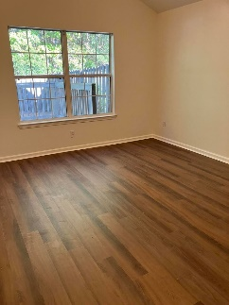
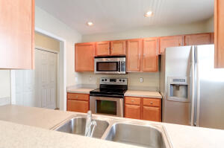
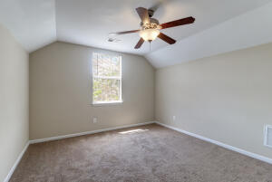
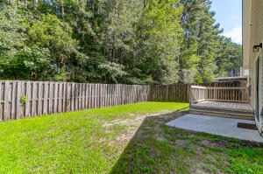


Back on Market
With Upgrades!
4865 Carnoustie Court
Wescott Plantation | Summerville, SC 29485 | MLS# 22024410 | $305,000
New & Improved! New Paint, New Luxury Vinyl Flooring, and New HVAC installed in December of 2020! This is the perfect patio home, starter home, or investment property in the much sought after Courtyards at Wescott Plantation!! 3 bedrooms with the master down featuring a vaulted ceiling, garden tub and walk in closet. The galley kitchen features stainless steel appliances with plenty of cabinet and counter space! The large living room/dining room combination leads you through a sliding glass door and into your private fenced in backyard with a patio area and deck. Back inside to the upstairs of the home where a third bedroom could easily serve as a perfect home office if need be. There is also a neighborhood pool! 4865 Carnoustie has had a makeover and is now move in ready!
John Nugent
(843) 304-2061
john.nugent@carolinaone.com
nugentknowsrealestate.com
Carolina One Real Estate | 628 Long Point Rd | Mt Pleasant, SC 29464

