Slide 1
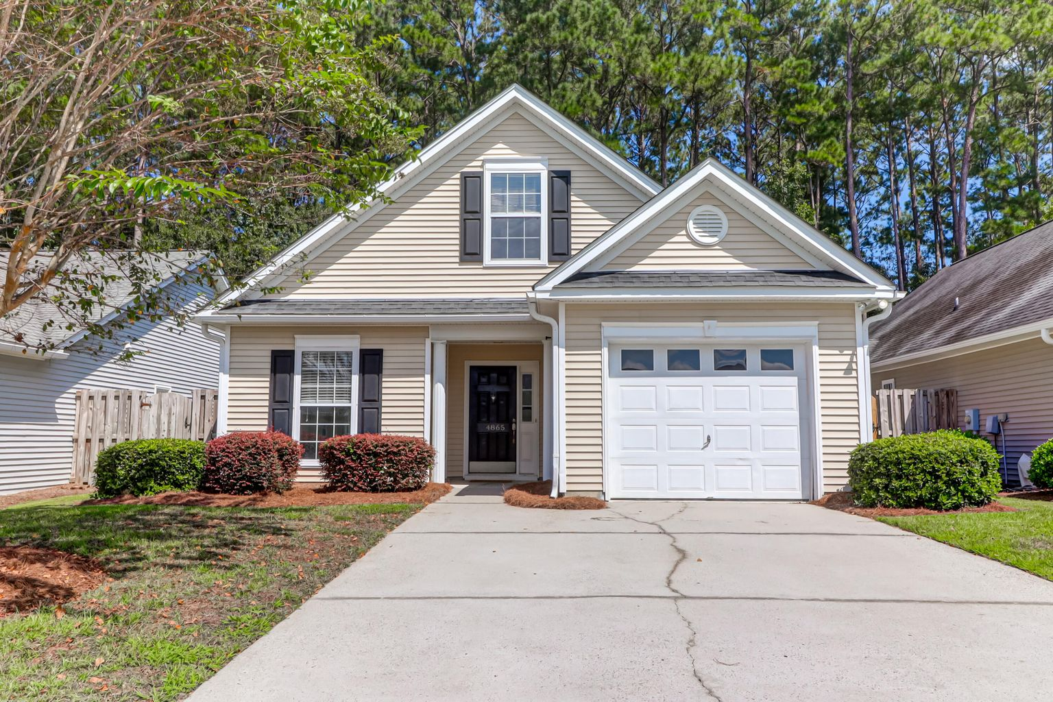
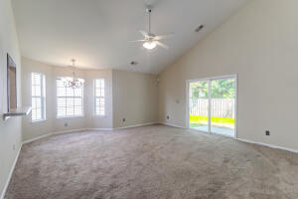
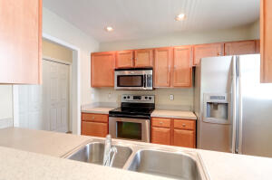
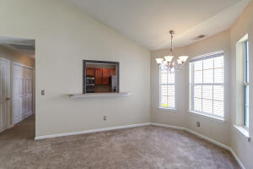
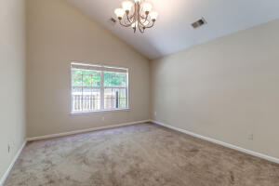
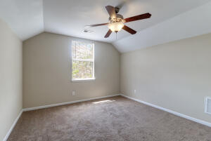
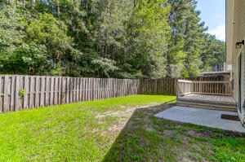
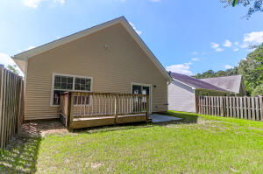


Open House Today! 4 – 6 pm
4865 Carnoustie Court
Wescott Plantation | Summerville, SC 29485 | MLS# 22024410 | $305,000
The perfect patio home, starter home, or investment property in the sought-after Courtyards at Wescott Plantation! 3 bedrooms with the master down featuring a vaulted ceiling, garden tub and walk in closet. The galley kitchen features stainless steel appliances with plenty of cabinet and counter space! The large living room/dining room combination leads you through a sliding glass door and into your private fenced in backyard with a small patio area and deck. Back inside to the upstairs of the home where a third bedroom could easily serve as a perfect home office if needed. A new HVAC was installed in December 2020! There is also a neighborhood pool! Houses sell quick in The Courtyards! Don't hesitate come see it today!
John Nugent
(843) 304-2061
john.nugent@carolinaone.com
nugentknowsrealestate.com
Carolina One Real Estate | 628 Long Point Rd | Mt Pleasant, SC 29464

