Slide 1
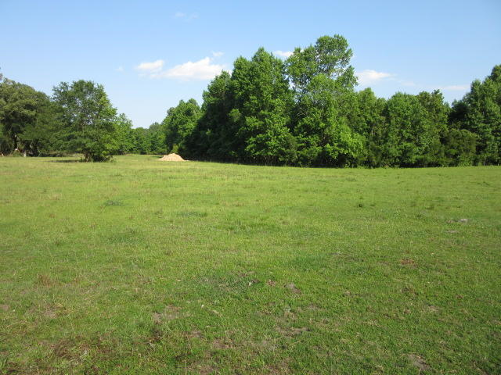
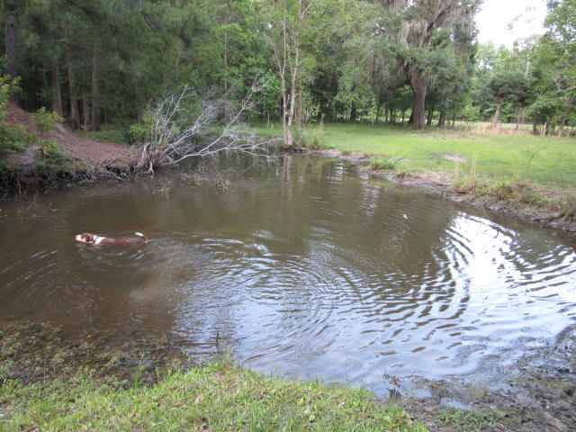
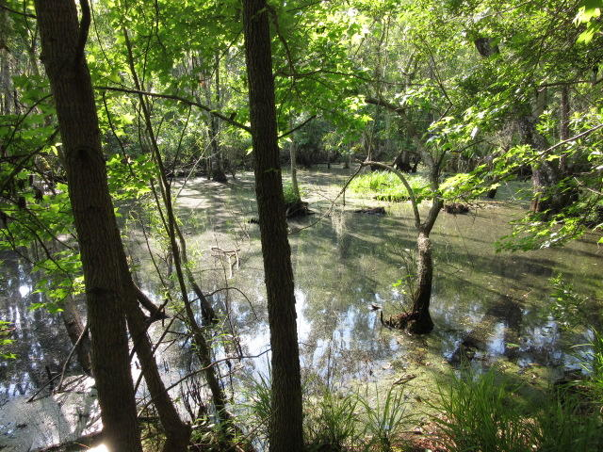
31.5 ACRES + HOUSE
$400,000
$40,000
Price Reduction!
MLS# 20018291
Plus additional land available for $10,000/acre
30 minutes to I-526 in Hollywood just a 7 minute drive from Hwy 17 South (Savannah Hwy). At the end of a dead end road…lots of privacy! The property is a mixture of open fields, woods, and shallow water duck impound.
DRAFT
Excellent soils for perks and can easily be subdivided into smaller parcels for multiple residences. The property includes a double wide mobile home…currently 2 bedrooms that was converted from a 3 BR home and can easily be converted back to 3 bedrooms.
Call for appointment today
Rick Willis
843-327-3017 Rick@RickWillis.com The Group, LLC

