Slide 1
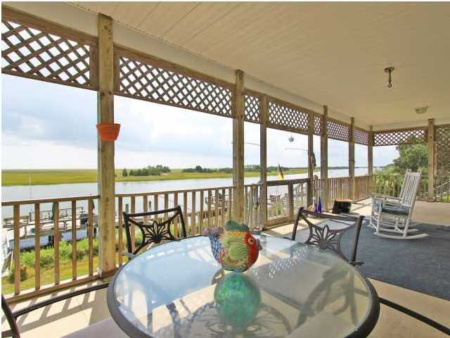
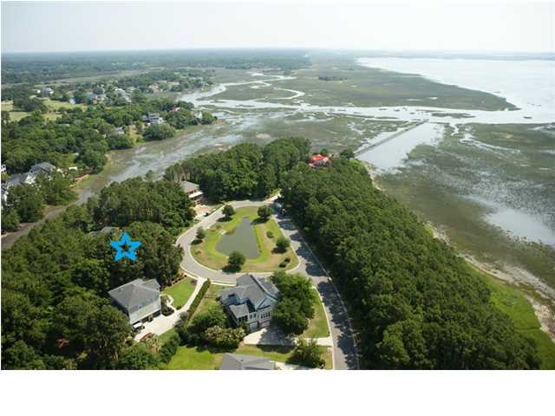
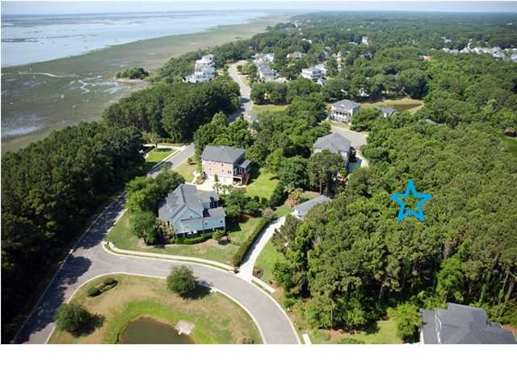
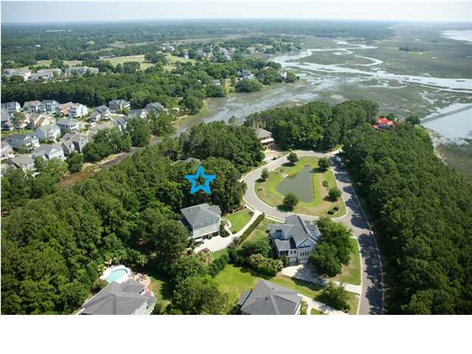
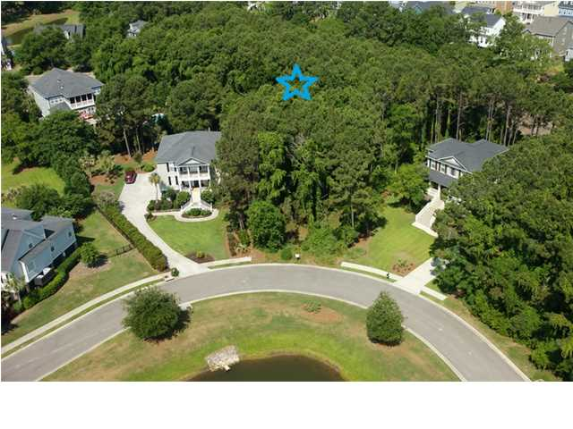
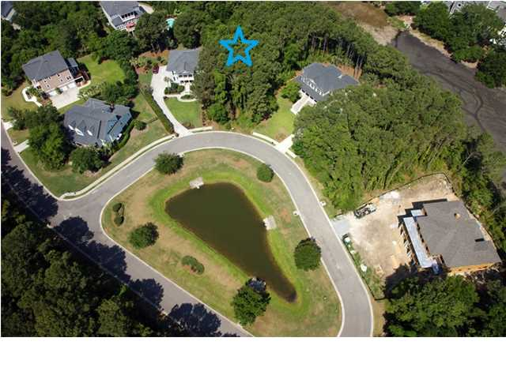
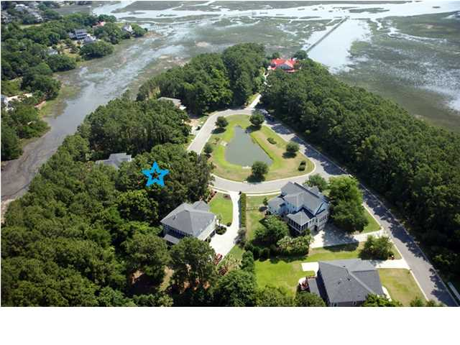
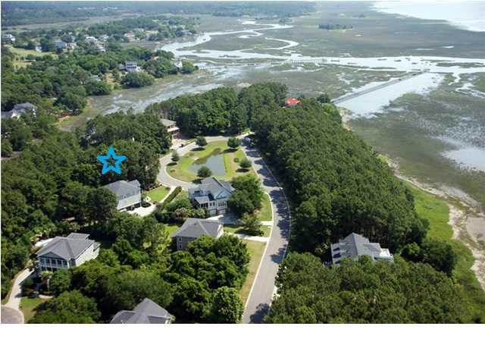
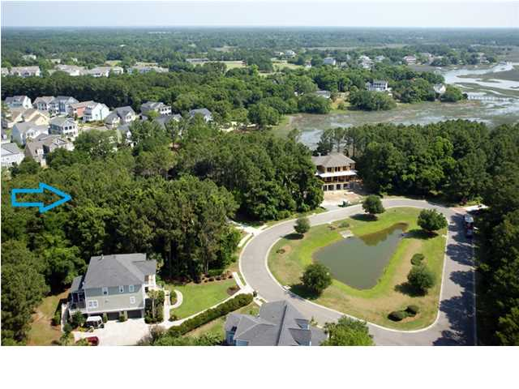
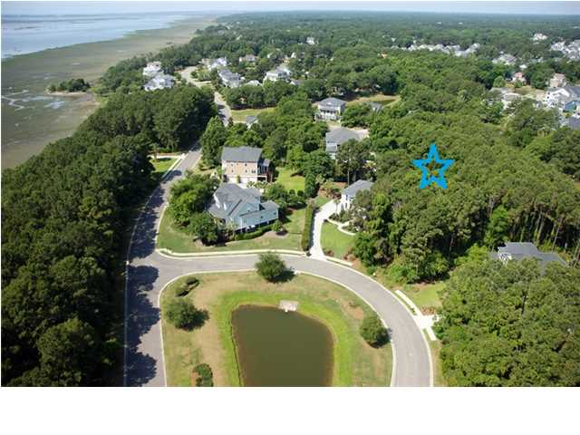

Unbeatable Hamlin Plantation Location!!!
4886 Sound View Dr ~ Mt Pleasant ~ MLS# 1415004~ $294,000
Build the custom home of your dreams in the award winning community of Hamlin Plantation. This superb .65 acre lot is situated on a private, highly desirable cul-de-sac that backs up to the marsh and is tucked away with the wildlife and dreamy sunsets along Sound View Drive. If you've been searching and simply don't want to settle for the current inventory, start building your dream home today! As a part of Hamlin Plantation you'll be able to enjoy the wonderful amenities which include the lighted tennis courts, fitness center, walking trails, basketball courts, volleyball courts, optional boat storage and the Olympic swimming pool complete with a waterslide! Enjoy the relaxing and laid back lifestyle of Hamlin without sacrificing convenience- you are within minutes to wonderful shopping, dining, the sandy white beaches of Isle of Palms, Wild Dunes and Sullivan's Island. Come walk this lot today- please call agent with questions. Thanks
Call or email for details: (843) 367-5333 or angelfrench4@gmail.com

