Slide 1
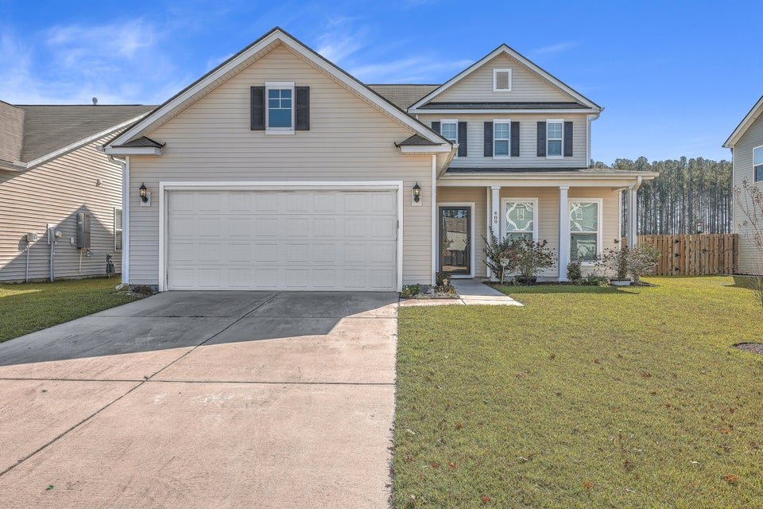
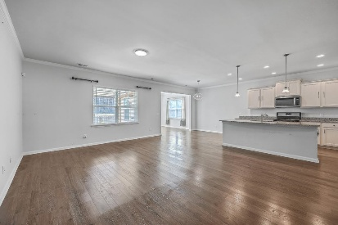
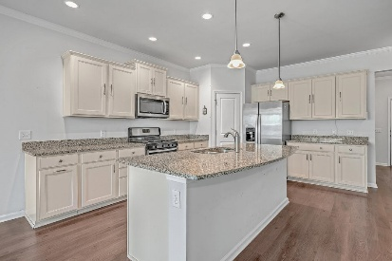
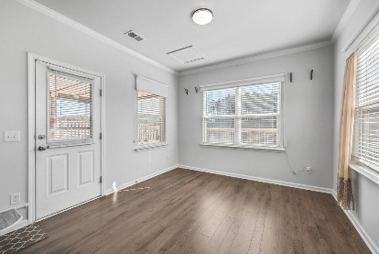
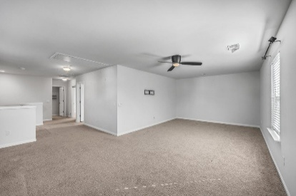
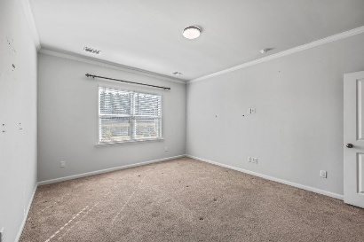
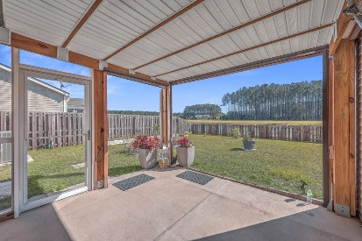
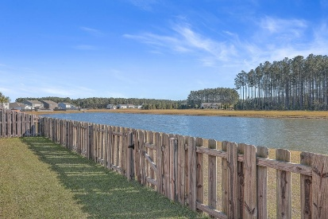


488 Sanctuary Park Drive
Sanctuary Cove @ Cane Bay Plantation | MLS# 24029673 | $399,999
SELLER MOTIVATED!
$10,000 PRICE IMPROVEMENT
Welcome to this beautifully designed home, perfectly situated on a peaceful pond lot in a sought-after neighborhood. Offering ultimate convenience and comfort, step inside to a light-filled foyer that leads to a study with French Doors which could serve as a 4th bedroom. continue on to the open-concept living area which includes a family room, sun room, dining area and a thoughtfully designed kitchen. The kitchen boasts granite counters, a large island with seating & pendant lighting, stainless appliances including a refrigerator and gas stove, white cabinets, a direct-vent hood and a pantry. Crown moulding adds a polished touch throughout the main living areas. You will love having the Owner's Suite on the main level and with a great view of the pond. Upstairs, you'll find two generously sized bedrooms, a spacious bathroom and a massive L-shaped loft, perfect for a second living space, playroom, media room or man cave. Relax year-round on the screened porch, which overlooks the backyard and serene pond views. The neighborhood offers exceptional amenities, including a pool, playground, and walking/jogging trails. Conveniently located near shopping, dining, top-rated schools, and major highways, this home provides easy access to downtown Summerville and Charleston, area beaches, state parks and the airport. Don't miss the chance to call this exceptional property home!
Enjoy a video tour!
Beth Mandell
M 803-463-7734 | O 843-871-2121
bmandell@century21properties.com
www.bestcarolinahomedeals.com
Century 21 Properties Plus of Summerville | 568-A Savannah Highway | Charleston, SC 29407

