Slide 1
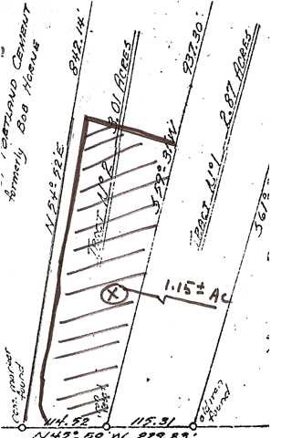
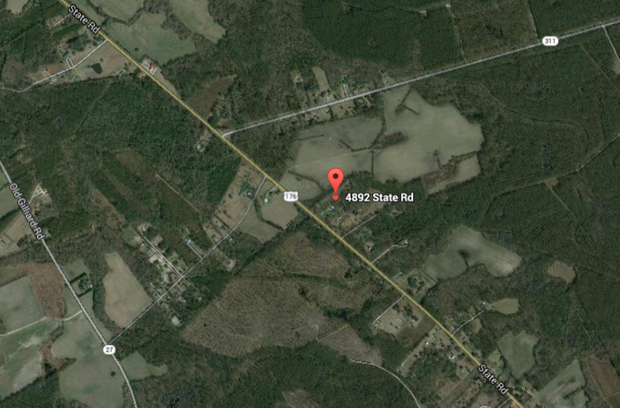
4892-B State Rd
Ridgeville
MLS# 1422442
$33,500
Country Living… Build Your Dream Home!
Priced reduced from $219,000 ( $35,100.00 ) to allow Buyer to modernize as they feel is necessary. Backs up to Lake Hastie, a man made fishing lake …no power boats. At closing, owner will pay CNT Foundations LLC $9,350.00 to repair brick work & foundation issues with full price offer.
Zachary Glover
843-810-9891 (Zachary)
mrcrealestate1@gmail.com
Matthew Ryan Company, 104 Berkeley Square, PMB 59, Goose Creek, 29445

