Slide 1
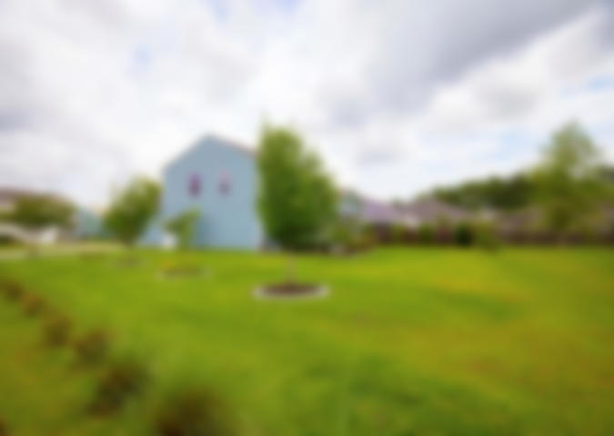
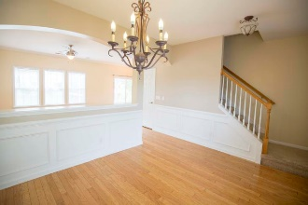
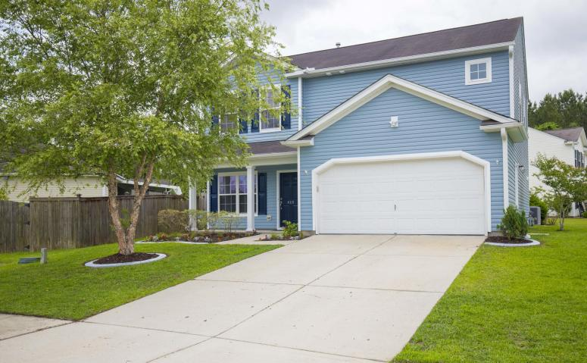
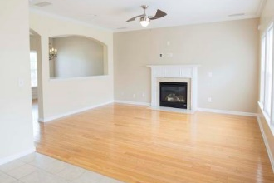
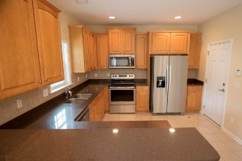
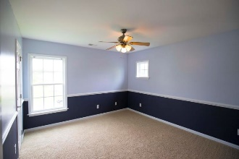
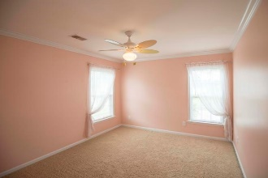
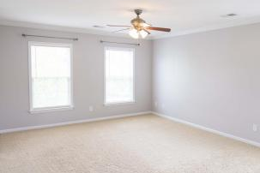
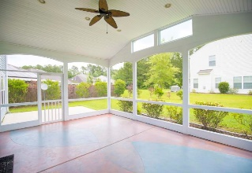
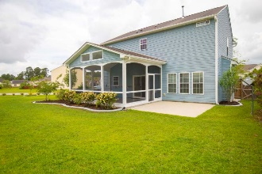

489 Dolphin Drive Arbor Walk ~ Summerville, SC 29485 MLS# 18014406 ~ $239,900
Custom home on beautiful lake!
Shows Like New!
Interior has recently been repainted, all new kitchen appliances, and large screened porch on this large lot in Arbor Walk subdivision. Located in Dorchester District 2 school system and minutes to shopping and Downtown Historic Summerville. As you walk through the front door, you will find hardwood floors in the formal dining and family room areas. Off the family room, there is a nice powder room, well laid out kitchen, and large breakfast area with access to the spacious screened porch. Upstairs you will find a large master bedroom, 2 spare bedrooms, and a laundry room. The 2 spare bedrooms share a separate full bathroom and the master bedroom has a private bathroom with large walk-in closet. In the family room, you will also find a pre-wired surround sound system.
Scott Fulton
(843) 324-8845 O | (843) 324-8445 M scott.fulton@agentownedrealty.com
AgentOwned Preferred Group | 824 Johnnie Dodds Blvd | Mt Pleasant, SC 29464

