Slide 1
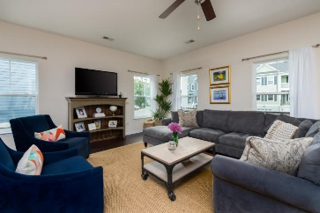
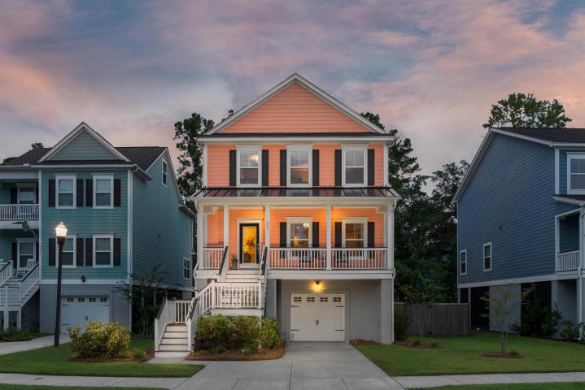
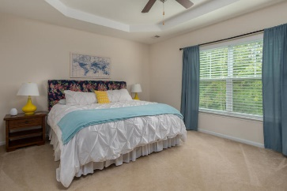
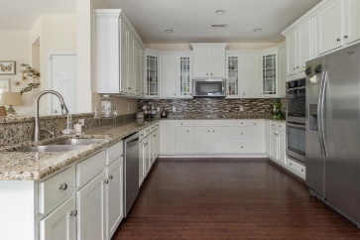
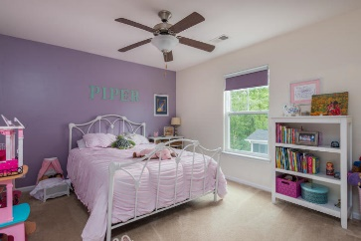
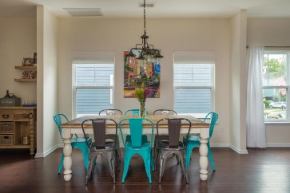
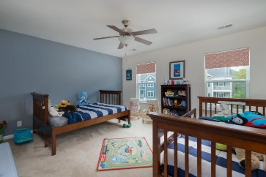
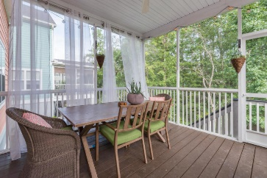
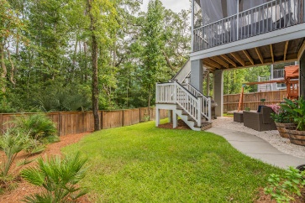


MAJOR PRICE DROP!
DON'T MISS THIS DEAL!
$10K Price Reduction!
489 Sanders Farm Lane
Retreat at Beresford ~ Charleston, SC 29492
MLS# 18003792 ~ $400,000
Gorgeous elevated home on a private lot with PROTECTED WETLANDS, located in the Retreat at Beresford, 1.5 miles from I-526, a few minutes to Daniel Island. This open floor plan has hardwood floors, granite counters, tons of cabinet space, a tile backsplash, double ovens, 9 ft ceilings and a roomy master bedroom downstairs. Upstairs has a large loft area, 3 additional bedrooms, large bathroom AND an office. Relax on the screened-in porch and catch a breeze from Nowell Creek at the end of the street! The lot backs up to protected wetlands to ensure future privacy as well. Come see 489 Sanders Farm Lane today!
Lara Harpe
Co-Owner, Broker/ Realtor
Mobile 843-298-6669
Lara@thepulsecharleston.com
thepulsecharleston.com

