Slide 1
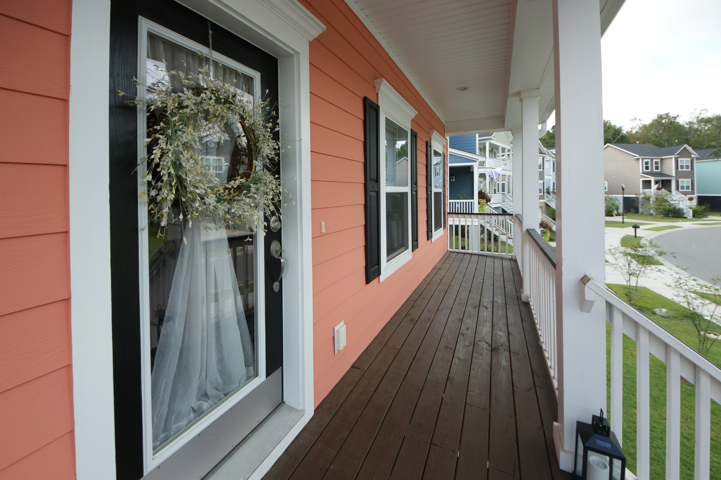
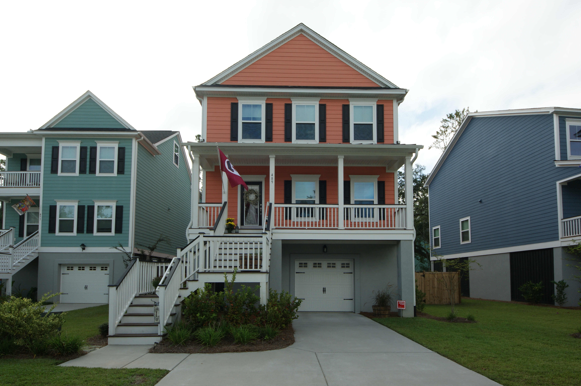
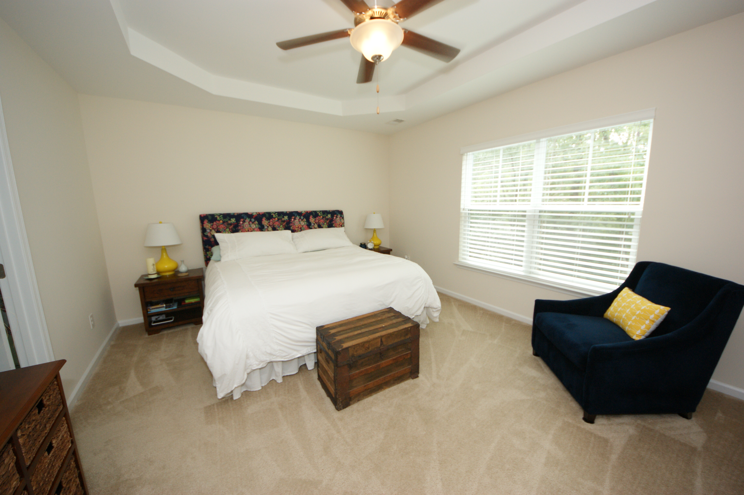
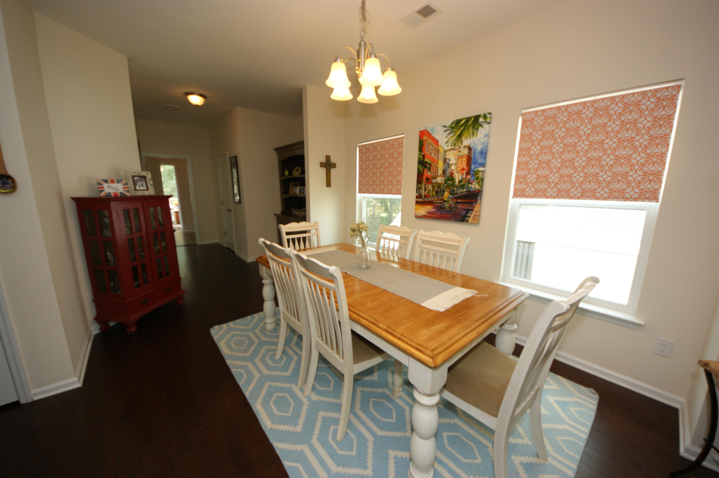
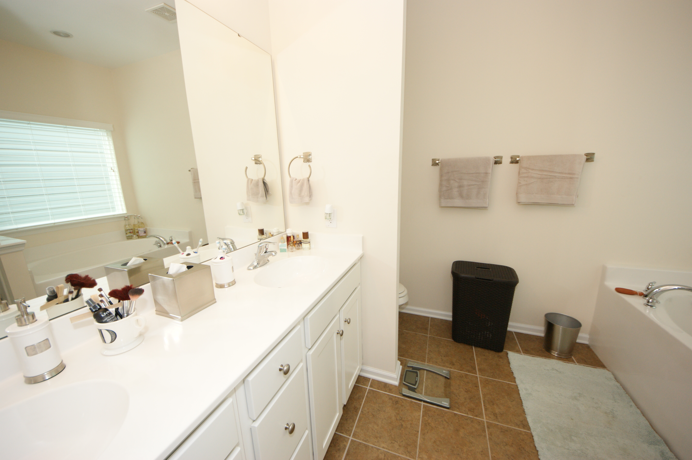
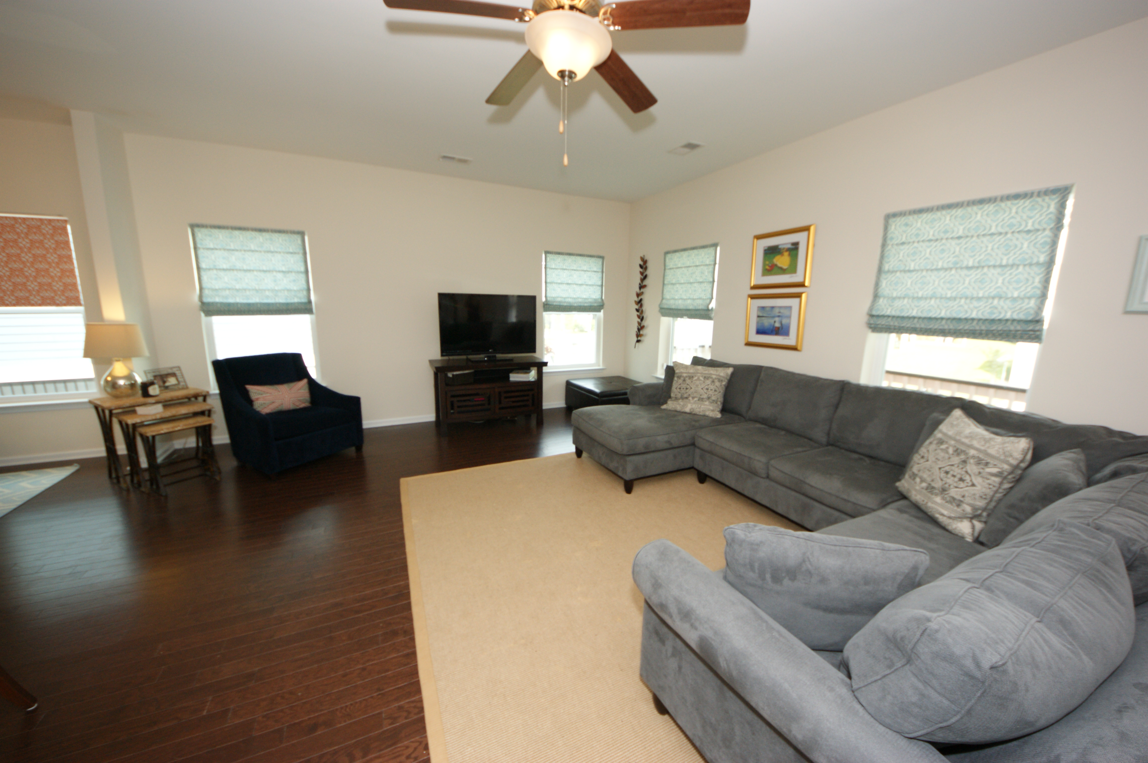
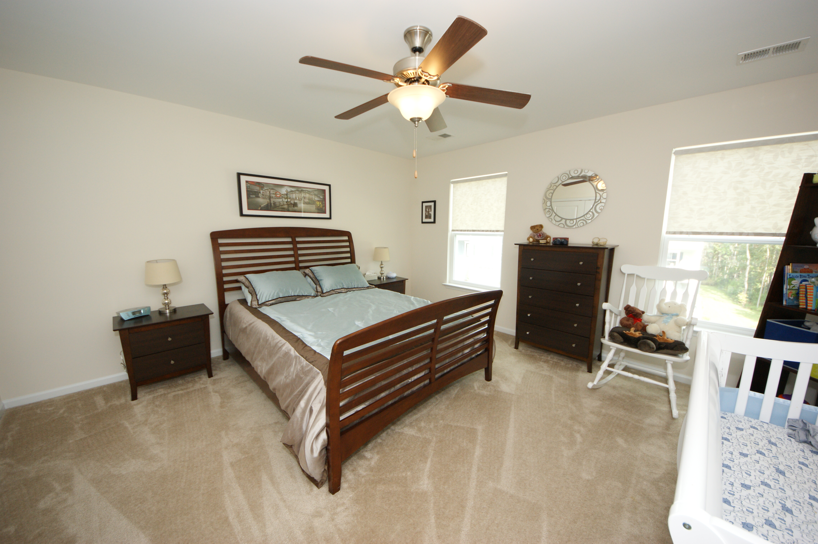
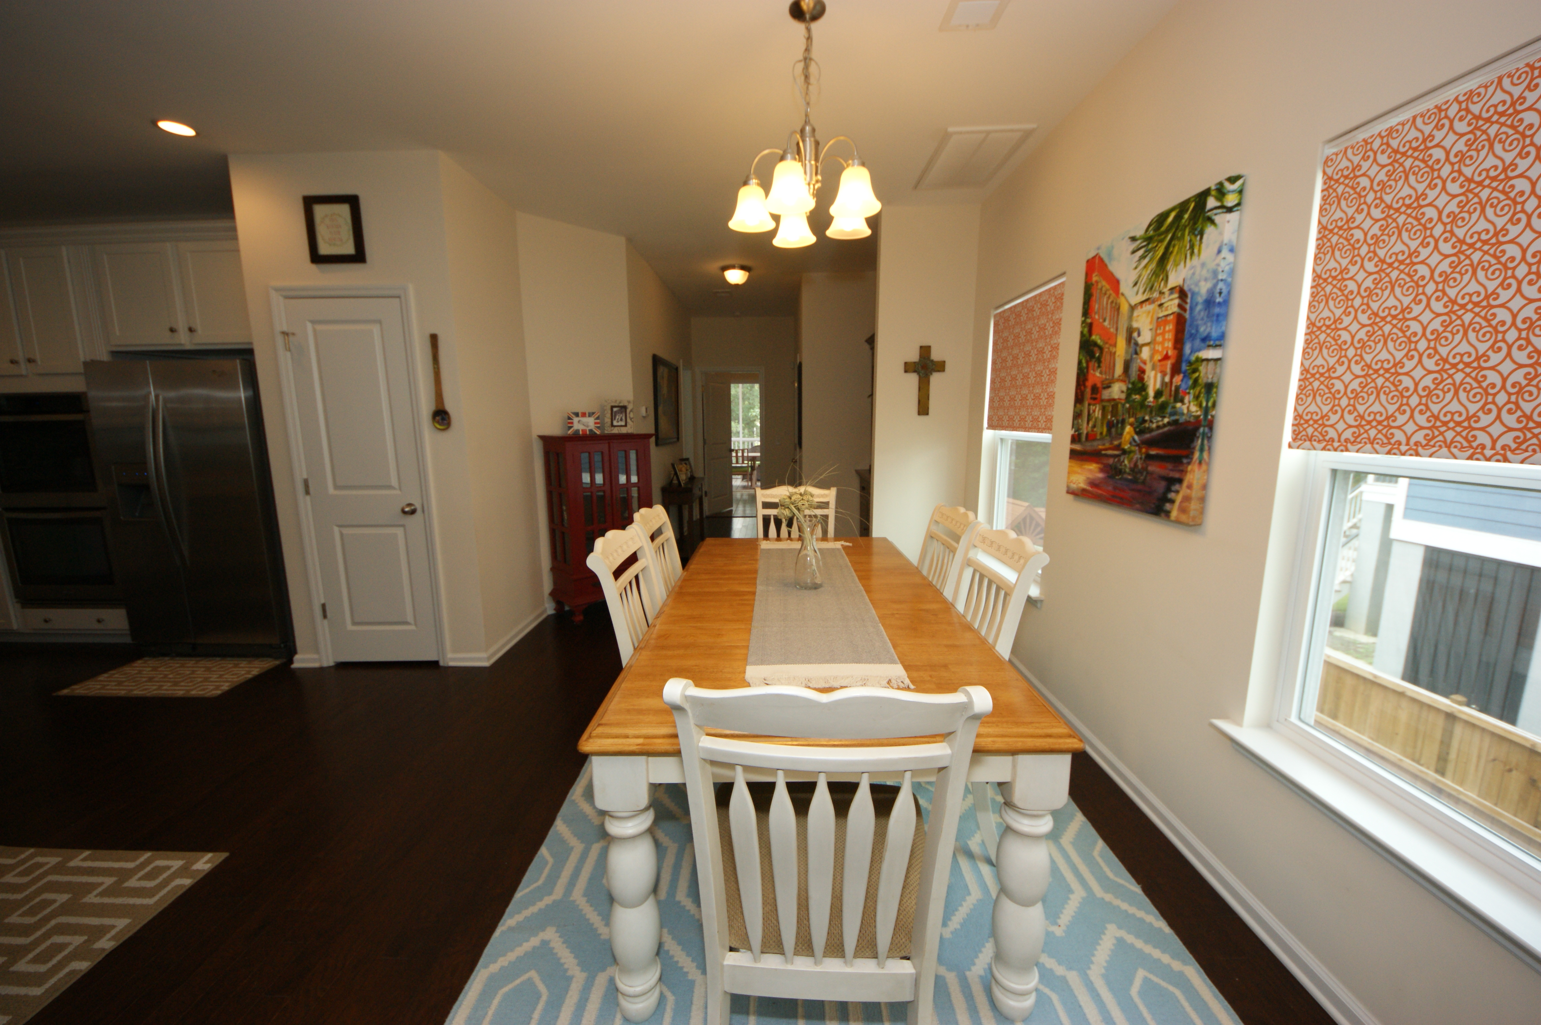
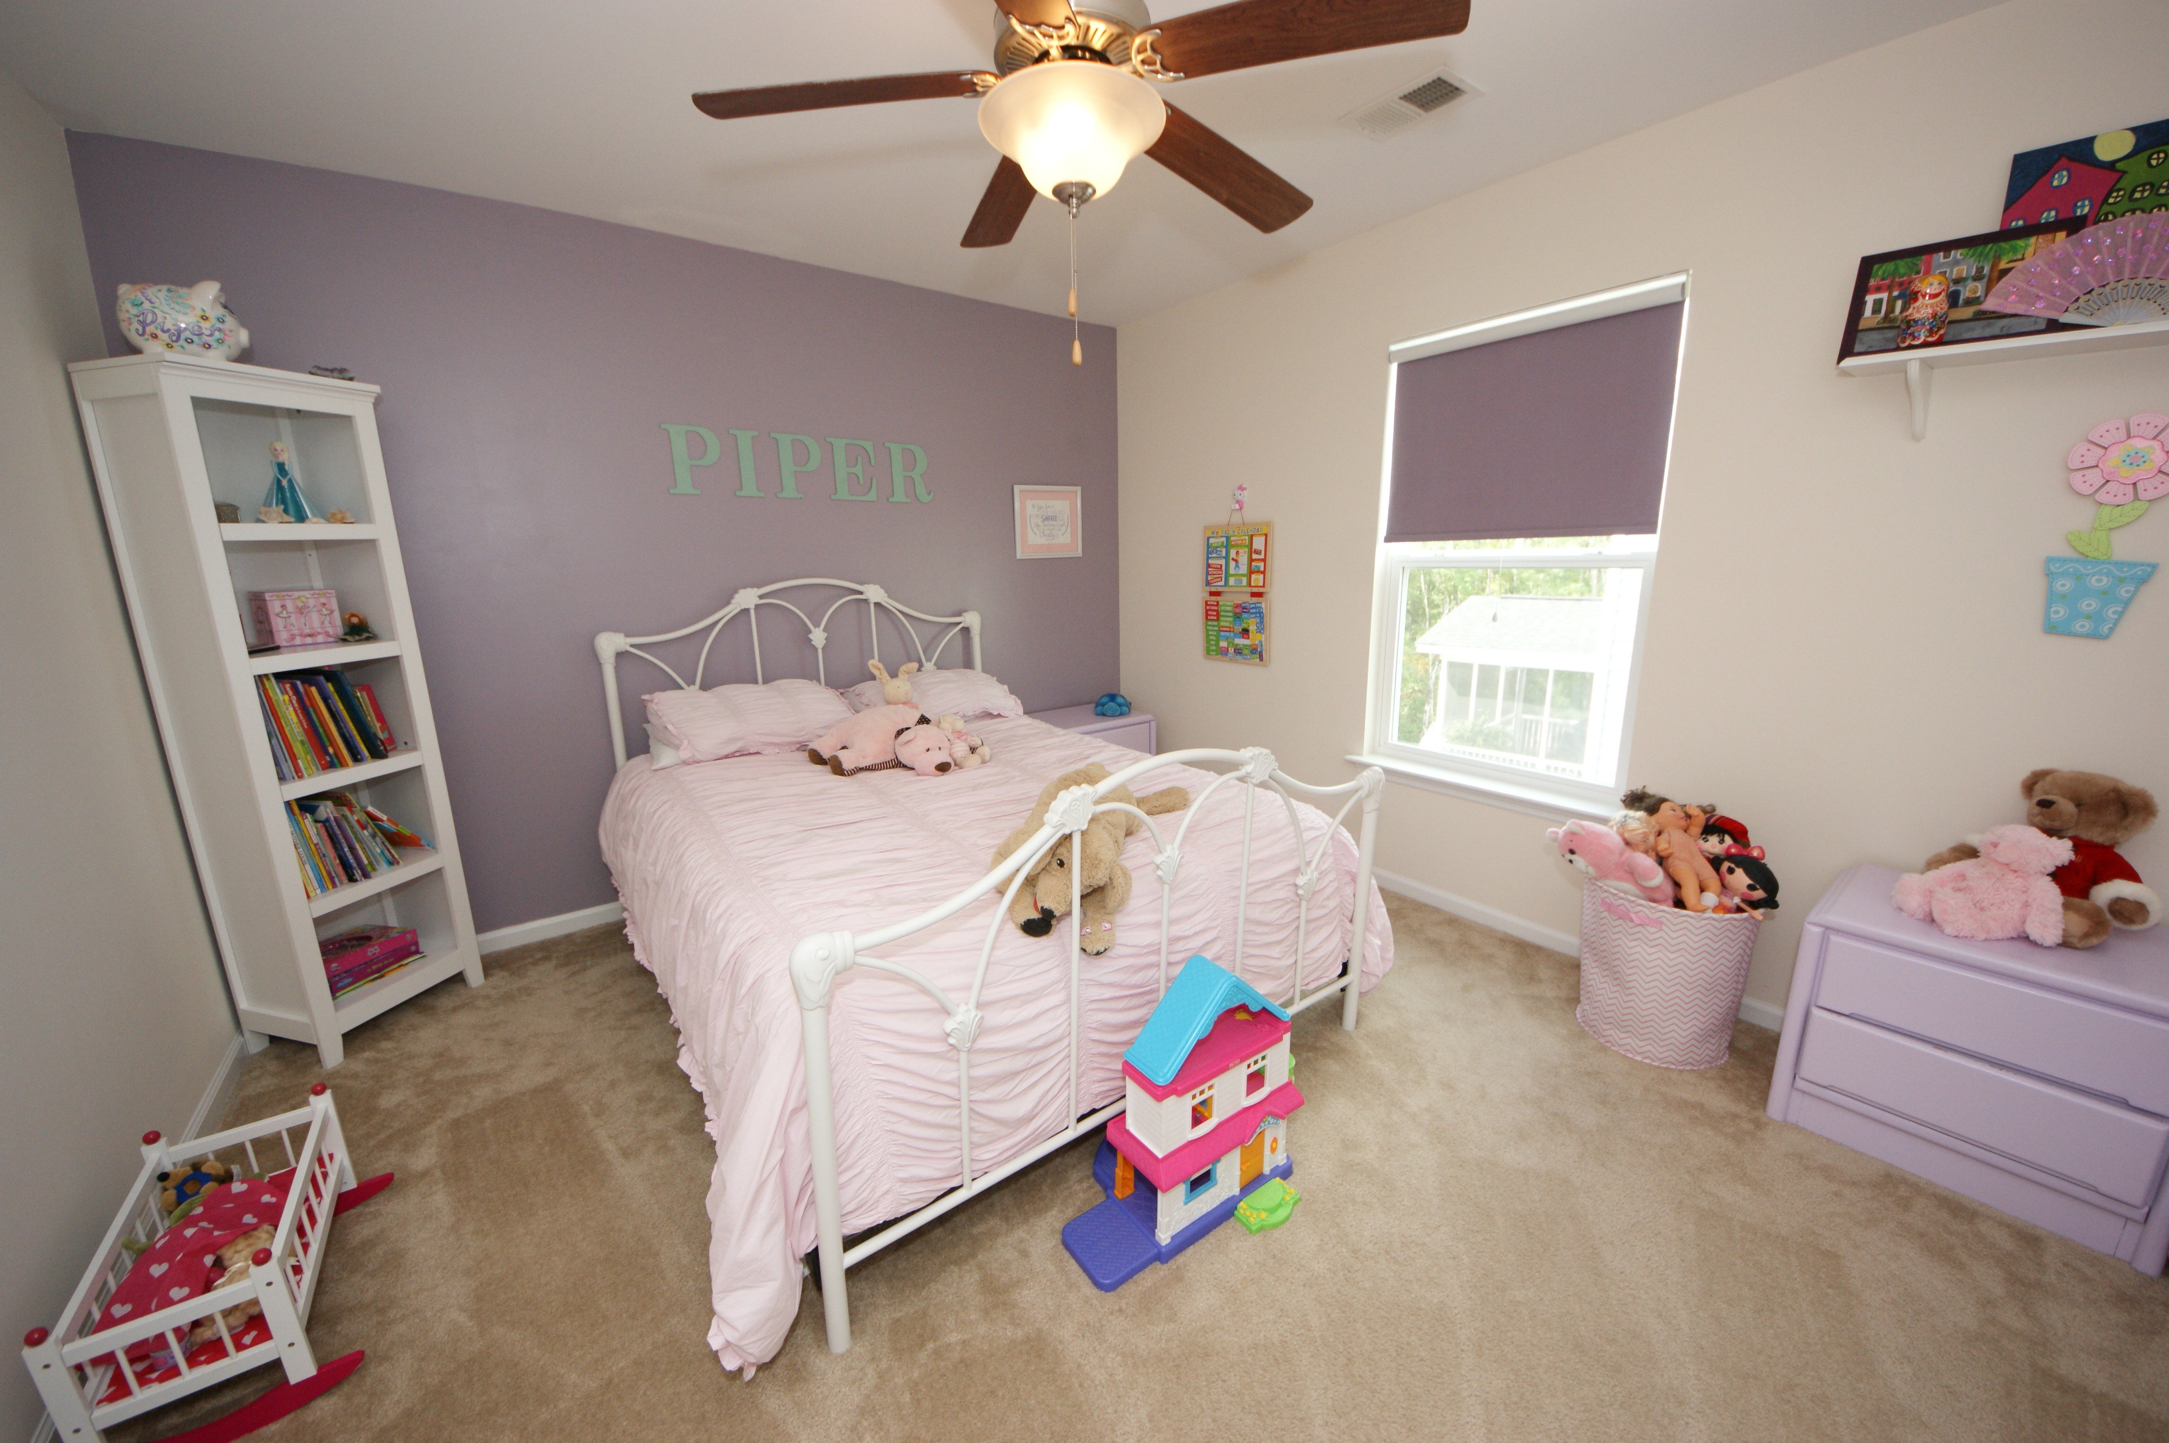
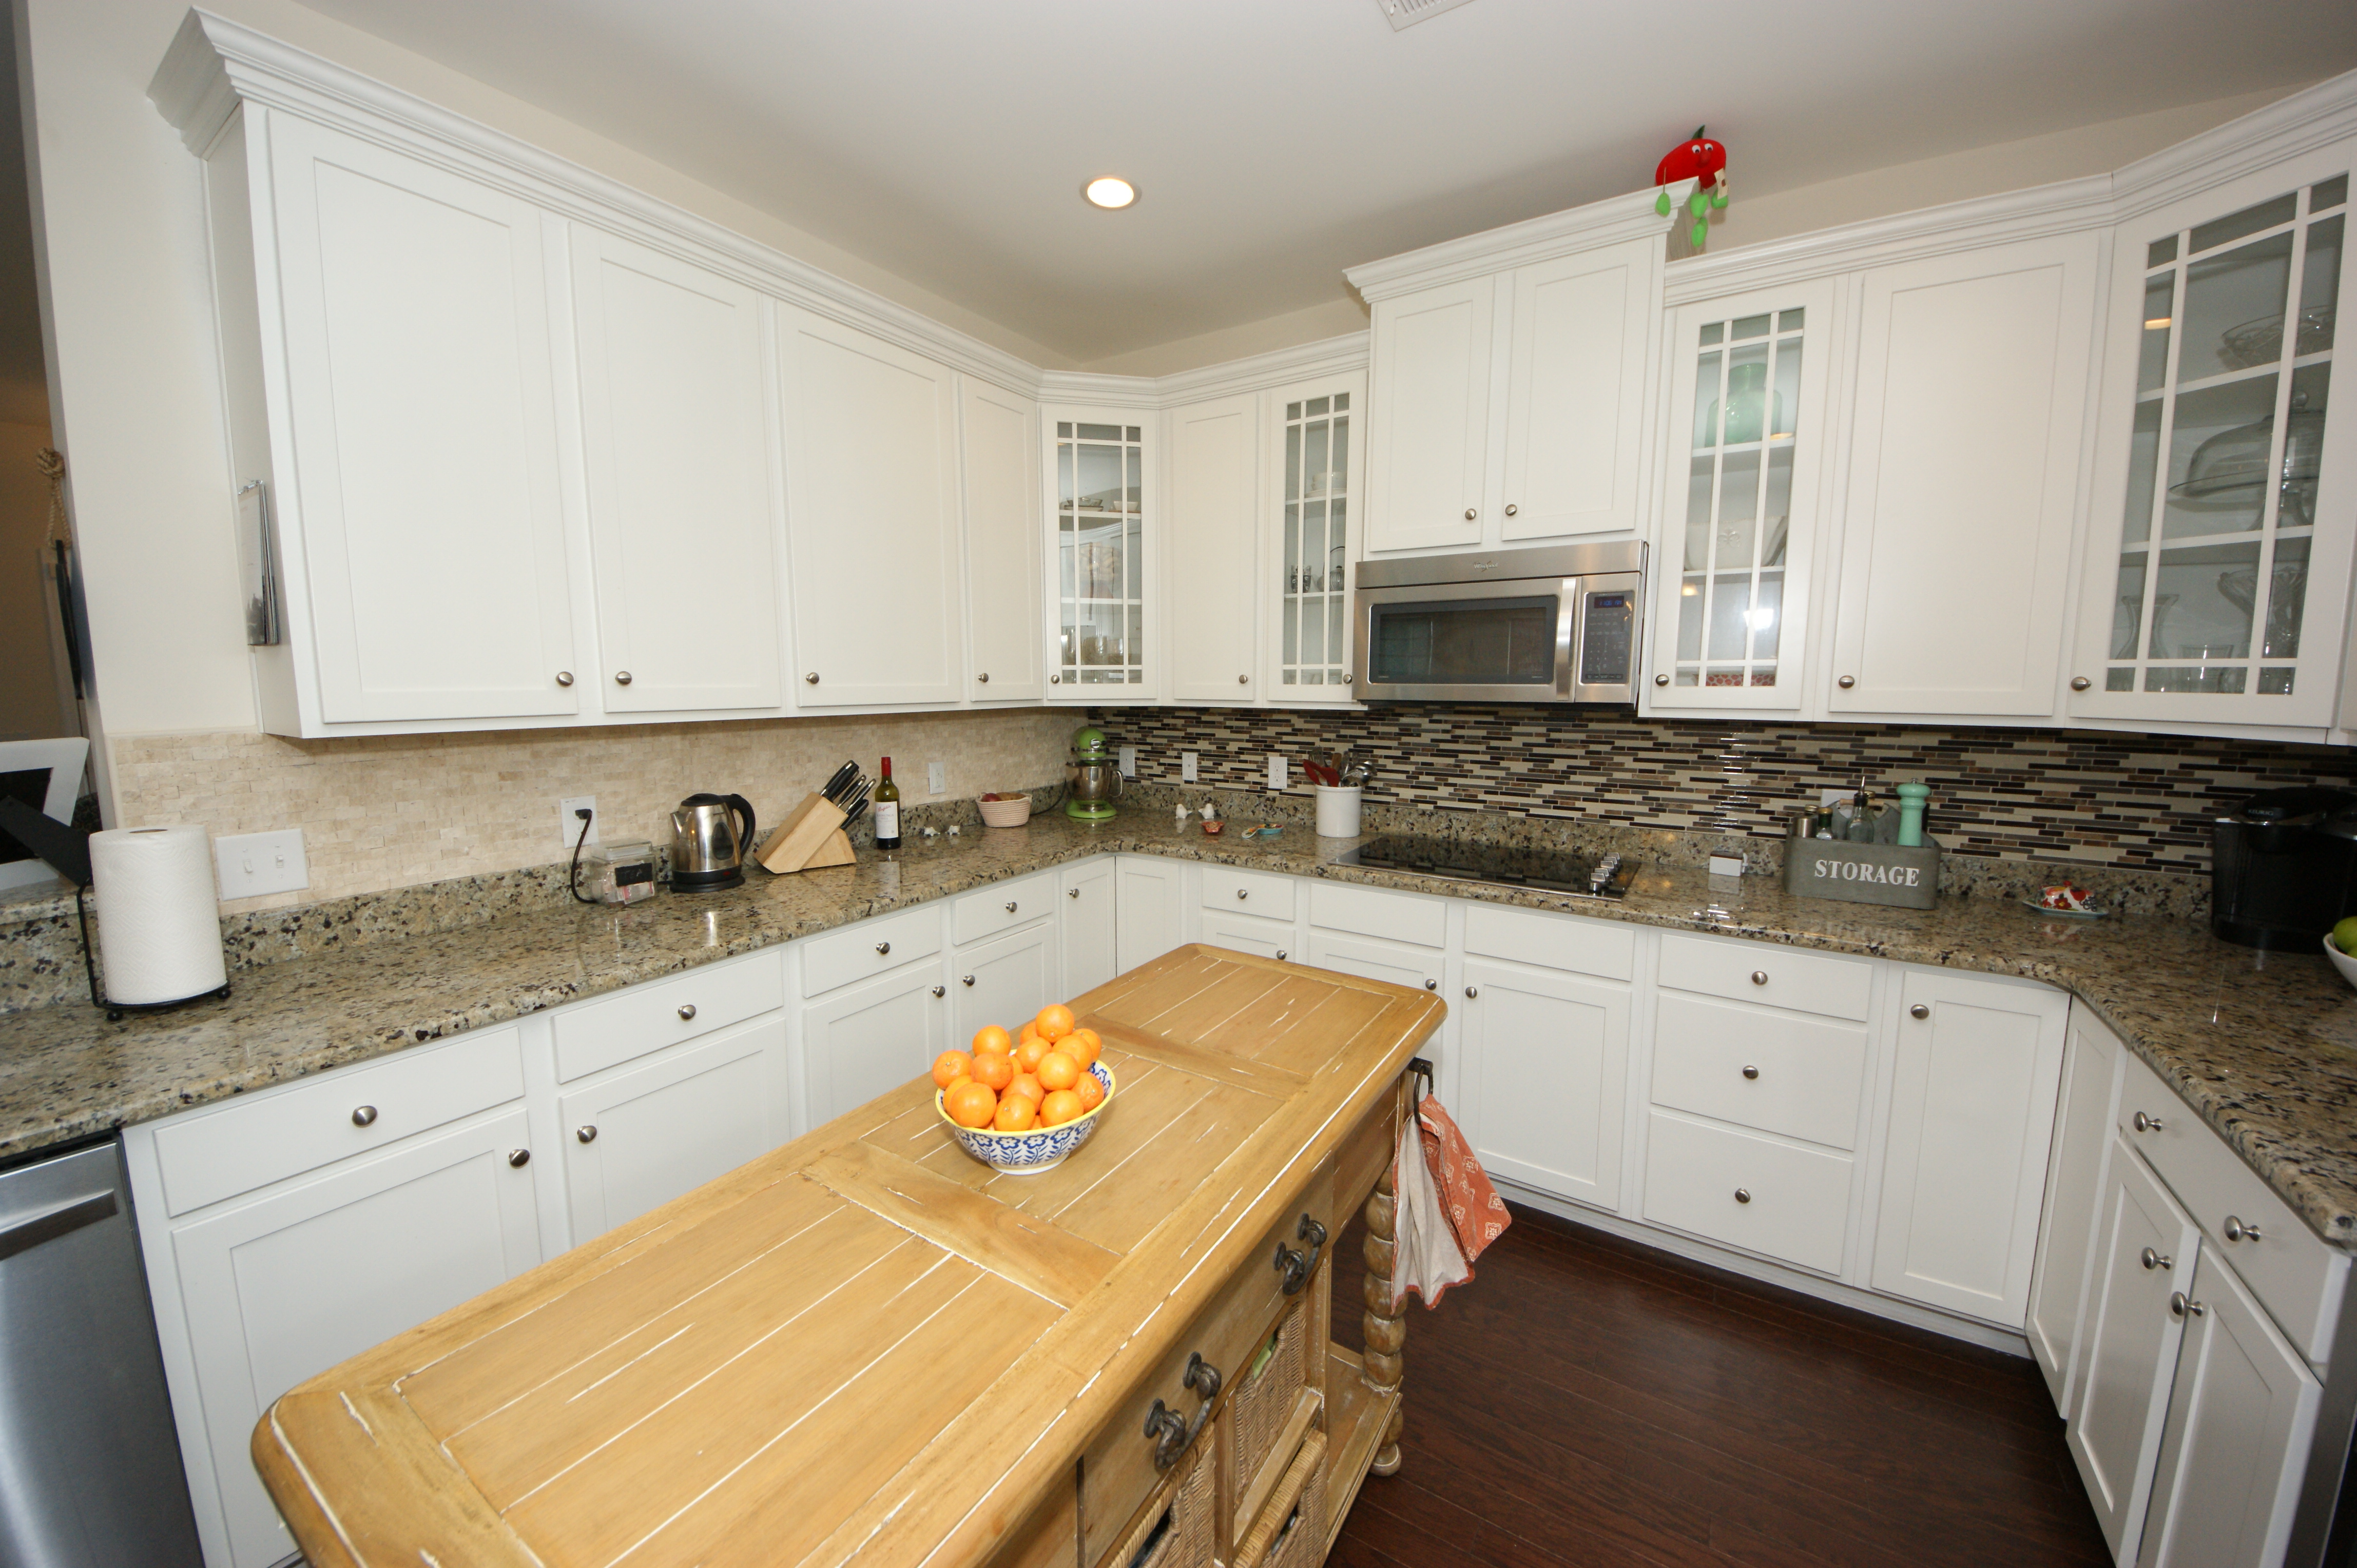
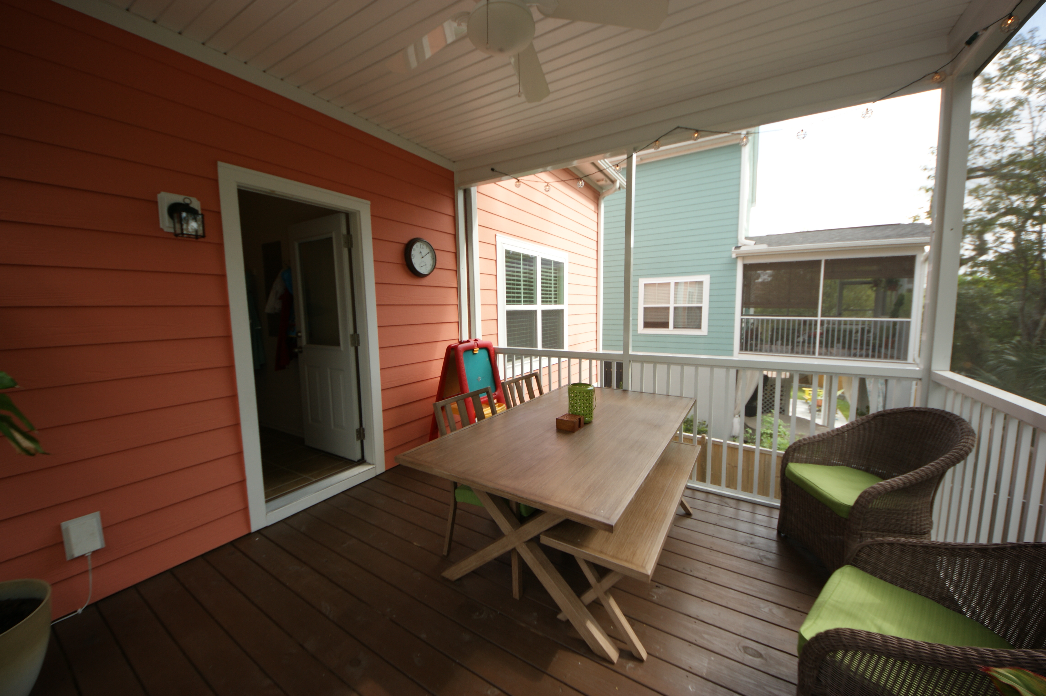
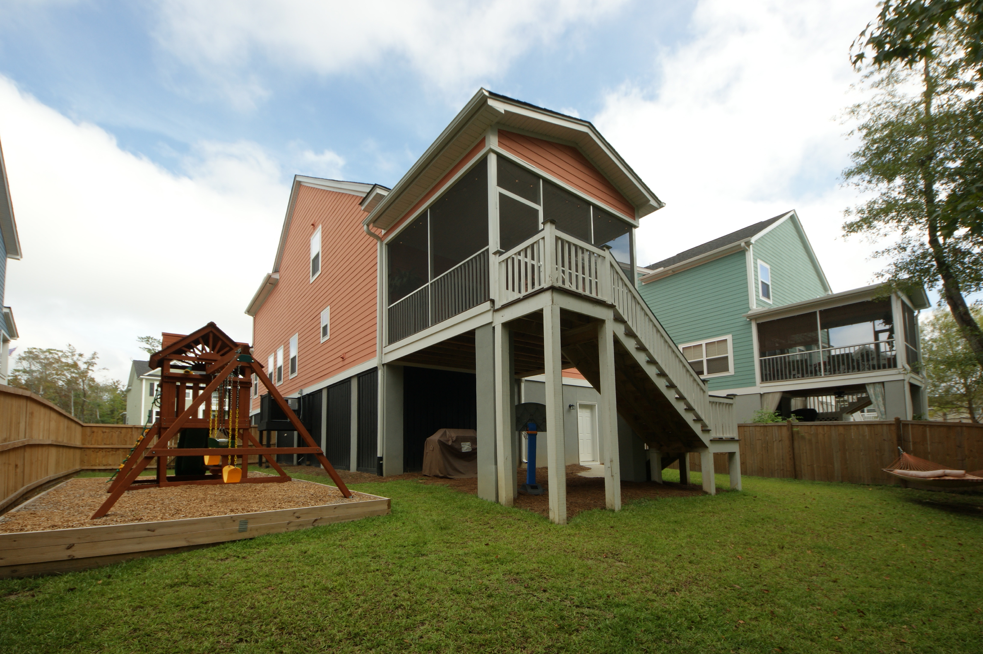
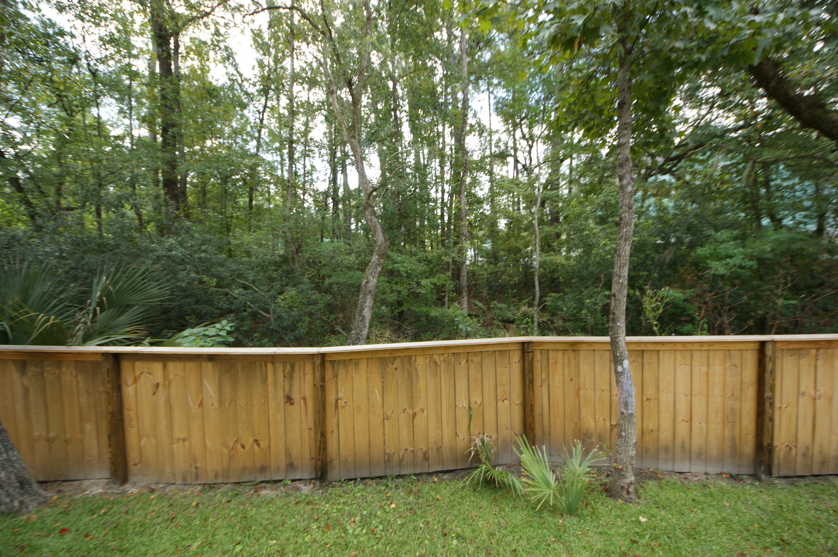
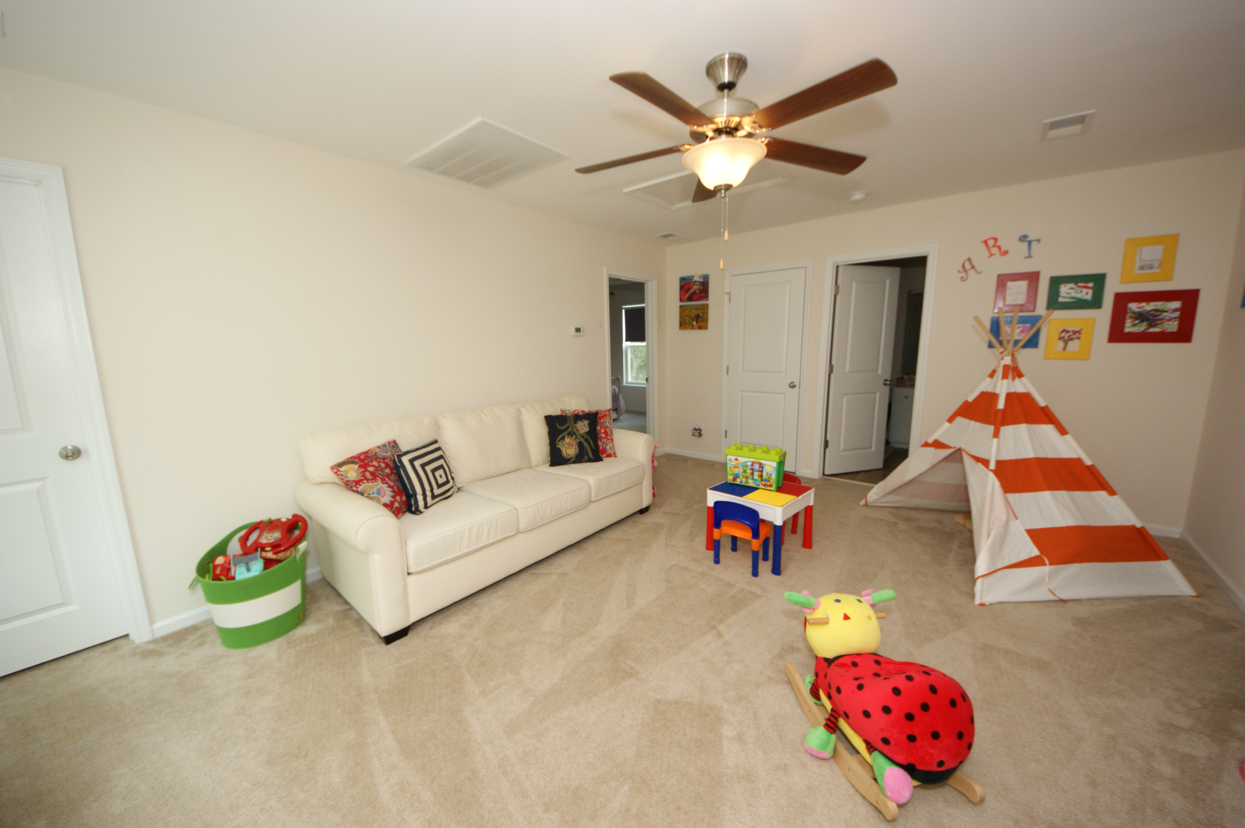



Price Reduced in the Retreat at Beresford
489 Sanders Farm Lane
Charleston, SC 29492 ~ MLS# 15024989 ~ $395,000
Just one year old and in pristine condition! You will not want to miss this house! Located in the Retreat at Beresford, just 1.5 miles from 526, a few minutes to Daniel Island and 7 minutes to Mt Pleasant, it's where all the growth is headed. This 4 bedroom 2.5 bath home has an open floor plan with beautiful upgrades and custom window treatments. Hardwood floors extend throughout the great room, kitchen and dining area and are complimented by the crisp white cabinets and new backsplash. The kitchen also boasts tons of cabinet space, double ovens wall ovens, drop in cooktop, and a stainless steel refrigerator that conveys. The first floor additionally includes the spacious master bedroom suite & a sunny laundry room. Upstairs has 3 additional bedrooms with a shared hall bath, a huge bonus loft area AND study/office. A screened-in back porch makes it easy to enjoy the private lot backing up to a stream. The fully fenced backyard is complete with a brand new swing set. There is great storage in the 2 car garage which extends underneath the entire home.
Lara Harpe
Co-Owner
Broker/ Realtor
Mobile 843-298-6669
Lara@thepulsecharleston.com
Stacey Boucher
Co-Owner
Broker/ Realtor
Mobile 843-817-8963
Stacey@thepulsecharleston.com
thepulsecharleston.com

