Slide 1
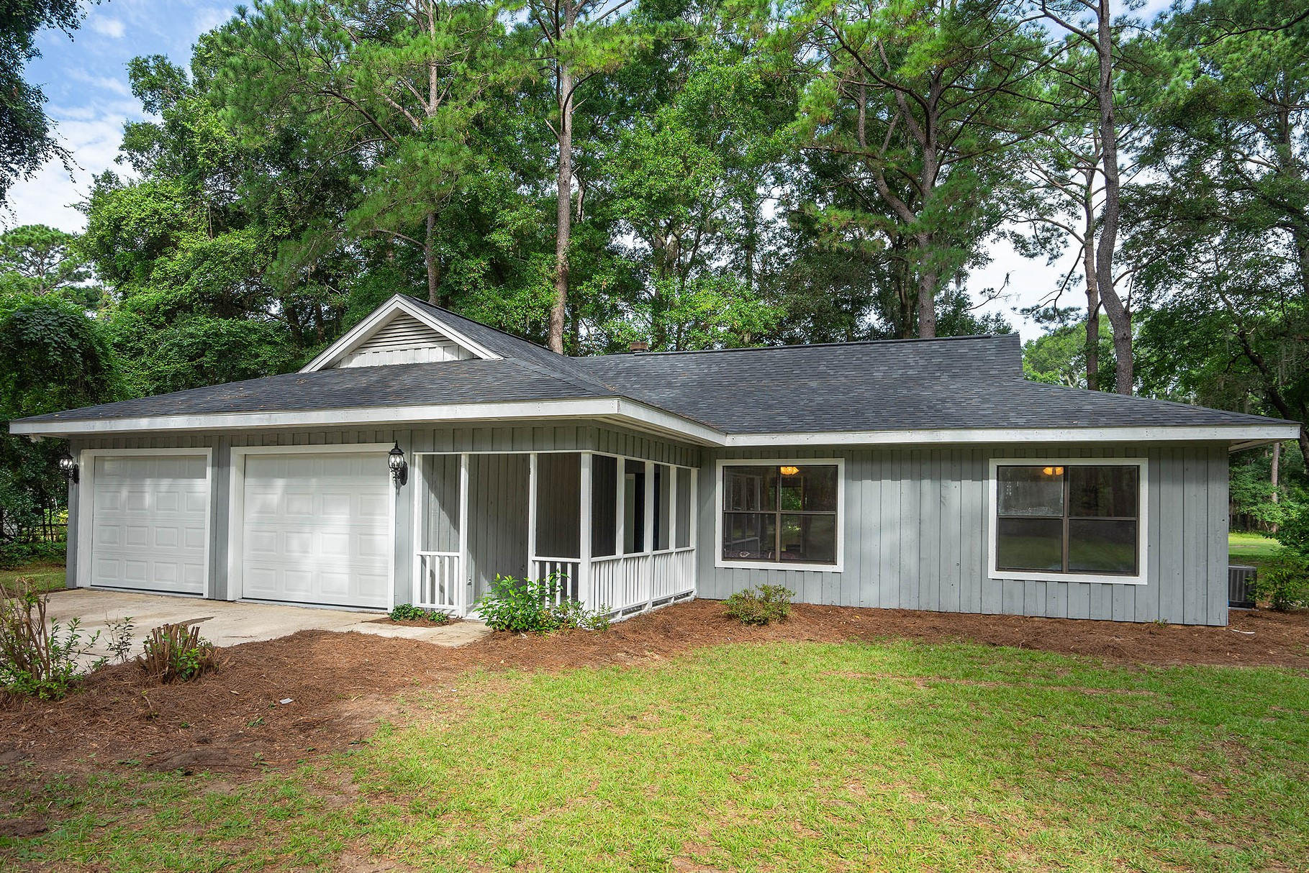
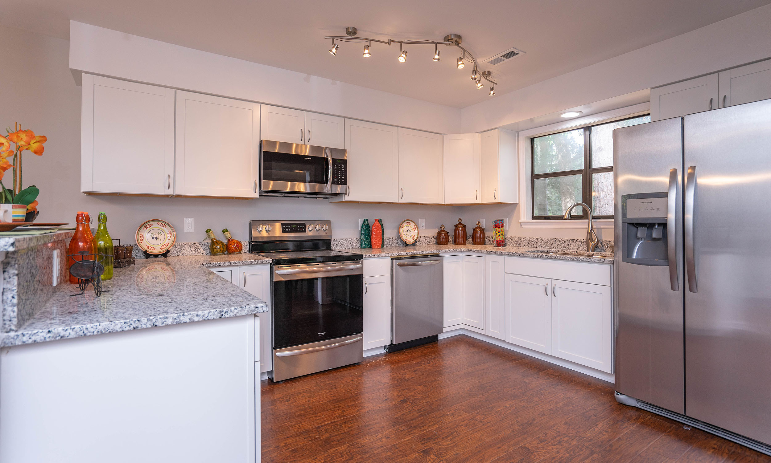
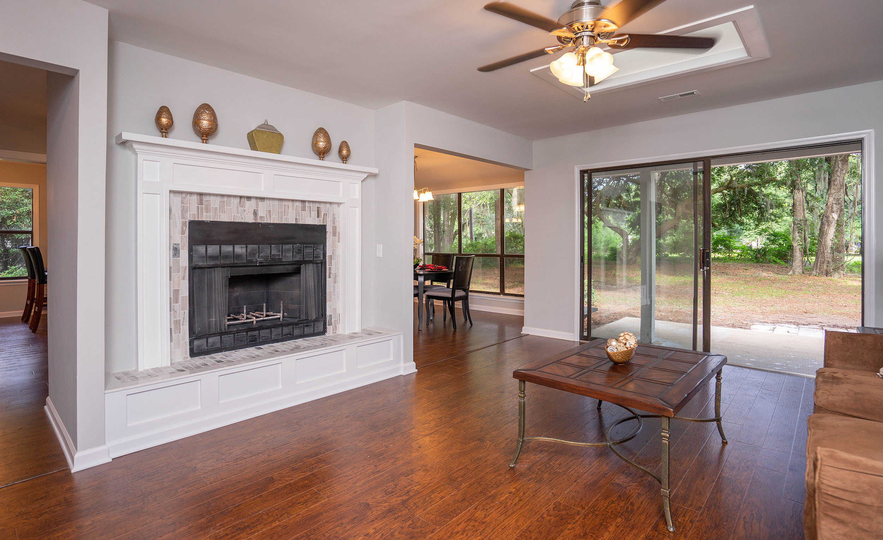
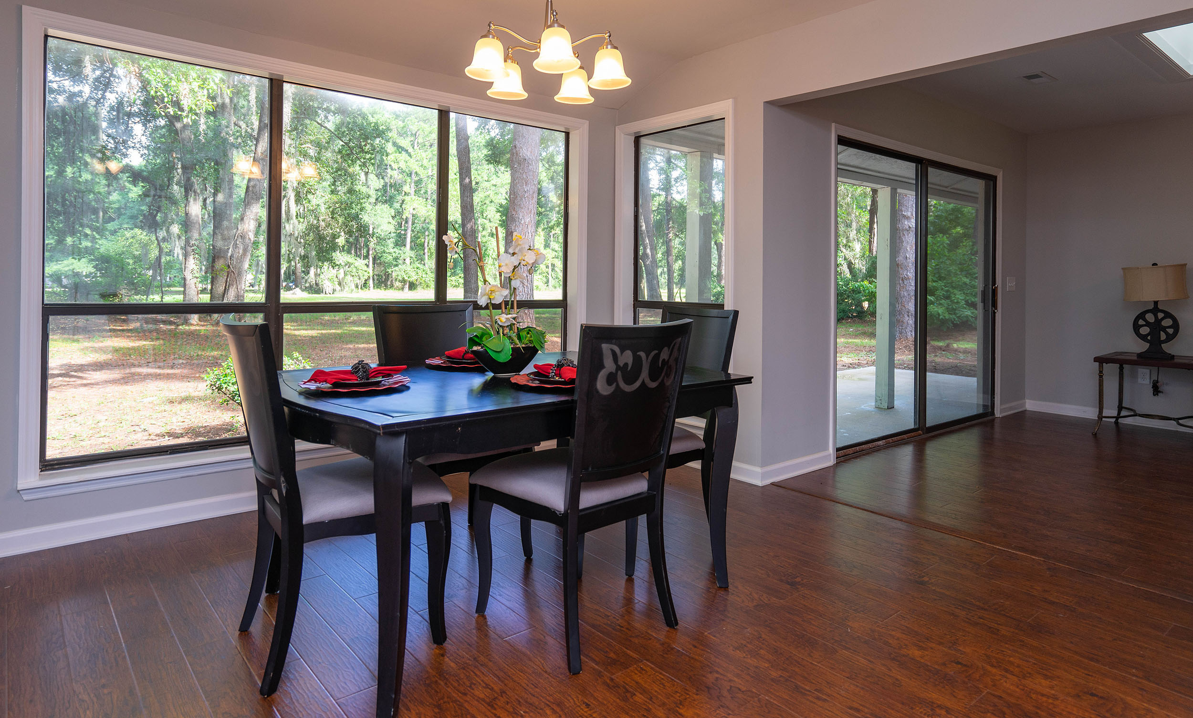
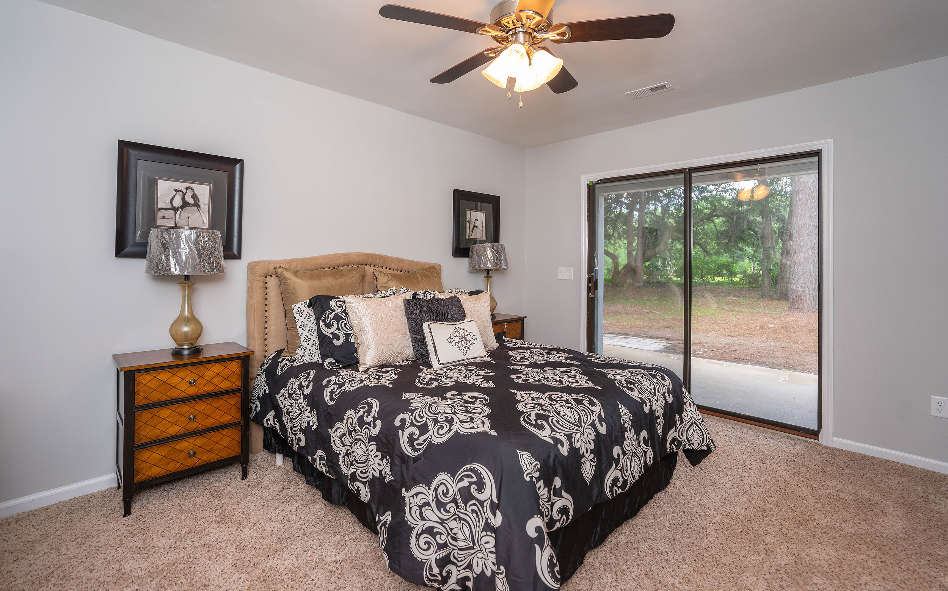
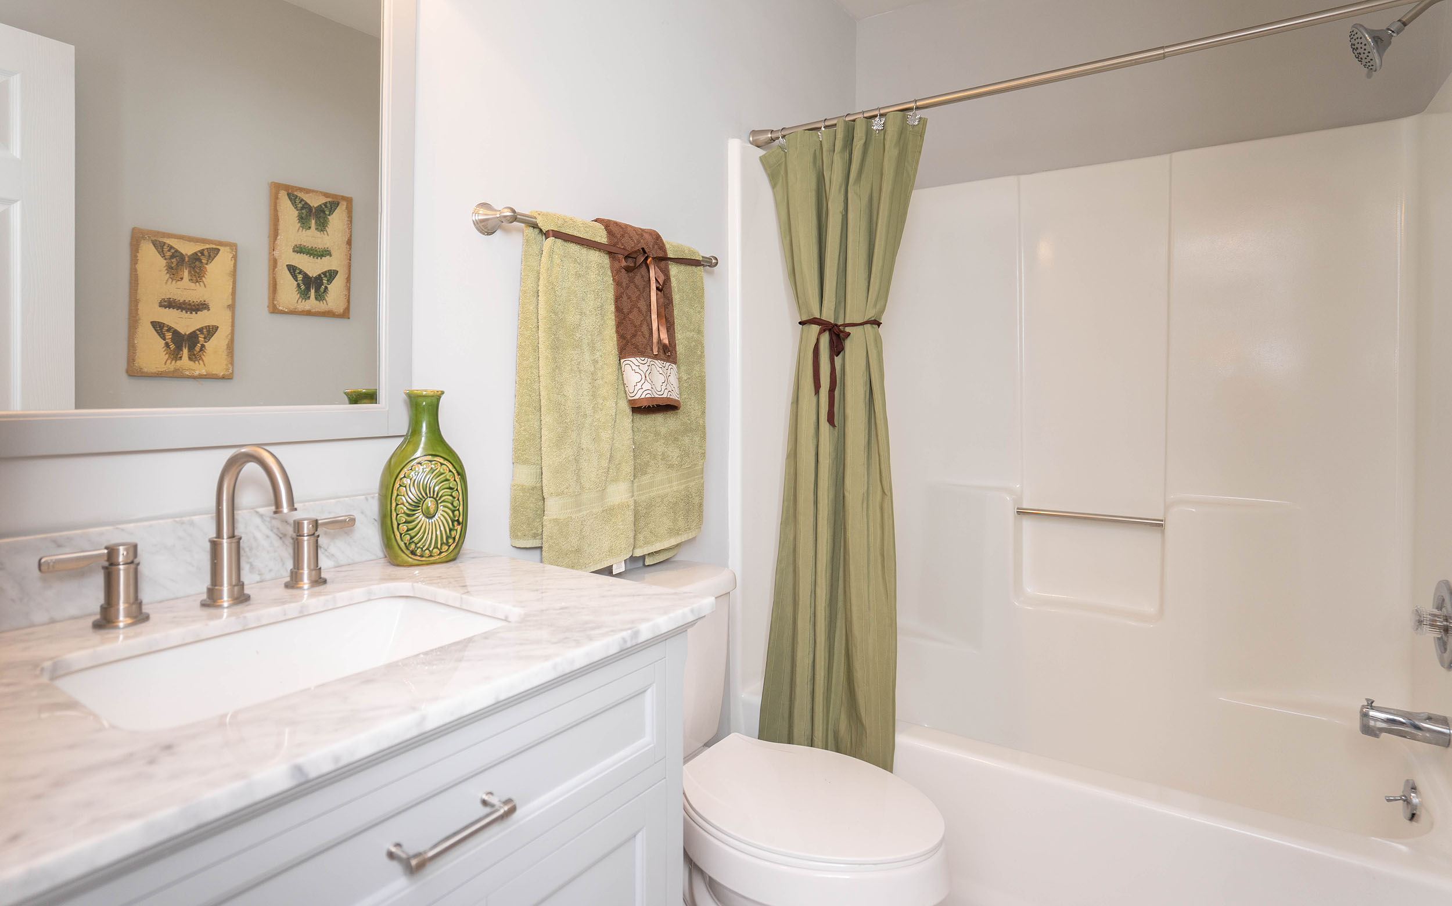

48 Fiddler Dr ~ Beaufort
$239,900
Fully-renovated 3BR/2BA Home on large wooded lot in Royal Pines Country Club! New Architectural Roof, HVAC, Water Heater! Just Painted Exterior & Interior! New laminate wood flooring! New frieze carpet/pad! New Brushed Nickel Ceiling Fans/Lights/Fixtures! Custom tile surround at wood burning fireplace! Kitchen has ALL new white cabinets, granite countertops, sink/faucet & stainless appliances! Both BA's w/ new vanities/tops & tile showers/tubs. All BR's have large closets. Large 2 Car garage w/ freshly painted epoxy floor & all drywall walls!
Bedrooms:
Bathrooms:
Sq Ft:
Garage:
Lot Size:
3
2
1444
2-Car
0.79 Acres
Year Built:
New Roof:
New Central Air:
New Heat:
Type of Floors:
1988
2018
2018
2018
Wood, Ceramic Tile, Carpet
For Showings Call:
843-343-3030

