Slide 1

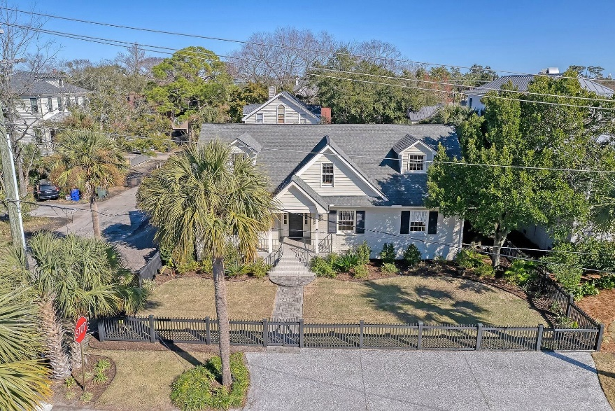
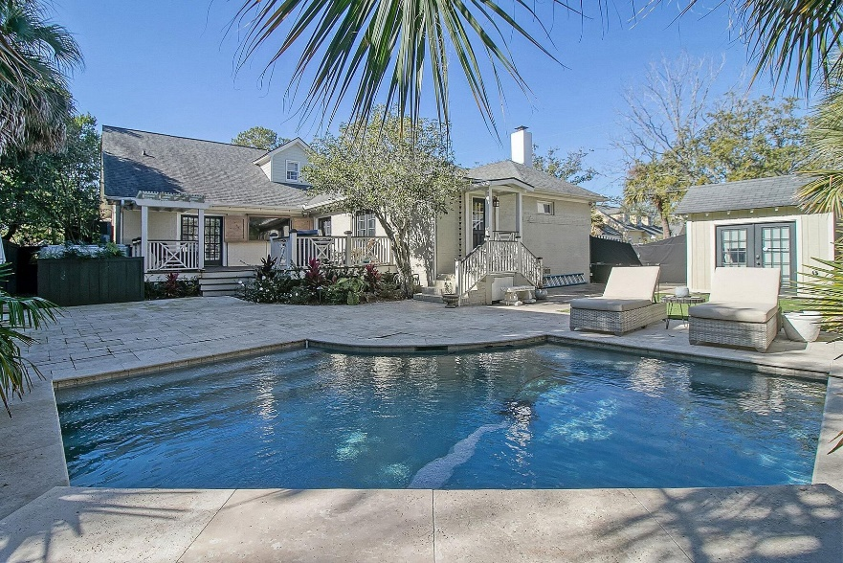
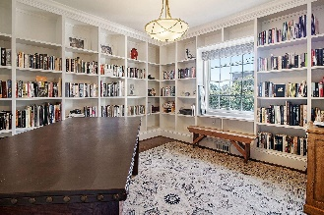
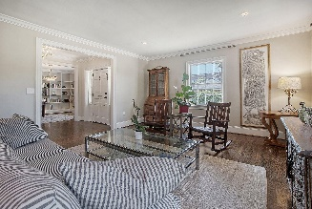
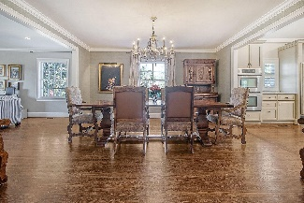
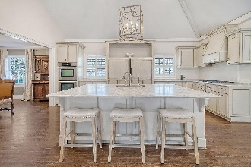
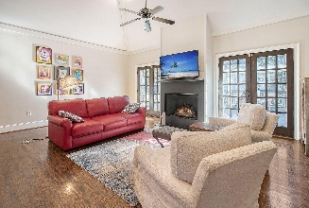

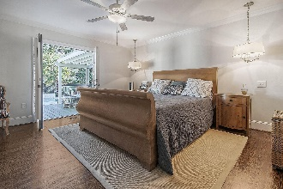
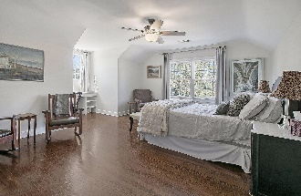
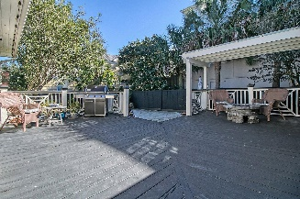
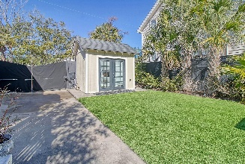
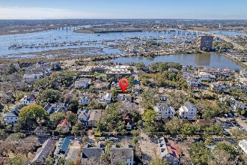
Amazing Downtown Home
With Pool
Debbie Cromer
ABR, RSPS, REALTOR, CRS
(843) 437-6342
debbie@debbiecromer.com
www.debbiecromer.com
48 Barre Street
Harleston Village | Charleston, SC 29401 | MLS# 24001566 | $3,000,000
Welcome to this stunning 1950's brick home on the corner of Barre and Bull Streets, just steps from the City Marina in Harleston Village. This property dazzles with an open concept floor plan and an expertly designed private backyard featuring a pool, spa, an expansive deck complete with landscape lighting. Upon arrival, notice the charmingly fenced front and side yards containing well maintained mature landscaping. As you enter the home, embrace the light-filled ambiance of the main floor, accentuated by beautiful hardwood flooring. To your right, discover a handsome office space/study, bathed in natural light and adorned with abundant shelving. To your left, a spacious formal sitting room seamlessly transitions into the main dining area, creating an inviting atmosphere for gatherings.
The heart of this home is the oversized kitchen and adjoining family room, sharing a vaulted ceiling and a cozy gas log fireplace. Dual sets of French doors, flanking the fireplace, provide access to the deck and flood the area with natural light. The kitchen is a chef's dream, featuring a massive marble-topped island, ample storage space, and bar seating. High-end appliances include a Sub-Zero side-by-side refrigerator, two Bosch dishwashers, double ovens, and a five-burner gas stove with custom hood. Adjacent to the kitchen, you'll find a convenient pantry/utility room with extensive storage cabinets, a laundry closet and sink, and a practical "drop zone" for everyday items. The first floor primary suite, which features two closets with built-in drawers, is very quiet and French doors offer direct access to the deck and spa. The ensuite bathroom features dual sinks, a jetted spa tub, and an open, dual shower. Also located on the first floor is a guest suite with a full bathroom and a half bath for guests.
Upstairs, the second primary suite provides ample space for relaxation and includes a full ensuite bathroom. Along the hallway, another guest room utilizes a full bathroom. Both upstairs bedrooms are designed with double closets and between them is a flex room for storage, playroom, etc. This home also includes a security system and small storage shed. Abundant parking includes an oyster shell parking pad in the front that can accommodate 2 vehicles in the front, as well as 2-3 cars on the side and 2 cars in the driveway. It is just a few blocks from the West Edge development which has a Publix, Woodhouse Day Spa and other retailers, as well as the world class doctors at MUSC and Roper. This exquisite property in Downtown Charleston blends classic charm with modern amenities, providing an unparalleled living experience. Don't miss the opportunity to make this your new home.
Video Tour
Century 21 Properties Plus | 1090 Park West Blvd; Ste 103 | Mount Pleasant, SC 29466

