Slide 1

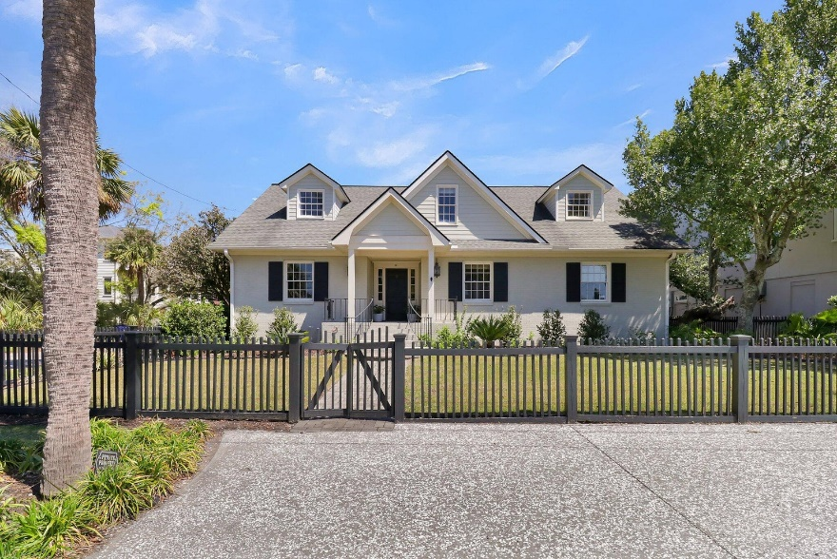
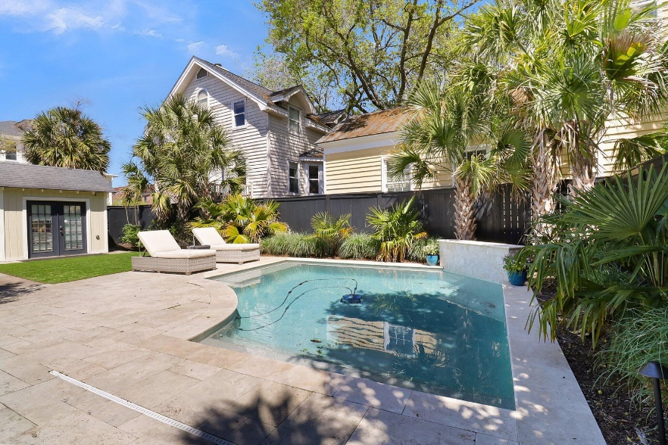
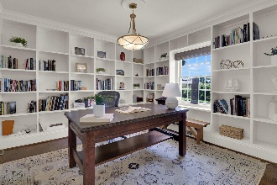
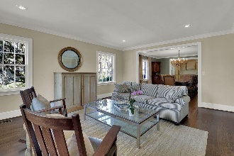
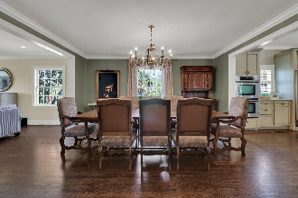
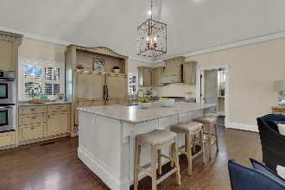
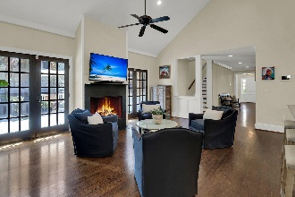

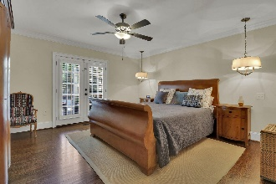
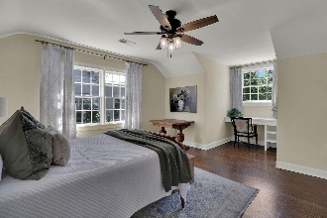
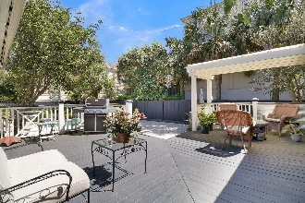
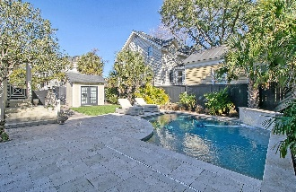
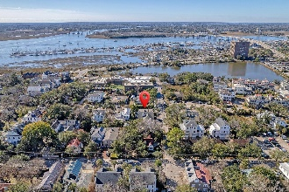
Open House Friday 5/17 ~ 4-5:30 $25K AGENT BONUS
For An Acceptable Contract By 5/27
Debbie Cromer
ABR, RSPS, REALTOR, CRS
(843) 437-6342
debbie@debbiecromer.com
www.debbiecromer.com
48 Barre Street
Harleston Village | Charleston, SC 29401 | MLS# 24001566 | $2,449,000
Must-See ~ Significant Price Reduction
The perfect home is now offered at the perfect price! Located at the corner of Barre & Bull Streets, this classic 1950s brick beauty stands moments away from Charleston's City Marina, South of Broad, & vibrant shopping & dining districts. Welcoming you, a beautifully fenced yard showcases mature, meticulously maintained landscaping. A private backyard oasis awaits, featuring a pool, spa, & extensive deck w/ landscape lighting, perfect for relaxation or entertainment. Inside, this home shines w/ a light-filled ambiance, accentuated by elegant hardwood flooring. The property features a thoughtfully designed layout, blending traditional charm w/ modern living. A sophisticated office space & a formal sitting room welcome guests, flowing seamlessly into the formal dining room.
The heart of the home, an expansive kitchen & family room, is bathed in natural light, courtesy of vaulted ceilings, a cozy gas log fireplace, and dual French doors that lead to an enchanting deck. The kitchen is equipped with a marble-topped island, high-end appliances & ample storage, making it a chef's delight. The first-floor primary suite offers serenity & direct deck access, complemented by a luxurious ensuite bathroom. A first-floor guest suite w/ full bath and powder room provide comfort for all. Upstairs, another primary suite with a full bath offers privacy, along w/ another bedroom, full bath & a serene study or playroom, ensuring ample space for relaxation and activities.
Notable features include a comprehensive security system, generous parking for 5 cars & proximity to Charleston's West Edge development & world class doctors at MUSC and Roper.
This exquisite Downtown Charleston property seamlessly combines timeless elegance with contemporary amenities, offering an unparalleled living experience. Don't miss the chance to make this magnificent residence yours.
Century 21 Properties Plus | 1090 Park West Blvd; Ste 103 | Mount Pleasant, SC 29466

