Slide 1
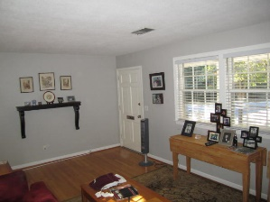
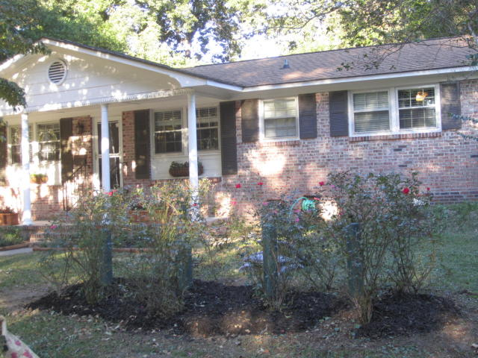
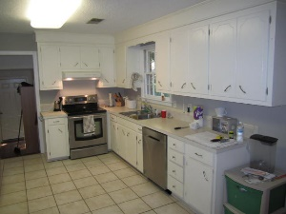
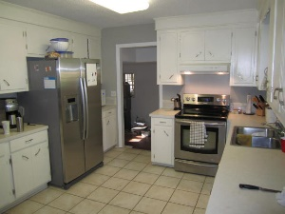
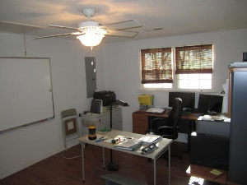
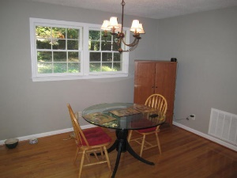
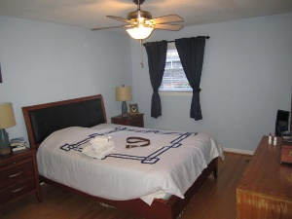
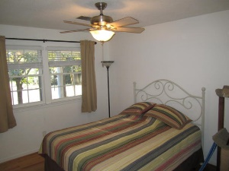
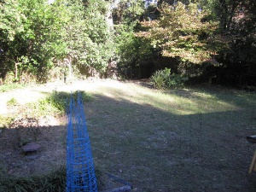
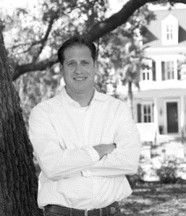

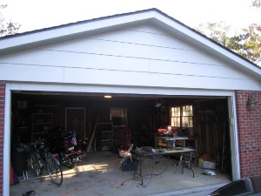
4901 Ashby Avenue Park Circle ~ North Charleston MLS# 15026841 ~ $245,000
Under Contract in 72 hours!!
Beautiful house and a great deal in the heart of Park Circle! This is an awesome neighborhood for anybody and there is no match for this central location. This is a must-see property that is well maintained. Let your imagination wander. When you preview this property, you may feel as if you don't want to leave! You will be impressed with the house and area. Gleaming hardwood floors as you enter the home. The kitchen is well appointed with a large eat in space. The living room is large and comfortable. The house has a converted garage that could be used as a den or office and there is an additional 2 car garage. The back yard has plenty of potential for additional exterior features. It is amazing how private and secluded the back yard feels. Roof and water heater was replaced in 2009 and a brand new 16 SEER HVAC was installed in Aug 2015. Kitchen totally repainted in Oct of this year. Kitchen also includes upgraded Stainless steel appliances to include a brand new stainless steel dishwasher.
John Chap
Mobile - (843) 901-1174
jchap@beresfordrealty.com
www.beresfordrealty.com
Beresford Realty, LLC | 672 Marina Dr, S-206B | Charleston, SC 29492

