Slide 1
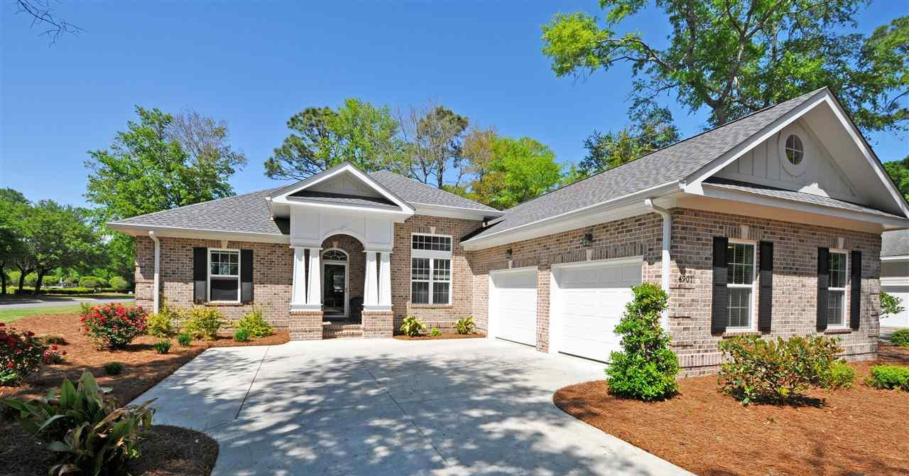
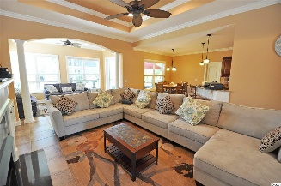
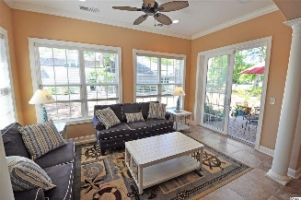
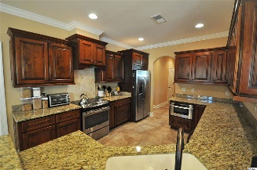
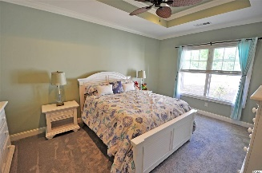
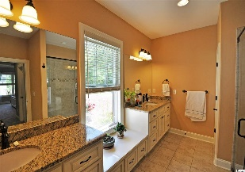
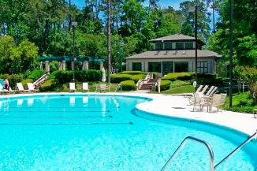
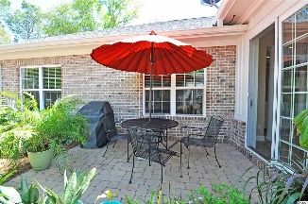
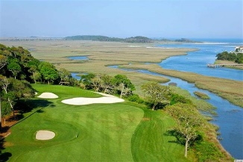
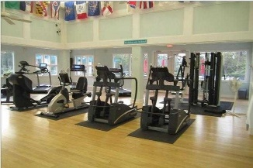
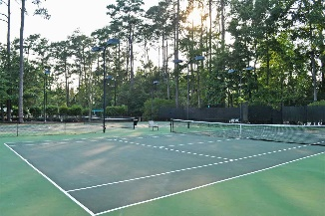
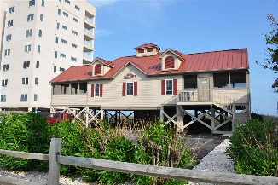


Luxury &Easy-living
Views Of Golf Course & Marsh
4901 Buck's Bluff Drive
Tidewater Plantation Resort ~ North Myrtle Beach ~ MLS# 1809351 ~ $379,900
This all-brick, one-level luxury traditional-styled house is set back on a corner lot, an easy stroll to the private Bluffs of Tidewater owners' pool, cabana and grilling area. There is also a charming turtle pond with viewing deck and bocce courts just across the street. The home itself is not only well located, it is inviting, from its manicured yard and extended driveway to its craftsman-inspired entry with architectural detail and columns. Of course, the porch is brick with room to sit and enjoy unique views and ocean breezes, as the deep corner lot is near the scenic Cherry Grove Marsh-front, with side views of the second hole of the world-class Tidewater Golf Course and the marsh from the front of the home. Listen for the ocean from the front yard! Inside, the impressive columns continue in the foyer and the formal dining room to the right. But it's the leaded-glass decorative door and interesting panoramic windows that capture the eye. The view goes from entry all the way to the backyard. In between is an entire wall of upscale custom shelving, cabinets, and a homey gas fireplace. A large tray ceiling with designer fan tops the welcoming great room which conjoins the comfortable Carolina room and extraordinary kitchen. The Carolina room has its own wall of windows and opens conveniently to the back brick patio, for grilling, dining and relaxing. There is a gas hook up for the grill. The backyard is lightly wooded, partially shaded and views the golf course. The kitchen dining area overlooks the patio as well. There is a wonderful breakfast bar in the kitchen, too, perfect, with an enormous amount of counter and custom-cabinet space and beautiful granite, gleaming stainless steel appliances and walk-in pantry. Appliances convey. The open space from entry to bedrooms is a popular neutral-color, over-sized ceramic tile floor. Compatible light fixtures, wider baseboard trim and crown molding, along with a beveled corner effect on walls and trim, create subtle sophistication. The fabulous master suite is to the left; extras include a tray ceiling, customized walk-in and linen closets and ensuite with stunning walk-in shower, his and her vanities, separate water closet and window seat, a true retreat! The two other big bedrooms are in a split bedroom plan, with a full bath, and lots of closet space. A side-load double-car garage is also to the right. There is a sink in the garage. A separate garage door to the yard leads to a brick privacy enclosure for trash bins and heat pump. The garage accommodates large vehicles and still has room for storage. A laundry room with plenty of cabinets and counter space is in the hall from the garage, conveniently leading to the kitchen. The washer and dryer convey. The spacious formal dining room off the kitchen looks out on the marsh and has dramatic window treatments for lots of light. This floor plan truly invites easy living with lots of style. Tidewater is a 24-hour, manned gated community on a tree-lined road to oceanfront Anne Tilghman Boyce Coastal Reserve, a nature conservancy. It is minutes from the beach, shopping, entertainment and access to major highways. The development has a private owners' beach cabana on the wide, white sands of the Cherry Grove Beach, just a few minutes drive. Tidewater amenities at low HOA fees include that oceanfront beach cabana. Bluffs residents enjoy the use of 3 pools/hot tubs. The pool in the Bluffs is, however, exclusive to its residents. Other amenities include driving range, putting green, golf shop, clubhouse with bar and dining overlooking the 18th hole, clay & hard-surface tennis courts, pickle ball, fitness center, bocce courts, amenity center/more. There is gated storage for boats, motorcycles campers, kayaks, RVs and the like. The HOA building is conveniently on site with library and event, meeting space. Tidewater Plantation in North Myrtle Beach reflects a special "way of life." This great newer home is an even greater value!
Deborah Collins
843-424-9013
dctidewater@yahoo.com
Connie Ross-Karl
702-306-2643
conniesross@aol.com
NEW WAY PROPERTIES MYRTLE BEACH

