Slide 1
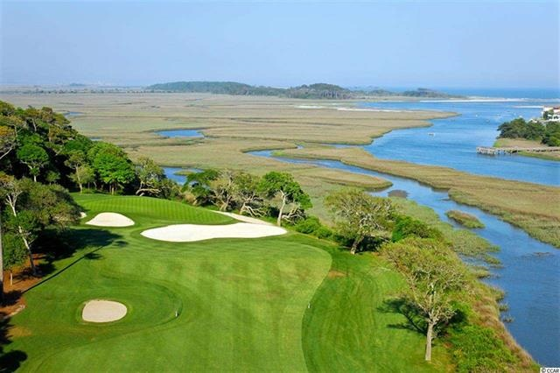
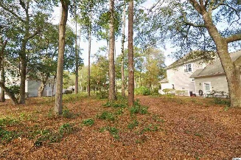
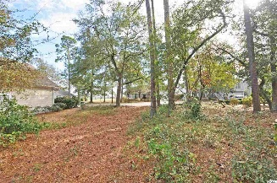
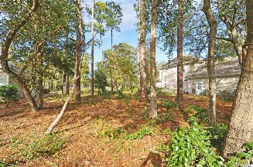
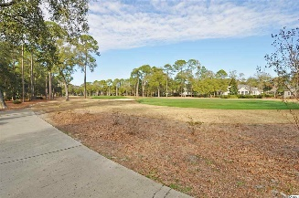
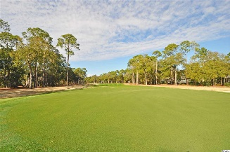
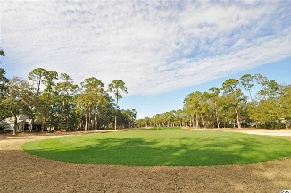
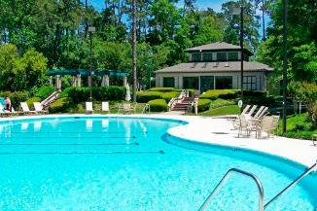
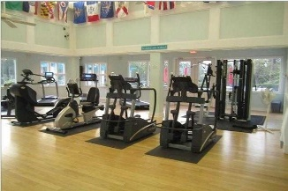
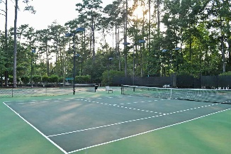
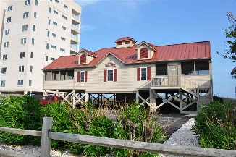


One And Only Tee To Green Full View
4905 Buck's Bluff Drive
Tidewater Plantation Resort
North Myrtle Beach
MLS# 1803698
$118,900
One and only TEE to GREEN full view, build-able lot now available in the prestigious Bluffs of world-class Tidewater Plantation Resort! This wonderful golf course property is more than rare...it looks straight up the expansive fairway of the impressive 2nd hole from the green, situated near the rear yard. The lightly wooded lot itself is also magnificently located across the street from the scenic Cherry Grove Marsh-front. The Bluffs of Tidewater borders the Cherry Grove Inlet where the Atlantic Ocean rolls into the marsh. The Bluffs are rapidly being built out as well; so this property is highly sought after for the builder, investor or soon-to-be home-owner who desire to acquire a luxury property at today's market prices to be built later. There is no deadline to build in Tidewater. Lot 519 has 68 feet of road frontage and is approximately 11,335 sq ft. Amenity-rich Tidewater is a 24-hour, manned gated community on a tree-lined road to oceanfront Anne Tilghman Boyce Coastal Reserve, a nature conservancy, including Waties Island, with access for managed recreational use. Tidewater itself is on an elevated peninsula of live oaks and southern pines between the Intracoatal Waterway and the Cherry Grove Inlet to the Atlantic Ocean. The plantation also preserves the unique look of its own historic origins. It is minutes from the beach, shopping, entertainment and access to major highways. The development has a private owners' beach cabana on the wide, white sands of the Cherry Grove Beach, just a few minutes drive. This lot enjoys that lovely, peaceful environment, along with the excellent reputation of the Tidewater Golf Course, the Pebble Beach of the East. Tidewater amenities at low HOA fees include that oceanfront beach cabana. Bluffs residents enjoy the use of 3 pools/hot tubs. The pool in the Bluffs is, however, exclusive to its residents. Other amenities include driving range, putting green, golf shop, clubhouse with bar and dining overlooking the 18th hole, clay & hard-surface tennis courts, pickle ball, fitness center, bocce courts, amenity center/more. There is even a gated storage yard for boats, campers, recreational vehicles and the like. The HOA building is conveniently on site with library and event, meeting space. Tidewater Plantation in popular North Myrtle Beach truly reflects a "way of life." Do not let this singular lot get away. Welcome to the the best of the beach on the golf course in the Bluffs of Tidewater Resort.
Deborah Collins
843-424-9013
dctidewater@yahoo.com
Connie Ross-Karl
702-306-2643
conniesross@aol.com
NEW WAY PROPERTIES MYRTLE BEACH

