Slide 1
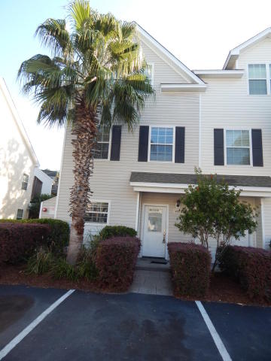
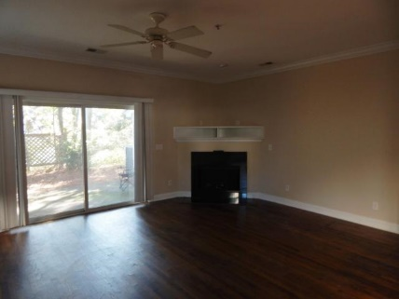
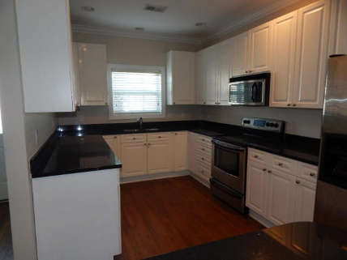
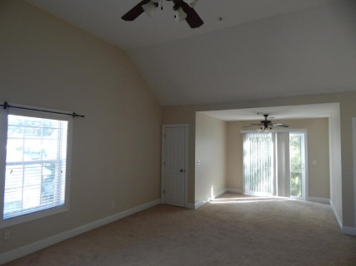
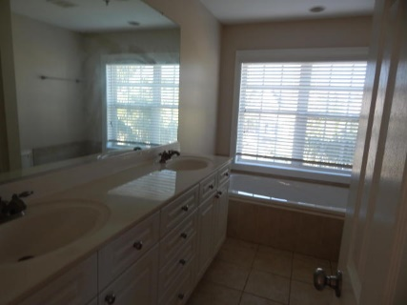
Fantastic Opportunity!
4912 Lake Palmetto Ln
Lake Palmetto
North Charleston, SC 29418
MLS# 17028665
$210,000
3 Bedroom | 2½ Baths
Big, beautiful 3-level townhome located in tranquil little corner of North Charleston that is convenient to everything! Freshly painted interior with main living area that features hardwood floors, corner fireplace, private patio overlooking small pond, open kitchen with black granite counters and stainless appliances. 2nd floor features two good-sized bedrooms, one with balcony, and large hall bath that has whirlpool tub and dual sinks. 3rd floor is huge master suite, with private balcony, vault ceiling, multiple closets, and lavish bath with another whirlpool tub. HOA covers exterior maintenance, and the townhome has two dedicated parking spaces. Lake access is directly across the parking lot.
Darlene Bollettino
Miler Properties
Office: 843-821-1111
Cell: 843-209-8955
dbollo84@yahoo.com
www.milerproperties.com

