Slide 1
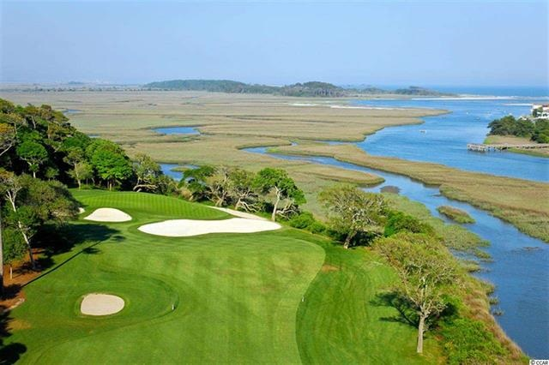
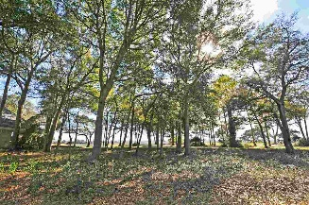
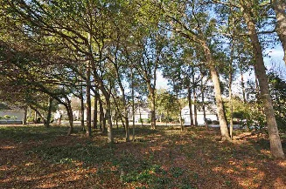
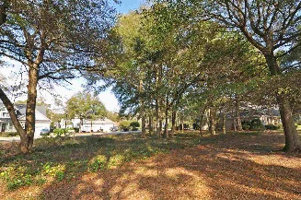
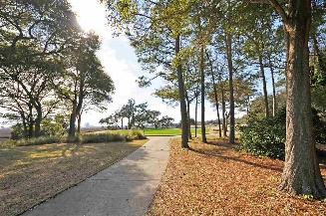
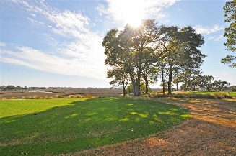
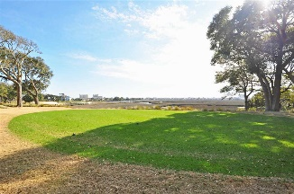
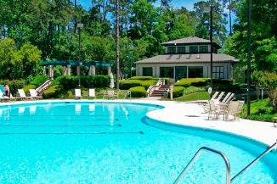
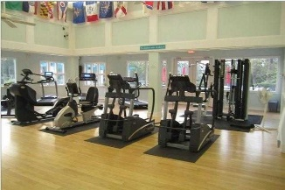
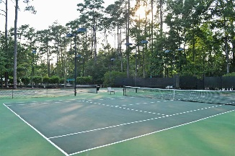
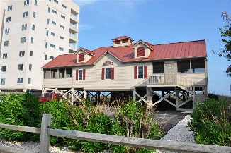


Premier Signature 13th Hole Marsh Front Lot
4914 Buck's Bluff Drive
Tidewater Plantation Resort
North Myrtle Beach
MLS# 1802615
$229,900
Premier marsh front-/panoramic-view lot in the beautiful Bluffs of Tidewater Plantation Resort. Good road frontage of 95' and overall size of 11,890.84 sq. ft. to build a dream home, with perfect location specifically selected to be out of the trajectory of golf balls. This luxury lot also boasts some of the most stunning scenery in the area of top-rated Tidewater Golf Course, the marsh and the Cherry Grove Inlet. The 13th hole, on which it is well situated, is often referred to as the "signature hole" in Tidewater, with the most must-see inclusive Cinerama scenery, just breathtaking! RARE OFFERING for a discriminating builder, investor or home buyer. No time frame to build. Amenity-rich Tidewater is a 24-hour, manned gated community on a tree-lined road to oceanfront Anne Tilghman Boyce Coastal Reserve, a nature conservancy, including Waties Island, with access for managed recreational use. Tidewater itself is on an elevated peninsula of live oaks and southern pines between the Intracoatal Waterway and the Cherry Grove Inlet to the Atlantic Ocean. The plantation also preserves the unique look of its own historic origins. It is minutes from the beach, shopping, entertainment and access to major highways. The development has a private owners' beach cabana on the wide, white sands of the Cherry Grove Beach. This lot enjoys that pristine environment, along with the world-class reputation of the Tidewater Golf Course, the Pebble Beach of the East. Tidewater amenities at low HOA fees include that oceanfront beach cabana. Bluffs residents enjoy the use of 3 pools/hot tubs. The pool in the Bluffs is, however, exclusive to its residents. Other amenities include driving range, putting green, golf shop, clubhouse with bar and dining overlooking the 18th hole, clay & hard-surface tennis courts, pickle ball, fitness center, bocce courts, amenity center/more. There is even a gated storage yard for boats, campers, recreational vehicles and the like. HOA building conveniently on site with library and event, meeting space. Singular Tidewater Plantation truly reflects a wonderful "way of life." Welcome to the Beach!
Deborah Collins
843-424-9013
dctidewater@yahoo.com
Connie Ross-Karl
702-306-2643
conniesross@aol.com
NEW WAY PROPERTIES MYRTLE BEACH

