Slide 1
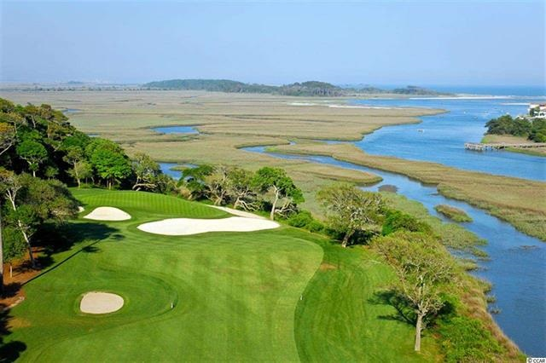
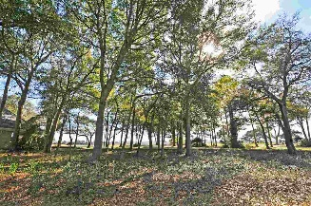
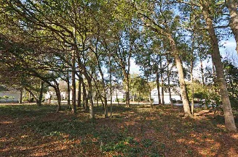
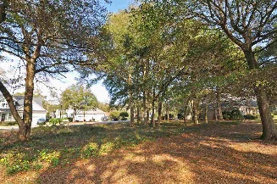
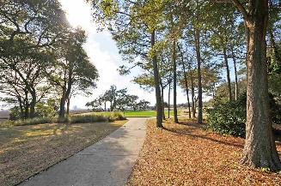
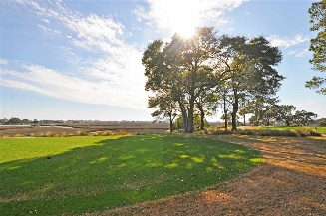
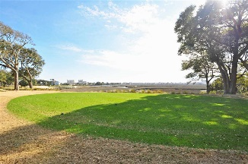
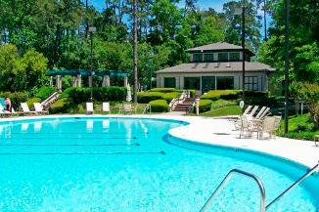
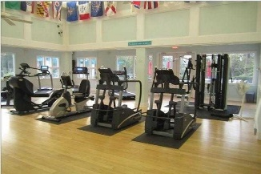
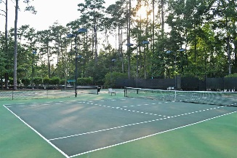
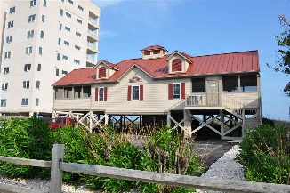


Premier Signature 13th Hole Marsh Front Lot
4914 Buck's Bluff Drive
Tidewater Plantation Resort
North Myrtle Beach
MLS# 1603141
$234,900
Premier marsh front-/panoramic-view lot in the beautiful bluffs of Tidewater Plantation Resort. Good road frontage of 95' and overall size of 11,890.84 sq. ft. to build a dream home, and location specifically selected to be out of the trajectory of golf balls. Location also boasts some of the most stunning scenery in the area of the world-class tidewater golf course, the marsh and the cherry grove inlet. The 13th hole is often referred to as the "signature hole" in Tidewater with the most inclusive cinerama scenery, breathtaking! RARE OFFERING for a discriminating builder or home buyer. Tidewater Plantation golf course is one of the top-rated golf courses in the US, referred to as the Pebble Beach of the east. Tidewater offers 24-hour, manned gated security and large, gated storage yard with security for boats, motorcycles, campers, jet skis and more. Other upscale Tidewater amenities include private, oceanfront beach cabana featuring open/screened porches, kitchen, showers and bathrooms. Enjoy the driving range, golf shop and clubhouse with bar and dining facilities overlooking the 18th hole. Additional amenities include clay and hard surface tennis courts, bocce courts, exercise facility overlooking pool. Group work out classes and water aerobics. Amenity center is adjacent to owners' pool for private/public functions. Active recreation committee sponsors outdoor summer concert series, parties, happy hours, dinners at private homes, bridge, mahjong, book clubs and holiday events plus more! You can do it all or nothing at all and appreciate everything Tidewater Resort has to recommend it. Wonderful, friendly neighbors will welcome you to your new home on this dream lot.
Deborah Collins
843-424-9013
dctidewater@yahoo.com
Connie Ross-Karl
702-306-2643
conniesross@aol.com
NEW WAY PROPERTIES MYRTLE BEACH

