Slide 1
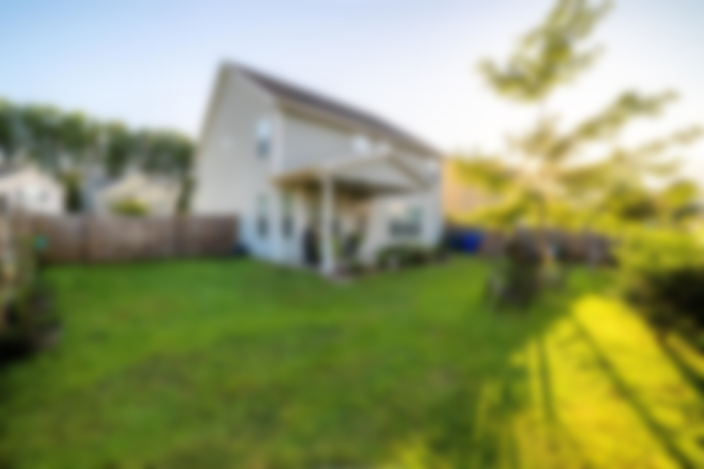
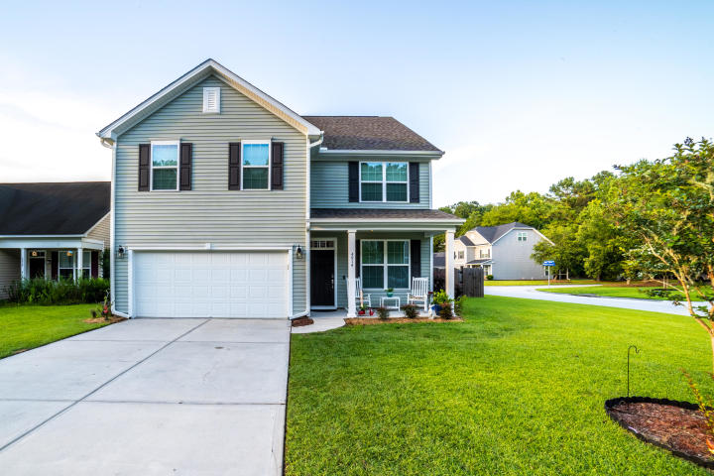
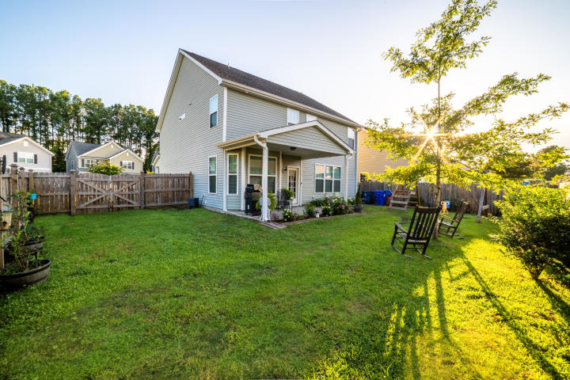
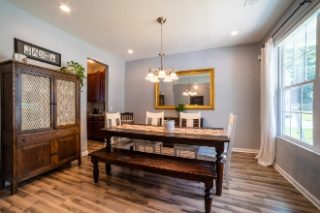
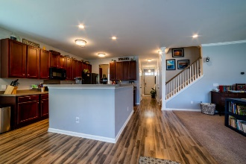
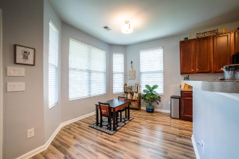
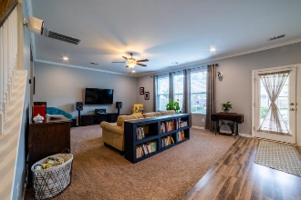
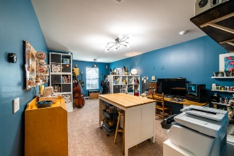
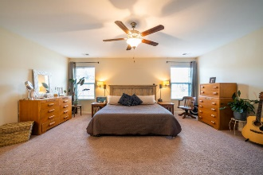
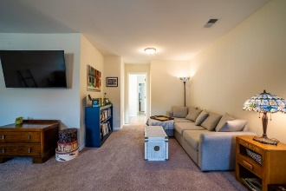
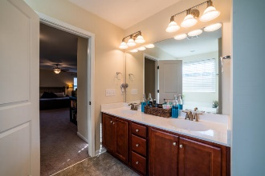
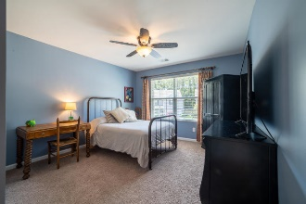
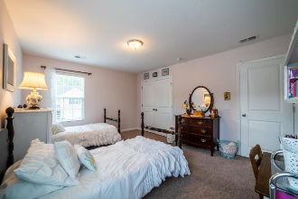


Immaculate Home On Corner Lot With Spacious Open Floor Plan
4914 Serene Lane
Deer Field Hall • Hollywood, SC 29449 • MLS# 20017547 • $316,500
Immaculate home on corner lot with spacious open floor plan. 3 bedrooms 2.5 baths formal dining room/flex room, kitchen boasts lots of cabinets and counter space plus extra storage in butlers pantry. Relax under the covered patio that leads to large privacy fenced yard. The large owner suite is upstairs and has an ensuite bathroom with double sinks, garden tub and separate shower and a large walk in closet. Upstairs also has 2 more bedrooms, full bath with double sink vanity, laundry and a flex space that would be a perfect game/play/office room. Ring door bell and other security do not convey.
Christina Garvin
(843) 270-7667 | cgarvin63@gmail.com
Elaine Brabham and Associates, LLC • 1890 Sam Rittenberg Boulevard, Suite 217 • Charleston, SC 29407

