Slide 1
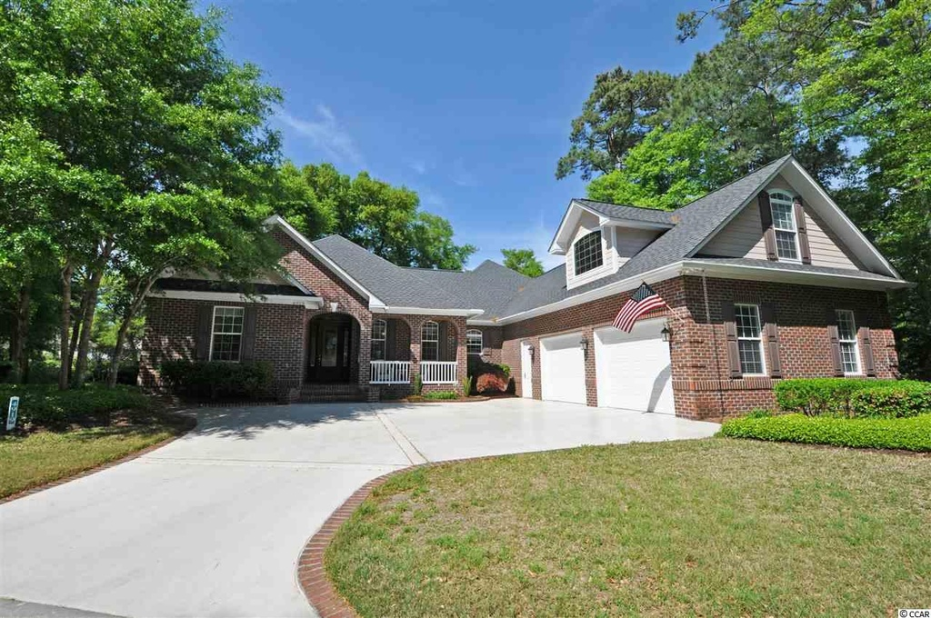
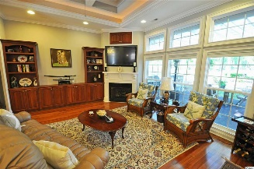
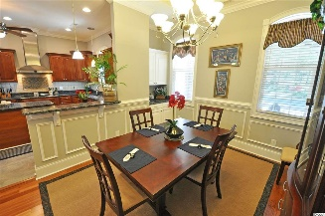
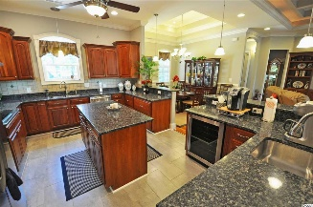
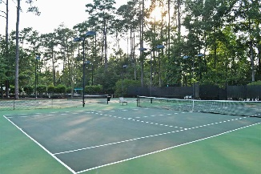
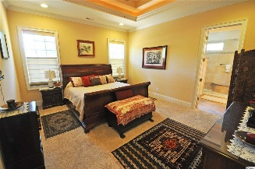
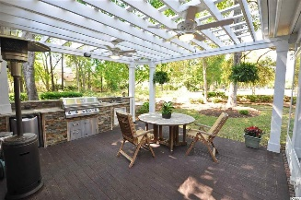
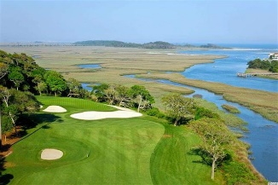
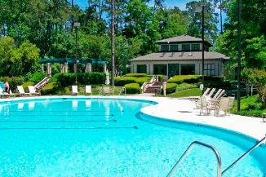
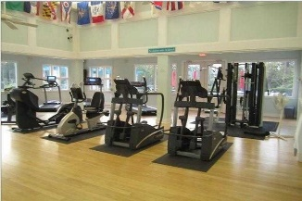
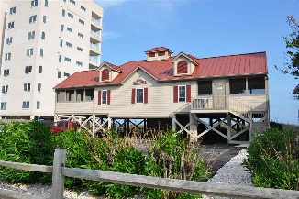


4919 Buck's Bluff Drive
Tidewater Plantation Resort
North Myrtle Beach
MLS# 1608663
$569,900
Grand All-brick Luxurious Smart Home On 11th Hole
Upgraded And Fully Handicap Accessible
Stroll through the marriage of the Colonial Coast with the Best of the Beach. This extraordinary all-brick home presents the substance of a house that blends rich historic detail with the ease and comfort of modern beach living. Casual elegance, for example, is carried out with the warmth of an external brick wall in the Carolina Room and the recognizable Williamsburg-inspired design elements on the beautiful window trim of the formal dining area with dry bar. Hurricane-impact windows are throughout. This flexible 4 bedroom, 4 1/2-bath grand, custom-built home consistently blends thoughtful, planned architectural design and convenience with tasteful décor and every imaginable upgrade, making your tour memorable and lingering. Across the street from the Cherry Grove marsh, the house is nestled on a lightly wooded lot with a wonderful, panoramic view from the green of the 11th hole of world-class Tidewater Golf Course. Easy indoor/outdoor living is enhanced with a splendid outdoor kitchen featuring a 6-burner grill. True Green is on an annual lawn maintenance program. Enter from the front through the lovely marble/granite foyer presenting an immediate full scope of the infinity open-concept floor plan. The great room boasts a coffered ceiling and build-in bookcases and cabinets. There are two fireplaces in the house, one with remote. The luxurious kitchen offers a warming drawer, touchless faucet, two garbage disposals and additional wine as well as beer and soda refrigerators. Of course, it has all stainless steel appliances and high-end floors and finishes. Breathtaking! The large master bedroom has two walk-in closets. Guest rooms are designed in a split-bedroom-bath suite, with handicap accessible features and all on the first floor. One of the 4 bedrooms is currently used as an office. There is a big bonus room, too. There are ceiling fans in all the rooms, with remote. Comfort abounds. The over-sized garage is a 2.5-car garage with workshop area and epoxy floor. This is a Smart House -- fire alarm, keyless entry automation, separate irrigation meter for water conservation, re-circulator on hot water heater and more. This unique home is impeccable and a rare find at a compelling price. Linger there awhile on your personal tour and make sure you acquaint yourself with the many amenities of Tidewater Plantation Resort that come with your home ownership. Tidewater Plantation is one of the top rated golf courses on the Grand Strand -- with 24 hour gated, manned security. Tidewater amenities include an oceanfront beach cabana for owners' use with open/screened porches, bathrooms, showers and kitchen. Residents of The Bluffs enjoy the use of 3 pools/hot tubs - one of which is specific only to Bluffs residents. Other amenities include a driving range, golf shop, clubhouse with bar and dining facilities overlooking the 18th hole, clay and hard surface tennis courts, pickle ball court, fitness center overlooking a pool, bocce courts and amenity center for public/private events. Other group activities include an outdoor summer concert series, workout classes including water aerobics, weekly art classes, Happy Hours, dinner clubs, book clubs, bridge club, mahjong and holiday events plus more! In addition, Tidewater boasts a gated storage yard for boats, jet skis, motorcycles and kayaks. Tidewater Plantation and its full range of amenities truly reflects a "way of life" where friendly neighbors will welcome you to your new home.
Deborah Collins
843-424-9013
dctidewater@yahoo.com
Connie Ross-Karl
702-306-2643
conniesross@aol.com
NEW WAY PROPERTIES MYRTLE BEACH

