Slide 1
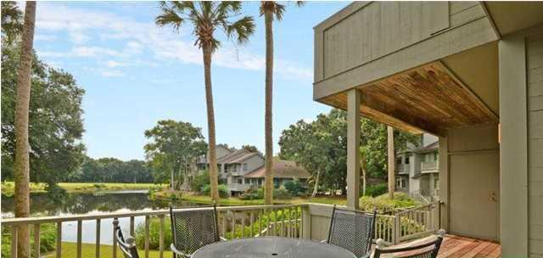
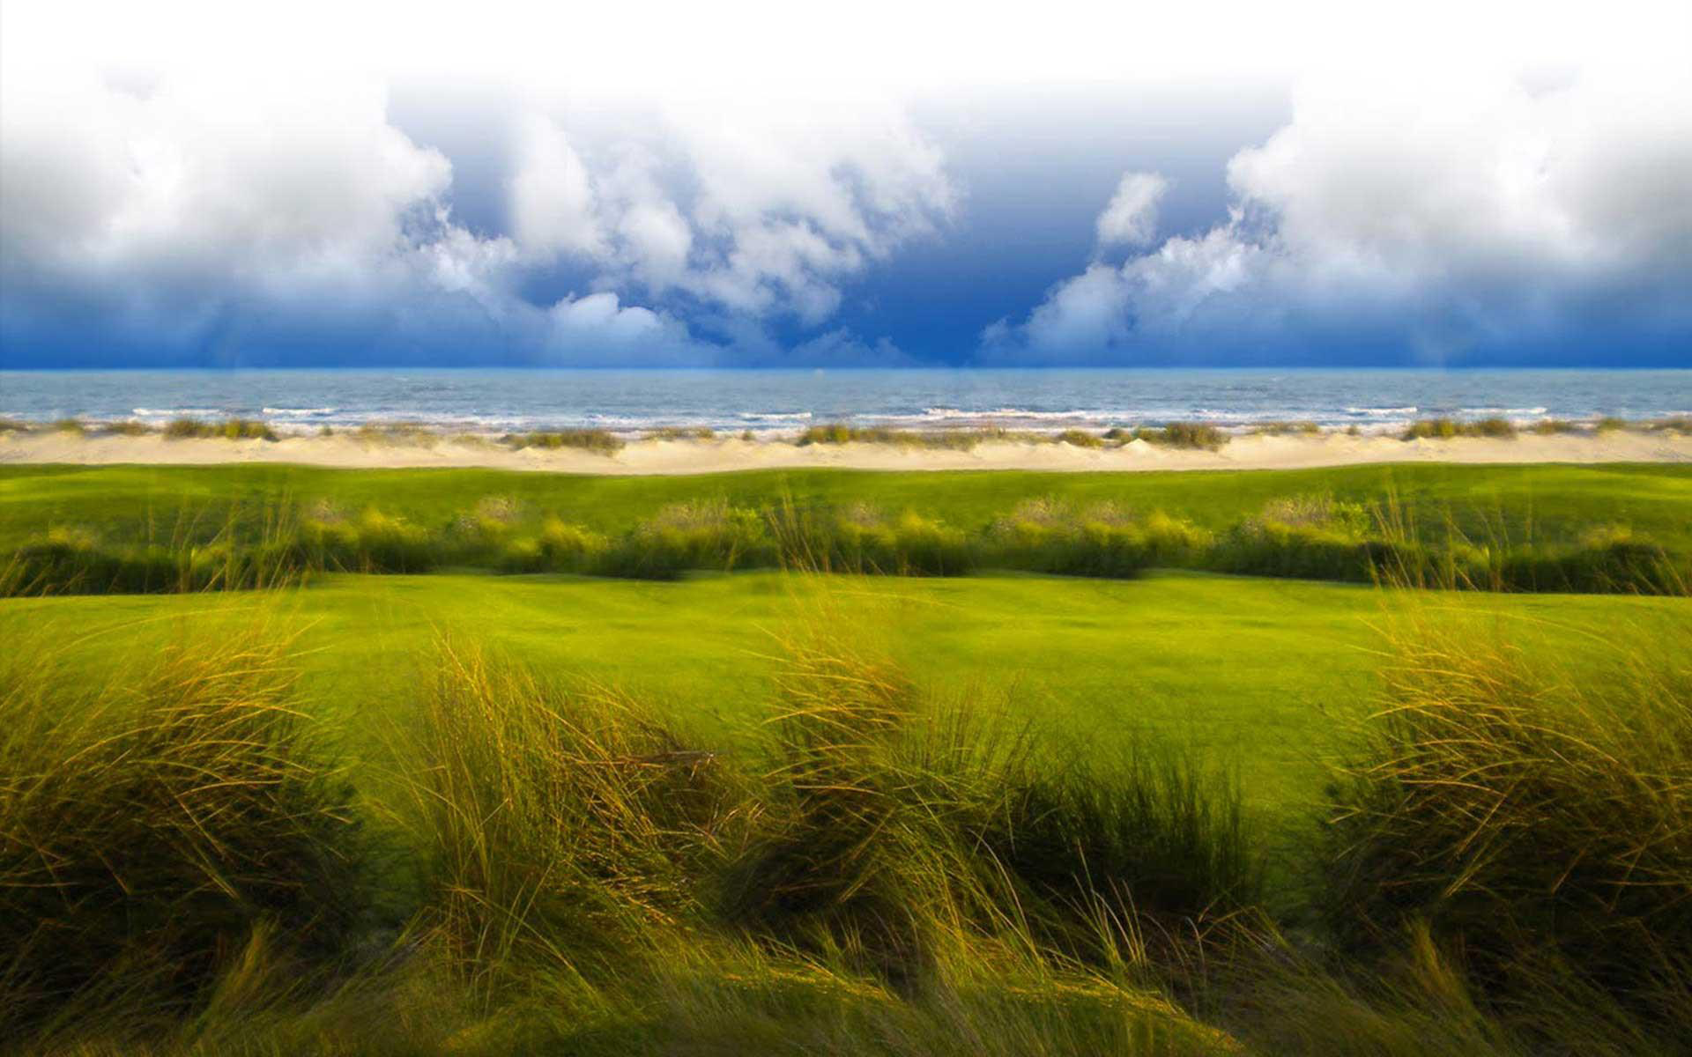
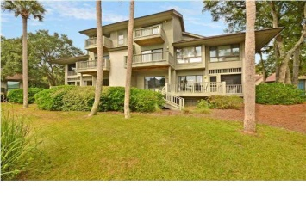
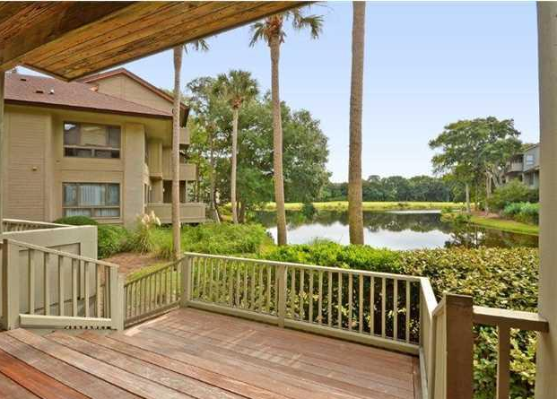
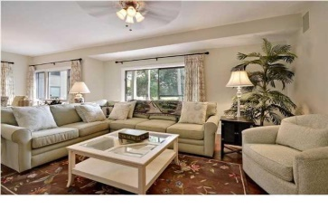
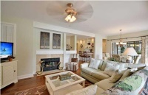
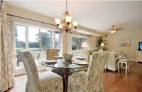
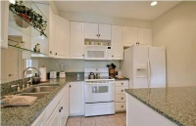
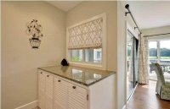
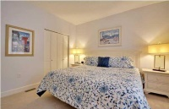
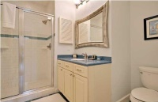
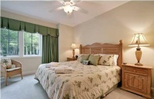
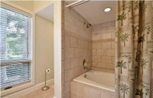
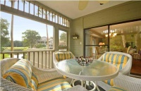


4919 Green Dolphin Way
Kiawah Island, SC
MLS# 1425920 ~ $595,000
Turtle Point Villa Turn-Key Unit Ready to Rent!
This beautiful first level 2 bedroom 2 bath villa offers a recent remodel and amazing lagoon views.
Villa was fully remodeled to accommodate modern yet comfortable tastes.
Open floor plan, large screen porch, sun deck overlooking lagoon.
All upscale furnishings are being sold with unit so this is truly a turn-key investment!
Listed Exclusively by
Christina Bucci
843-830-0888 Cell
christina@sweetgrassps.com
RE/MAX Elite | Sweetgrass Properties, 91A Broad St, Charleston, SC 29401

