Slide 1
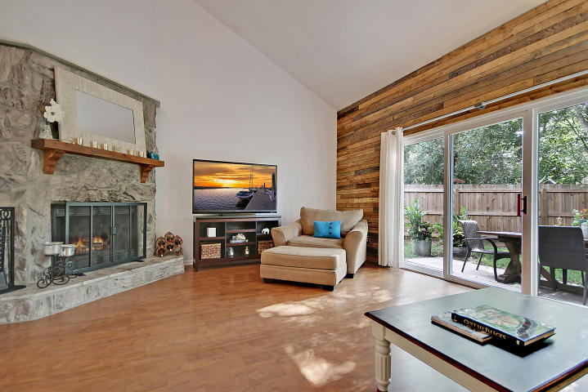
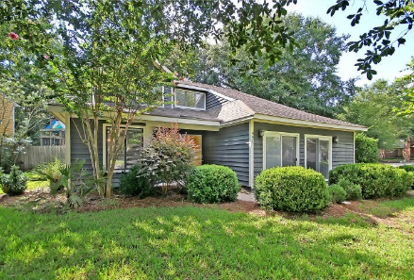
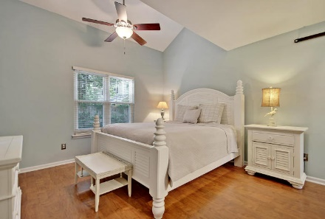
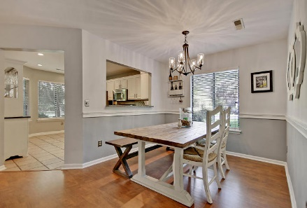
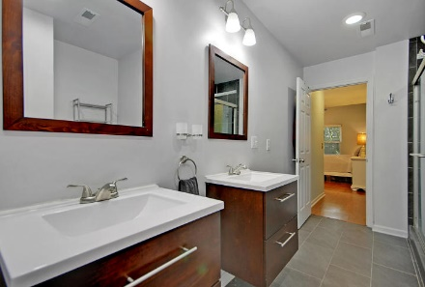
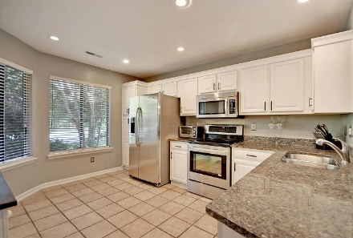
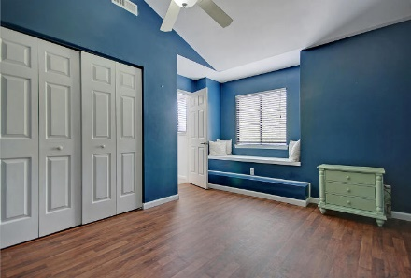
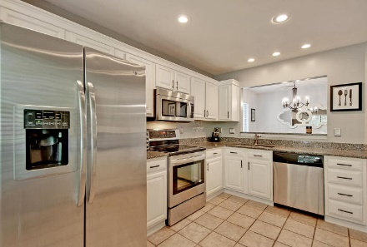
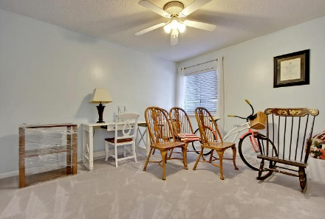
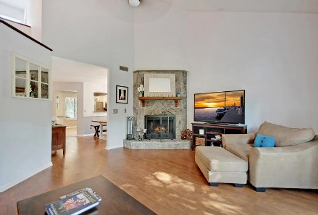
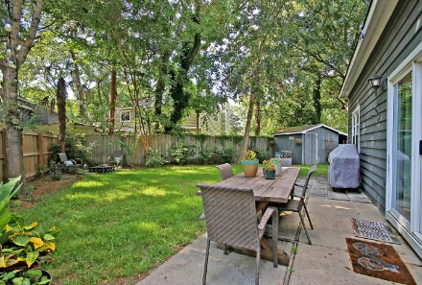

Price Reduced!
Price Reduced
For Quick Sale
Open House Saturday 12-3
491 Mount Royall Drive
Longpoint ~ Mount Pleasant, SC 29464 ~ MLS# 18022947 ~ $399,000
Situated on a wooded, corner lot in Mount Pleasant's Longpoint community, this contemporary style home is set to impress. The heart of this home is definitely the living room with its vaulted ceiling, wood, ship lap walls and wood burning fireplace. Another great living space that you'll gravitate towards is the sunroom which is a spacious bonus area could function as a media room, play room or whatever space you may need! The eat-in kitchen features SS appliances, granite counters and a look out over the sink into the dining area with its chair rail molding. The first floor master has two walk-in closets, a beautiful barn door and an end-suite full bath with dual vanity and walk-in shower. The fenced-in backyard has a storage shed and a patio area that's great for enjoying the outdoors!
Additional features include:
Community includes a clubhouse, pool, playground, tennis courts, soccer field, basketball court and volleyball court
Palmetto Island Park is just down the road
3 Bed/2½ Bath
2,157 square feet
Book your showing soon!
Katie Wishneff kwishneff@mattoneillteam.com 843-870-8784

