Slide 1
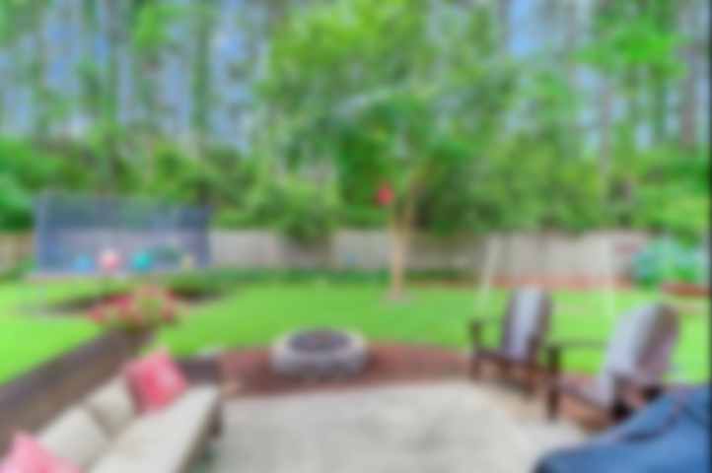
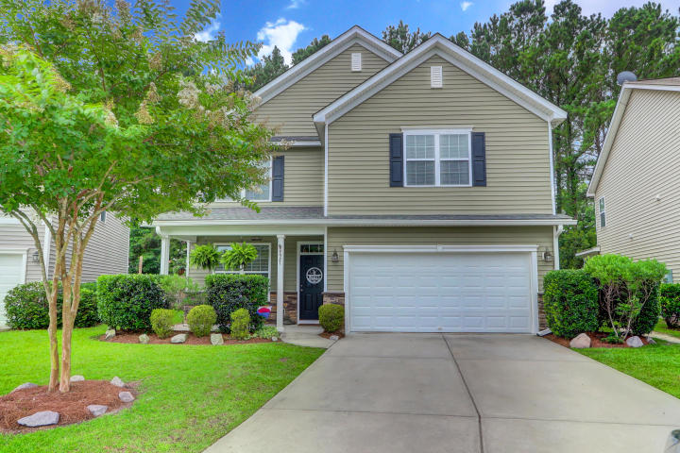
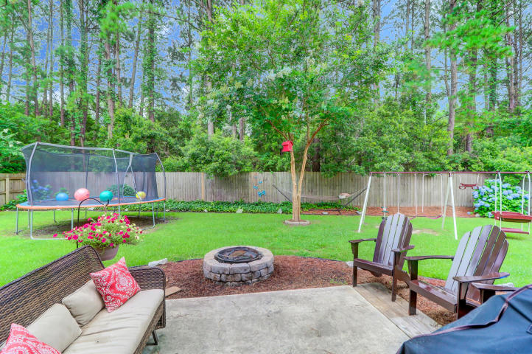
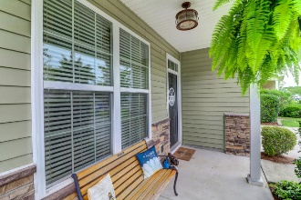
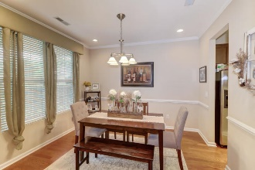
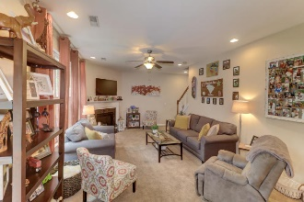
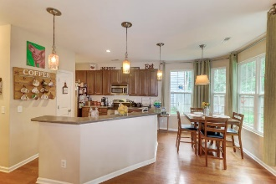
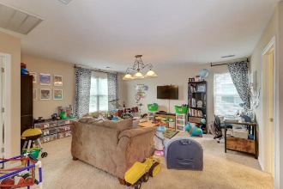
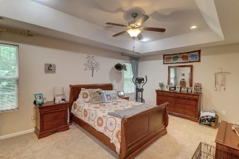
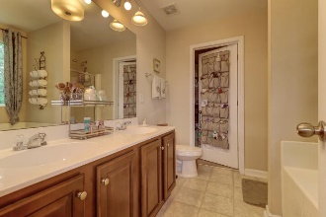
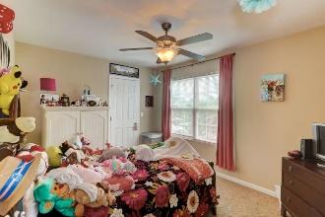
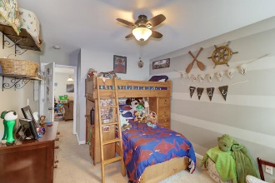
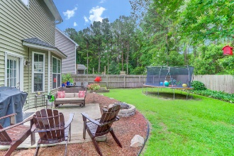


Nestled On One Of The Largest Lots In The Neighborhood
4921 Serene Lane
Deer Field Hall • Hollywood, SC 29449 • MLS# 20016199 • $299,999
Come see this beautiful, well-maintained home, nestled on one of the largest lots in the neighborhood. The open floor plan has many upgrades. Corian countertops in the kitchen Raised panel maple cabinets, Stainless Steel Range and Dishwasher. The bay window in the kitchen offers a beautiful view to the large fenced in backyard, where there is lots of room to play! Upstairs you will find a huge loft area for an office or playroom or both! All bedrooms have walk in closets. The large master bedroom is complete with a master bath and large walk in master closet. Master bath has dual vanity, separate shower and soaker tub and tile flooring. Deer Field Hall neighborhood only 5 minutes from bustling West Ashley shopping and 20 minutes from Downtown Charleston and the beaches.
Christina Garvin
(843) 270-7667 | cgarvin63@gmail.com
Elaine Brabham and Associates, LLC • 1890 Sam Rittenberg Boulevard, Suite 217 • Charleston, SC 29407

