Slide 1
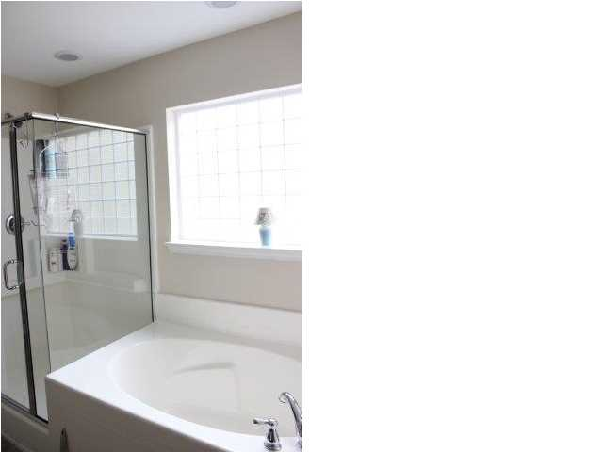
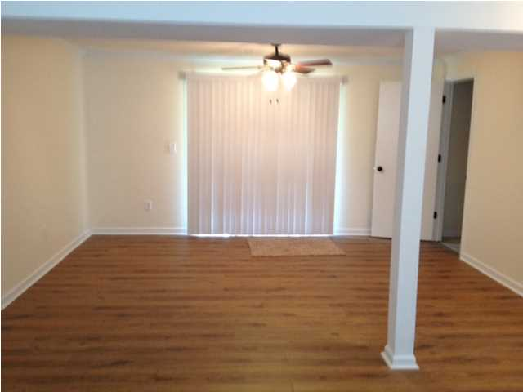
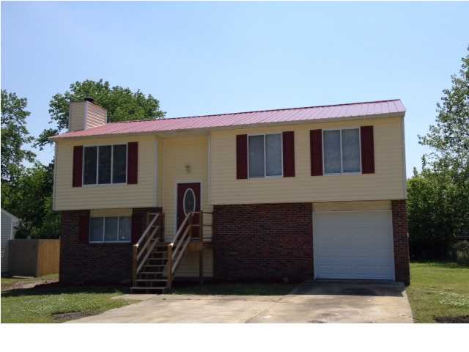
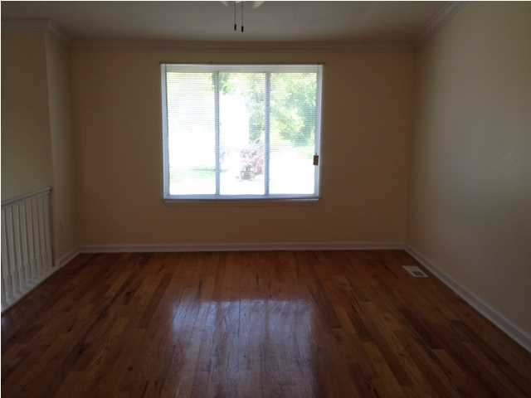
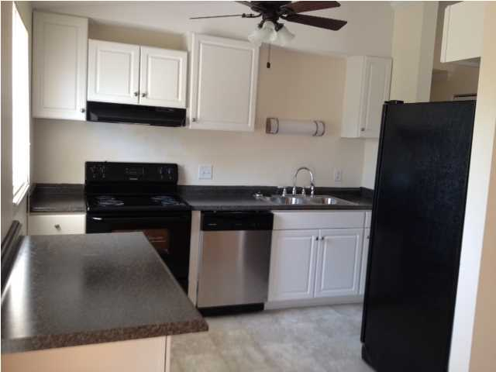
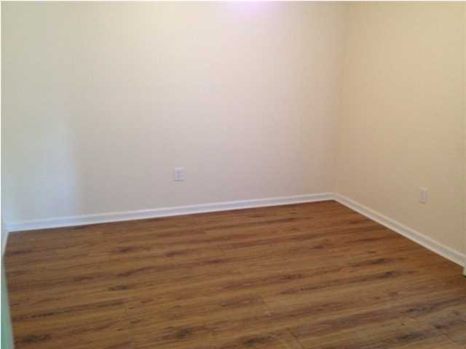
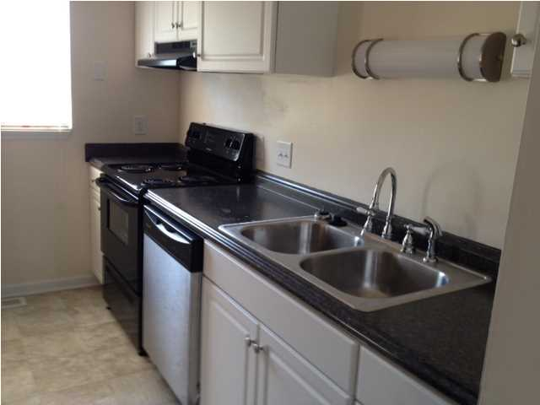
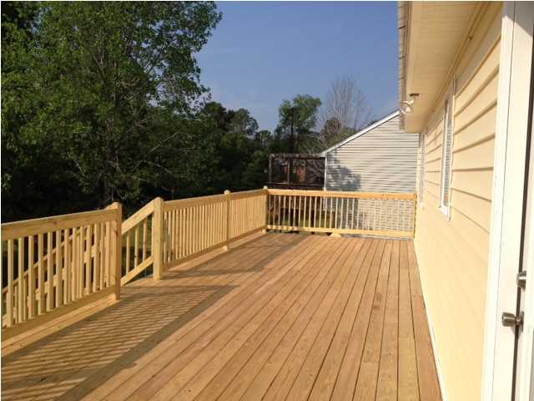
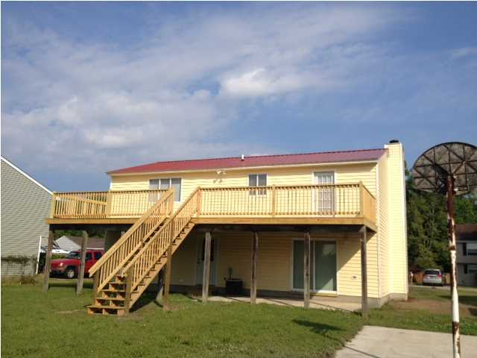
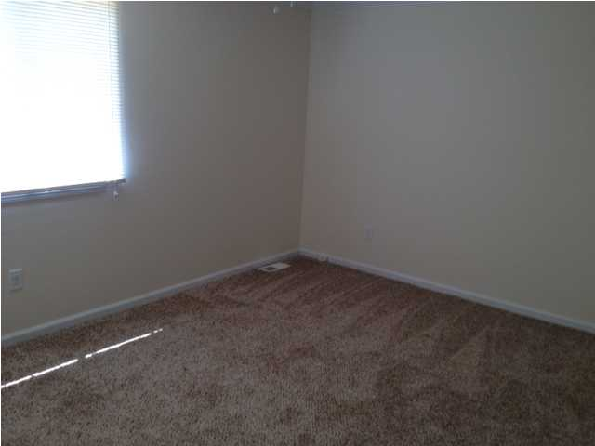


Updated Home With Master Suite
4921 Sierra Ct
Amberwood
N Charleston
MLS# 1411211 ~ $147,000
Updated home on cul-de-sac. Home has Master suite downstairs with sitting area which has a fireplace and newly added master bath with shower and sliding door to the backyard. Updates include New metal roof, garage door, siding, appliances, lighting and ceiling fans, front steps, large deck and much more. Home has an office/den area and large laundry room. This home has a large deck great for entertaining with family and friends and backyard has basketball goal and is partially fenced. Home has easy access to Boeing and Air Force Base.
Joanie Rhoten
Office: 843-261-7166
Mobile: 513-518-7475
joanie.rhoten@agentownedrealty.com
www.agentownedmainst.com
AgentOwned Realty Co. Premier Group | 141 A N. Main Street | Summerville, SC 29483

