Slide 1
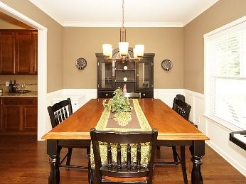
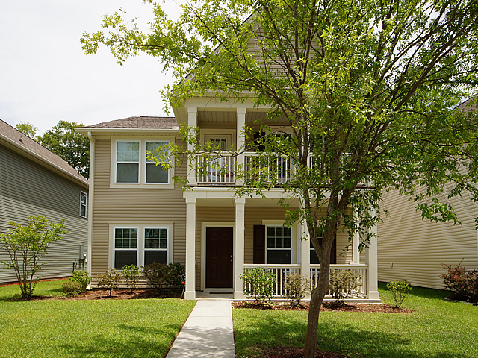
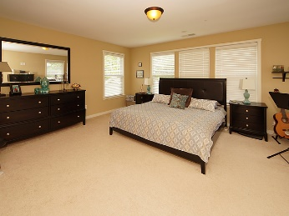
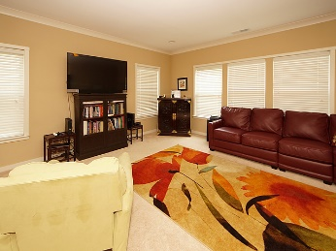
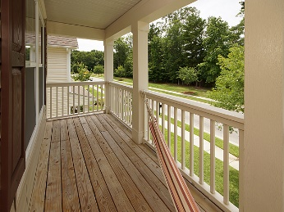
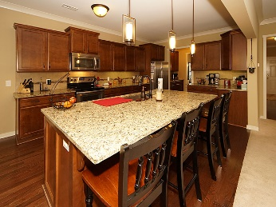
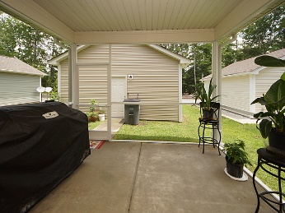
Open House Saturday June 10th from 11:00-2:00
4932 Ballantine Drive
Wescott Plantation ~ Summerville, SC 29485
MLS# 17015307 ~ $284,000
Are you looking for a home with a great kitchen for entertaining? You found it, this home features a large granite island and tons of cabinet space. Just off the kitchen is the elegant butlers pantry. Built in 2013 by True Homes, 4932 Ballantine has a detached rear entry 2 car garage and an additional 2 parking spaces. The first floor includes a large screened porch, open family room, separate dining room and a study (currently being used as a bedroom). Upstairs are 3 nice sized bedrooms, laundry room and a huge master suite. Enjoy the double front porches on nice evenings. Schedule your showings now!
Mike Goldston, Realtor
mikesellscharleston@gmail.com | 843-343-7026 | www.cometocharlestonsc.com
Brand Name Real Estate | 4 Carriage Lane, Suite 106 | Charleston, SC 29407

