Slide 1
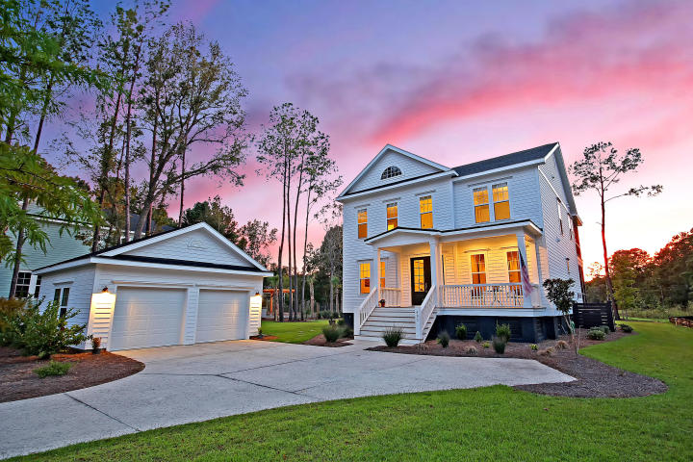

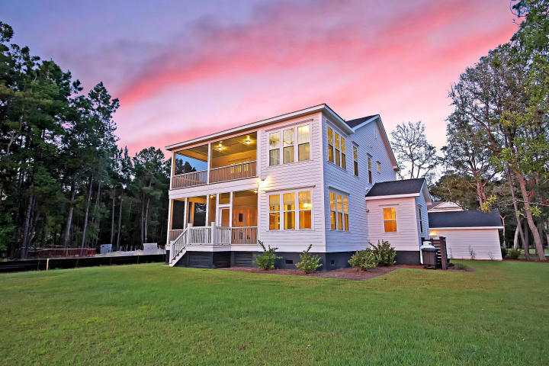
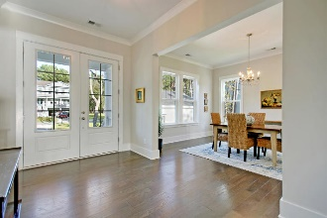
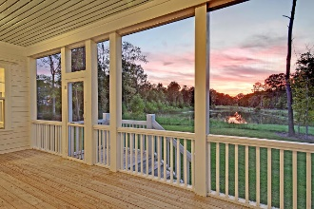
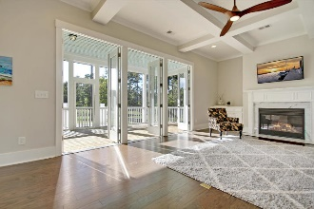
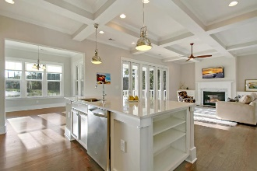
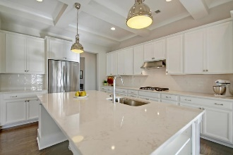
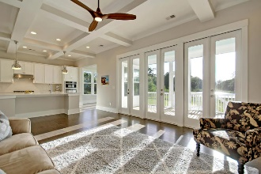
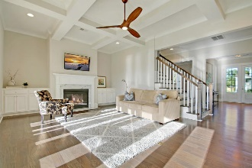
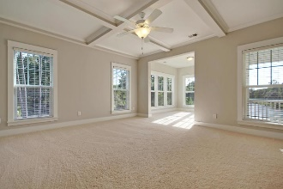
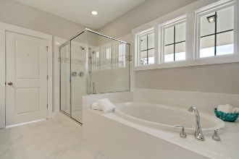
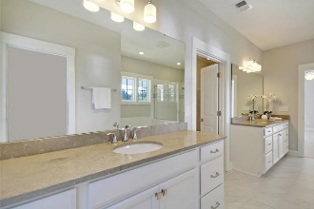
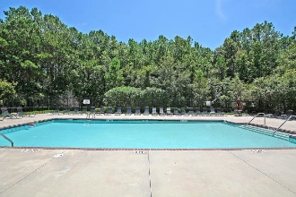

Fabulous New Listing Under $600k
Recent $10,000 Price Drop
493 Woodspring Road
Darrell Creek ~ Mount Pleasant, SC 29466 ~ MLS# 18027209 ~ $599,900
Looking for a Mt. Pleasant home with the look and feel of new construction on a spacious lot with a water view at a price that's affordable? Situated on nearly .5 acres with a panoramic lake view and priced over $200,000 less than new construction homes on comparable lots, this barely-lived-in stunner, bursting with custom upgrades and luxury finishes, is a rare find of unmistakable value. Coffered ceilings, Cambria quartz counters, stainless appliances, high-end light fixtures and fans, gorgeous wood flooring, bright and open living spaces, soaring ceilings, and two huge screened porches are just a few features that impress. Come experience breathtaking sunsets over the lake and the sights and sounds of lowcountry wildlife for yourself in this gorgeous home that is better than new!
Additional details include:
Highly-functional and flexible floor plan features open-concept living with loads of natural light and ample storage. The main floor features formal dining, a huge gourmet kitchen, a family room and breakfast room open to the kitchen with access to the huge downstairs screened porch, a bedroom/study/playroom, a half bath, and an office with a separate valet entrance. Upstairs features the master suite with a private screened porch, the laundry, and two other bedrooms with ensuite baths and walk-in closets.
Gourmet kitchen features Cambria quartz counters, sky-high upgraded cabinetry, stainless appliances, a gas range with a range hood, a stacked microwave and convection oven combo., coffered ceilings, TONS of cabinet storage and counter prep space, and a huge center island with a breakfast bar, custom pendant lighting overhead, and bookshelves at either side.
Master suite features fantastic coffered ceilings, a large sitting room with lake views and access to the private and very spacious upstairs screened porch, a HUGE walk-in closet, and an ensuite bath featuring a large shower with tile surround, a large soaking tub, a separate water closet, and two oversized vanities with ample storage space.
Gorgeous family room open to kitchen features a gas fireplace, built-ins, a high-quality and unique wood fan, views of the lovely lake, and a wall of doors leading to the giant screened porch, all of which can be opened along with the lovely double front doors to create a wonderful cross breeze.
Need a bedroom suite downstairs? There's plenty of space to combine the downstairs bedroom with the half-bath and create a guest suite on the main floor. Need a private office area for your home business where clients can come and go without interrupting your family? The valet entrance to the office wing makes it simple, just add a door to close off the office space from the main living area. Need a playroom, a media room, a game room, a craft room, etc.? Just take your pick from the downstairs bedroom, the breakfast room, or the office. Lots and lots of options!!
Darrell Creek is a community well-regarded for its natural beauty and features a neighborhood pool, a crabbing dock, several picturesque ponds, a cabana, and HOA fees less than $500 a year, which are among the most-reasonable in town.
Home is located within 10 minutes from Wando High School and Center for Advanced Studies, Oceanside Academy, Cario Middle School, Carolina Park Elementary School, Roper St. Francis Mt. Pleasant Hospital, the new Costco, the new Lowe's, the upcoming 40,000 sq. ft. public library, tons of restaurants and shopping destinations in North Mt. Pleasant, and the Paradise Island Public Boat Landing!! Plus, Isle of Palms Beach and Mt. Pleasant Town Centre are less than 20 minutes away, Sullivan's Island Beach and the Ravenel Bridge to downtown Charleston are 25 minutes away, and the Charleston International Airport is only 30 minutes away. The location is convenient to anything and everything you need!
Highly energy-efficient home with an average electric bill of $167 a month.
Flood insurance only $391 a year.
Home and appliances still under warranty!
Julie Nims julie@mattoneillteam.com 843-580-6310

