Slide 1
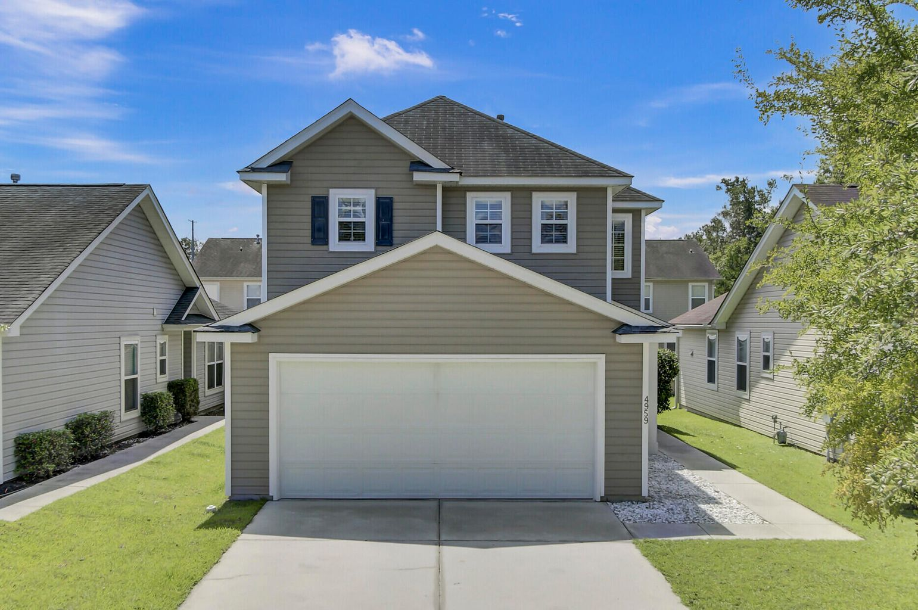
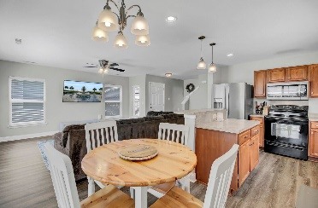
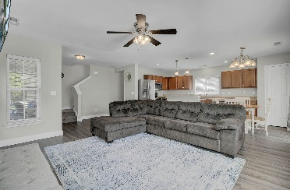
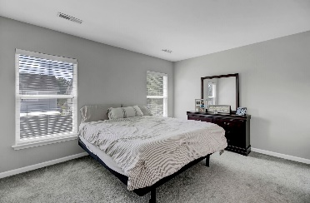
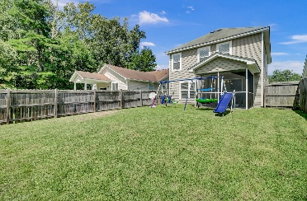
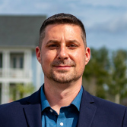


4959 Trump Street North Charleston, SC 29420 | MLS# 22023590 | $325,000
Charleston Park in Dorchester County
This home is in a great location, close to everything, and in the Dorchester County school district! The floor plan is open, perfect for entertaining or just spending time with your loved ones! It has waterproof luxury vinyl plank throughout the first floor, an enormous kitchen with counter space for days and an island! The powder room is hidden away from everything for privacy. There's also a huge storage closet under the staircase. Upstairs, you'll find a large landing with space for a drop station, kids' toy storage, desk space etc. The owners' suite is quite spacious with plenty of room for a king size bed and furniture to accompany, as well as a bathroom with a large vanity and custom glass enclosed shower. The walk-in closet is also large with a window for natural light! The two secondary bedrooms are both a great size, and the bathroom is conveniently located. As another bonus, the laundry room is upstairs with plenty of space for a folding station! The yard is already fenced in, and you can really enjoy your outdoor space on the screen porch! Charleston Park is a sidewalk community and has the cutest playground! It is only moments away from the Charleston AFB, many restaurants, shops, golf courses, river access, the airport and more! Come see this home today!
Take a virtual tour: https://virtualrealtyllc.gofullframe.com/ut/4959_Trump_Street.html
Matt Kimes
843-860-1669 | mattkimeshomes@gmail.com
www.mattkimeshomes.com
Meg H. Kandik
843-814-5137 | Meg@HolyCityRE.com www.holycityre.com
Brand Name Real Estate | 4 Carriage Ln | Charleston 29407

