Slide 1
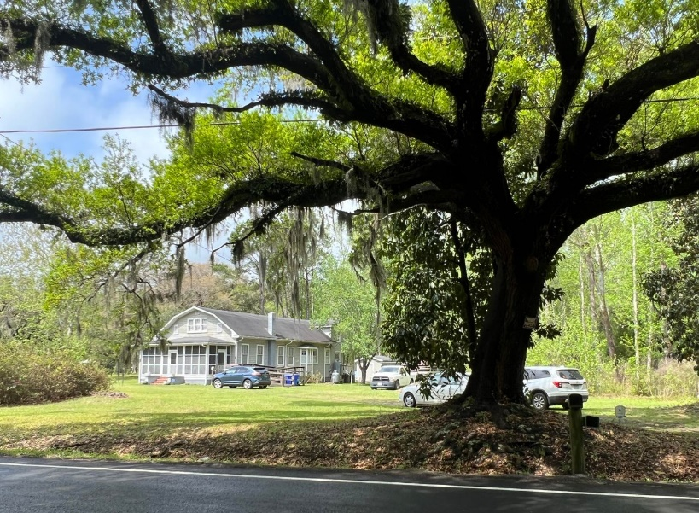
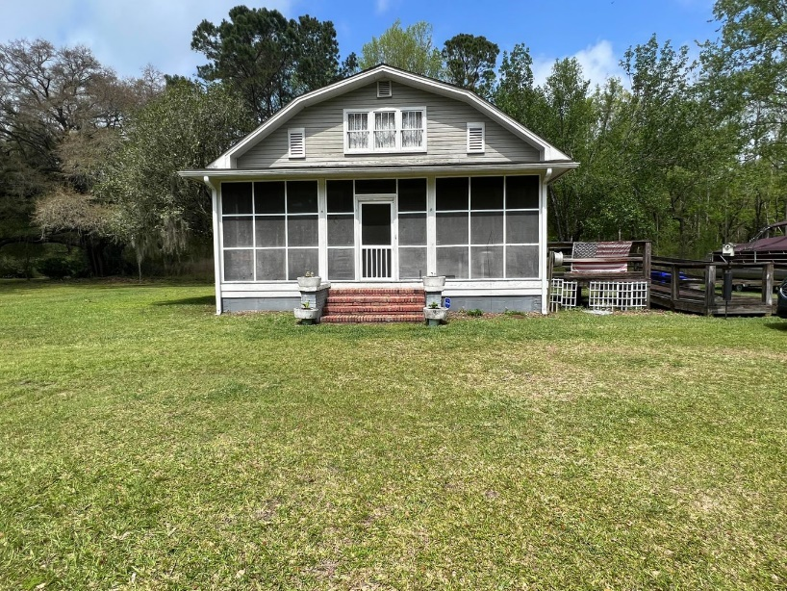
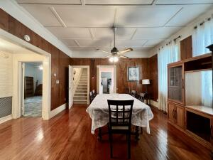
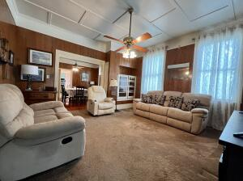
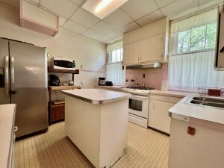
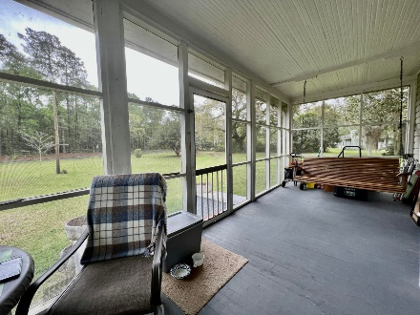
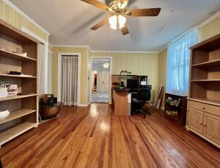
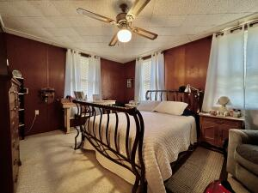
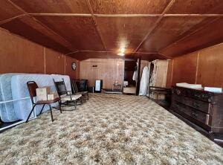
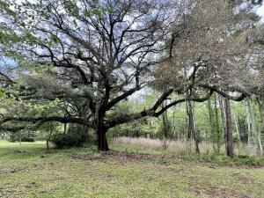


4968 Highway 162
Hollywood, SC 29449
MLS# 22008739 ~ $485,000
Almost 3 Acres in Hollywood with a Unique Home
What a unique home, that is full of character, and the potential is endless. Words and pictures do not capture the craftsmanship of this home. It is a must to see in person to appreciate. It was built to standards we rarely see anymore. It has survived storms before and after Hurricane Hugo. No flood Ins is required. Each board was laid and nailed by hand. Wood floors are throughout the home even under the carpets. There is a large front screened porch to enjoy the outside and there is also a covered porch along the back of the house. It has the characteristics of a historic farm house with the five large bedrooms, the kitchen has a large pantry and gas stove. There is even a breakfast nook with a bay window. You have to tour this home and see if you can find the hidden stairwell!
If for some reason this is not your dream home you can certainly live in it while you build somewhere else on the almost 3 acres! There has been talk that this would make a great bed and breakfast if approved by the town of Hollywood and the remainder of the property if approved could be subdivided for additional home sites along Hwy 162 with Stono Ferry, Boone Run, and Wide Awake.
Kelly Rozier
(843) 209-3129
kellywrozier@gmail.com
Brand Name Real Estate
4 Carriage Lane Suite 106
Charleston, SC 29407

