Slide 1
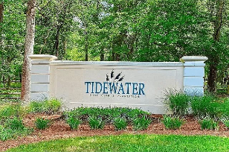
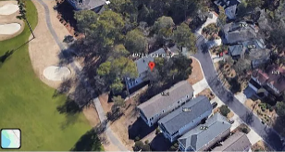
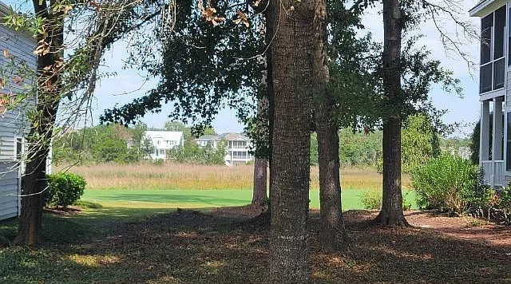
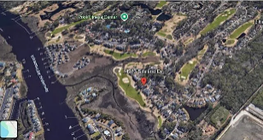
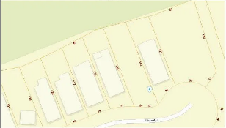
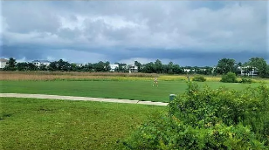

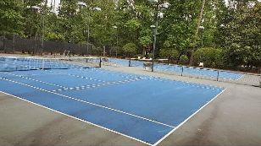
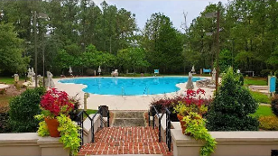
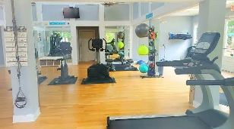

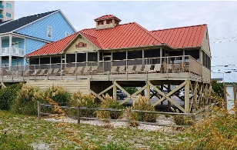



Rare Rectangular Lot On The Tip Of The Cul-de-sac On South Island Dr. Of Highly Coveted Tidewater Plantation Resort Is Unexpectedly Available For Sale.
4973 S. Island Drive
Tidewater Plantation Resort | North Myrtle Beach SC 29582
MLS# 2519832 | $124,000
Seller willing to assist with buyer financing!
Amazing opportunity!
Rare rectangular lot on the tip of the cul-de-sac on South Island Dr. of highly coveted Tidewater Plantation Resort is unexpectedly available for sale. And, even more amazing, this highly sought-after location is right on the 8th hole of works-famous Tidewater Golf Course, named the best in the nation in 2022... Tidewater amenities located on the Plantation side: Tidewater Clubhouse Grill and bar, golf shop, driving range, pools, hot tubs, fitness and amenity centers, hard and clay surface tennis courts and pickle ball court. Bocce and horseshoes are located on The Bluffs side of Tidewater. Motorcycles and golf carts are not permitted in Tidewater. However, there is a complimentary gated storage yard with 24 hour video monitoring for boats, kayaks, motorcycles, jet skis and small trailers etc. These items may be driven from the storage yard onto the public road. This motivated seller is also offering some owner-financing.
When this lot is purchased, this Intracoastal Waterway with marsh- scenery neighborhood of South Island Dr., will be all but built-out... Unique opportunity so do not delay.
Connie Ross-Karl
Realtor Broker SC/NC
702-306-2643
conniesross@aol.com
Ronnie Nichols
Realtor / BIC
RonnieNichols8@icloud.com
Helen Ashby
Realtor Agent
804-426-7758
hhashby@gmail.com
NEW WAY PROPERTIES MYRTLE BEACH

