Slide 1
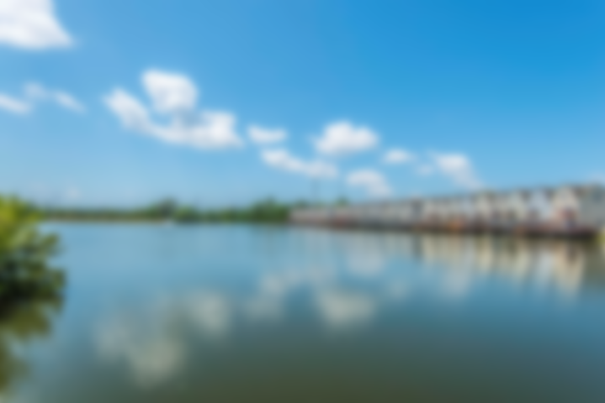
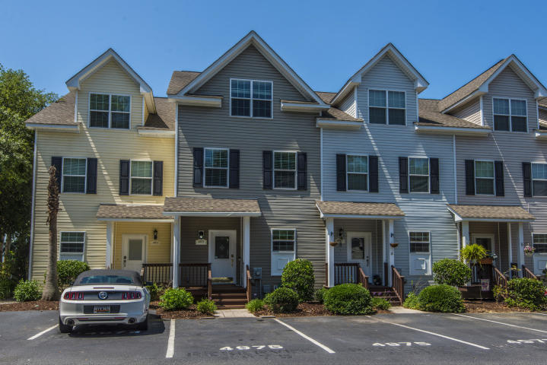
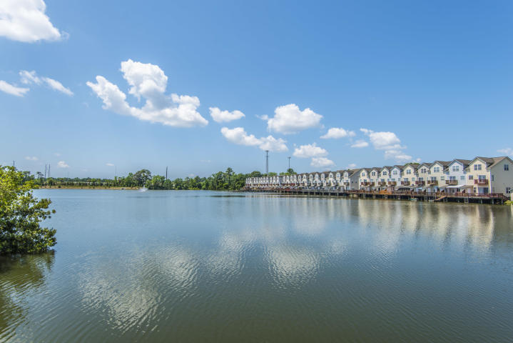
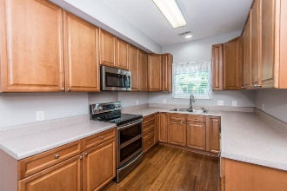
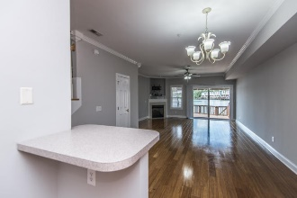
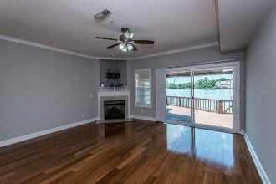
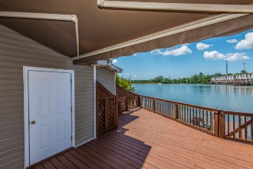
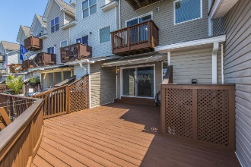
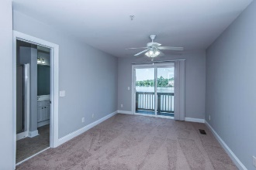
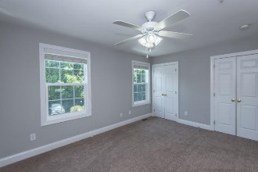
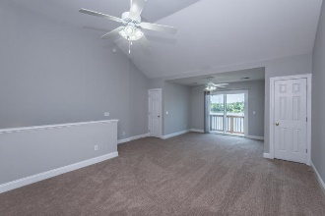
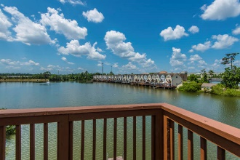
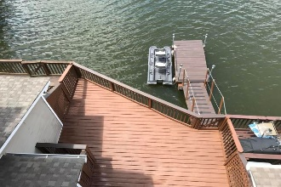


4975 Lake Palmetto Lane
North Charleston, SC 29418 ~ MLS# 19015440 ~ $235,000
Stunning Waterfront Location!
Own Your Piece Of Paradise On The Gorgeous 14 Acre Lake Palmetto
The 3 bedroom (all masters) 3 1/2 bathroom home has it own private composite wood dock where you can keep your paddle boards, kayaks, or electric motor boat. (bass boat stays) You will love the beautiful first level open floor plan with views of the lake. The spacious living area includes beautiful crown molding and a cozy gas log fireplace. Newly re-finished wide plank bamboo floors throughout first level. Walking out back you will find a large extended deck with sunsetter awning, perfect for entertaining, grilling, or just sitting to enjoy watching the turtles swimming. The kitchen boasts tons of cabinets lots of counterspace, all stainless steel appliances, newer double oven with warming tray, brand new dishwasher and built in microwave (installed May 2019) Second level you will find two secondary master en-suites and the laundry room. Washer and Dryer convey. Back bedroom has a balcony affording expansive views of the lake. Enjoy waking up to the waterview from the enormous third floor master that spans the entire level. Spacious Master bath has jetted garden tub, separate shower and double sinks. TV stays. Set up your office or reading area in the attached sitting room. There is plenty of room for clothes and storing items with the huge walk in closet, two additional closets and attic storage space. Additional perks include freshly painted interior, new carpet, one car garage, two assigned parking spaces, outdoor finished shed, and much much more. One of the only units with a 220 sq.ft. 1 car garage and dock. Truly a one of a kind home in a convenient location near shopping, the airport, entertainment and easy highway access. Won't Last Long, Schedule Your Appointment Today!
Asking $1,200,000
MLS# 17023051
3,692 SqFt
4 Bed/3½ Baths
Short Drive to Historic Downtown Charleston & Beaches
Jacqui Swain
(843) 295-9484
jacqui.swain@carolinaone.com
www.jacquisellscharleston.com
Carolina One Real Estate
1530 Old Trolley Road
Summerville, SC 29485

