Slide 1
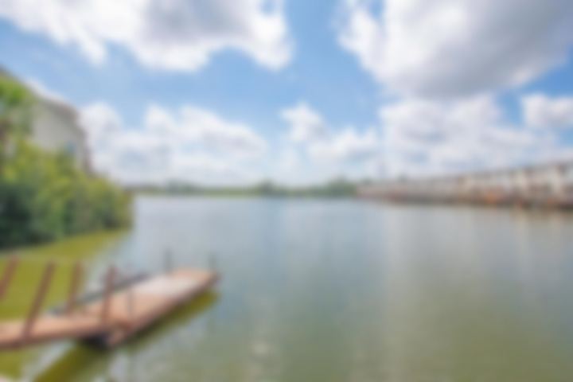
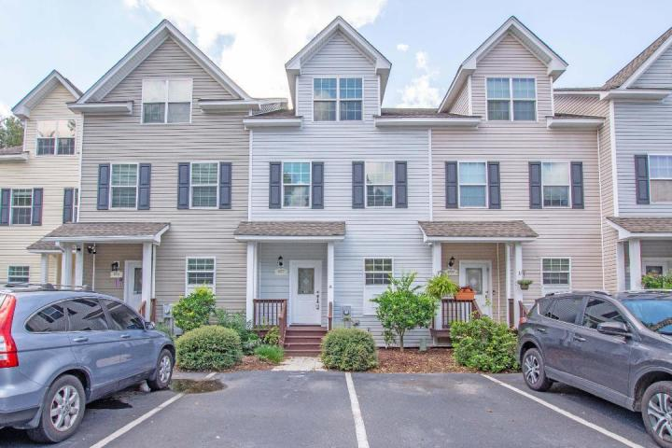
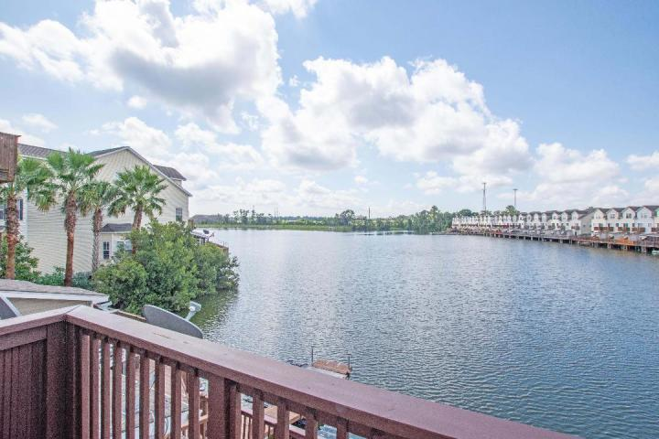
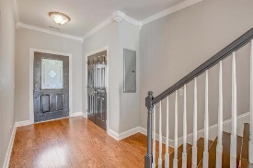
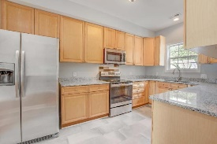
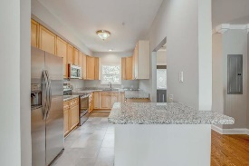
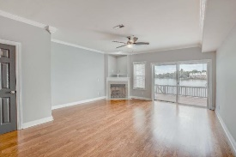
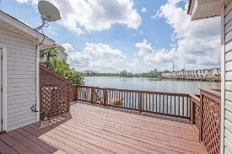
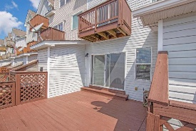
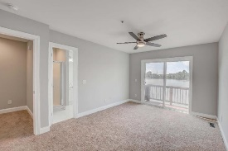
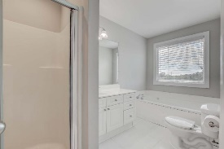
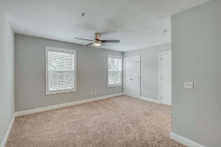
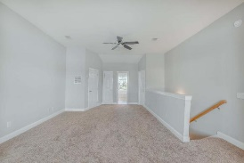
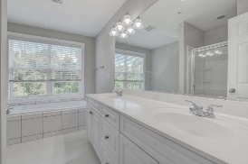
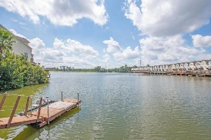


Must See For Investors, Empty Nesters, Shoppers, And Travelers
Priced Reduced $25,000
4977 Lake Palmetto Lane
Lake Palmetto ~ North Charleston ~ MLS# 18013527 ~ $205,000
A must see for College parents paying for housing at C of C or CSU. Feels like new construction. Upgraded kitchen features New Granite Countertops, New Tile Floor and All New Appliances. Stylish new grey paint throughout and new carpet. Located on beautiful Lake Palmetto, this three master suite townhome is located within walking distance to the Coliseum, Performing Arts Center, Tanger Outlet, and numerous shops and restaurants. Conveniently located close to both I-26 and I-526, this central location is a short drive to downtown Charleston and most frequented locations in the Charleston Area. Step out of your living room onto the back deck and fish while you enjoy the sunset overlooking Lake Palmetto. It won't last long in this condition. Schedule a showing today.
The second floor features 2 bedrooms and each have access to a dedicated full bath. The bedroom at the rear of the townhome on the second floor has a balcony overlooking the lake. This bedroom features a jetted tub with a large window that also overlooks the lake. The entire third floor is reserved for the owner's suite and features a large master bathroom with separate shower. The Owner's suite features a sitting area that overlooks the lake.
Bob Bryan
(843) 760-1495
bob.bryan3@yahoo.com
AgentOwned Premiere Group | 1800 Trolley Rd | Summerville, SC 29485
The Boulevard Company, LLC | 35 Broad Street | Charleston, SC 29401

