Slide 1
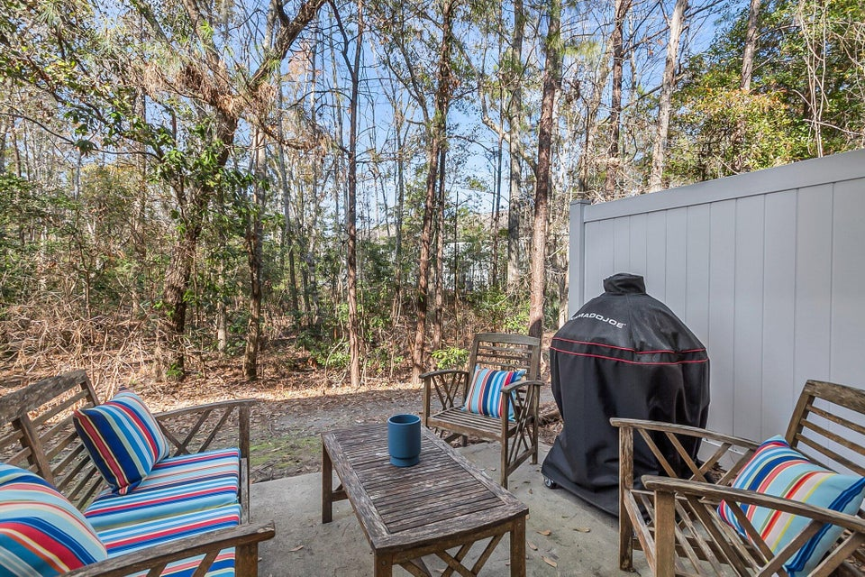
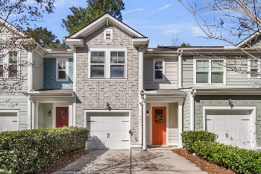
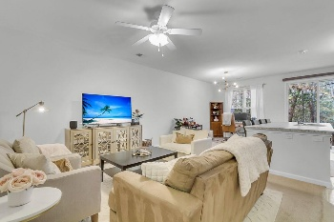
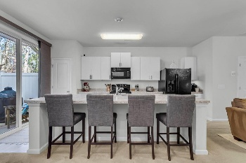
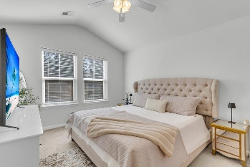
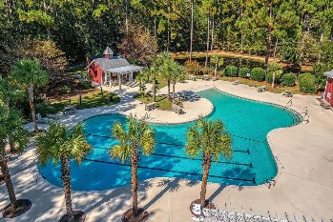

4977 Hay Bale Court Wescott Plantation · Summerville, SC 29485 · MLS# 25002526 · $290,000
Just Listed! Townhouse with Cement Plank Siding!
Stunning 3-Bedroom Townhouse with Exceptional Features in Wescott Plantation - The Farm/Sunrise! Welcome home to this beautiful 3-bedroom, 2.5-bath townhouse that perfectly blends style, comfort, and convenience! From the moment you arrive, you'll be captivated by the stunning curb appeal and gorgeous 8-foot front door that sets the tone for this exceptional home. Step inside to an open floor plan filled with natural light, perfect for modern living. The spacious kitchen is a dream, featuring a huge island, pantry, and ample storage—ideal for entertaining and everyday life. The inviting private backyard with a patio offers a serene retreat for relaxation or outdoor gatherings. Upstairs, the primary suite is a true sanctuary, boasting soaring ceilings, a luxurious ensuite bath with an oversized shower, a dual sink vanity, and a generous walk-in closet. Two additional nicely sized bedrooms share a well-appointed full bath, and multiple extra closets throughout provide excellent storage solutions. This energy-efficient home is equipped with smart thermostats and smart light switch capability, along with a Nest doorbell, adding convenience, security, and efficiency to your daily life. The attached one-car garage is equipped with a 50 amp NEMA 14-50 outlet, allowing for quicker charging of your EV vehicle. Plus, the washer, dryer, and refrigerator are all included, making this home move-in ready! This townhouse is in a prime location close to major employers such as Bosch, Mercedes, Boeing, and the Joint Air Force Base. Enjoy easy access to a variety of restaurants, coffee shops, grocery, and home improvement stores, with the airport and beaches just a short drive away! Residents of The Farm enjoy outstanding amenities, including a large community pool, playground, clubhouse with a gym, and scenic walking and jogging trails. Don't miss this opportunity to own a stunning home in a fantastic community...schedule your showing today!
Stan Huff
843-670-2835 stan.huff@agentowned.com
Jill Marcacci
843-297-5590 jill@agentowned.com
www.agentownedrealty.com
AgentOwned Realty Co. Preferred Group, Inc. | 824 Johnnie Dodds Blvd | Mt Pleasant, SC 29464

