Slide 1
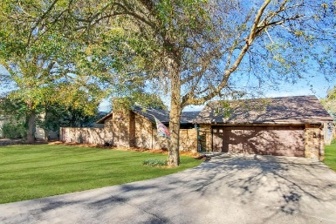
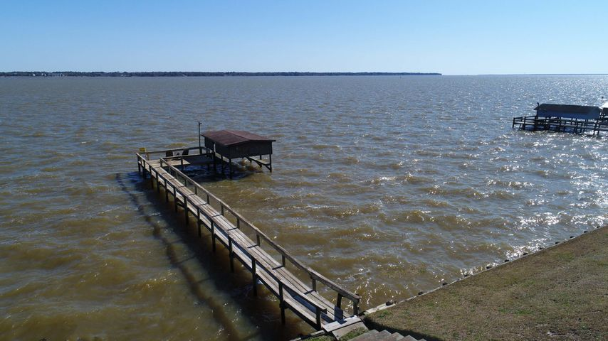
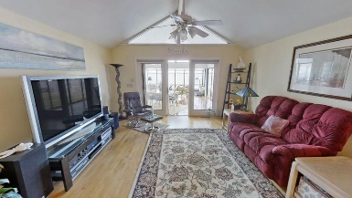
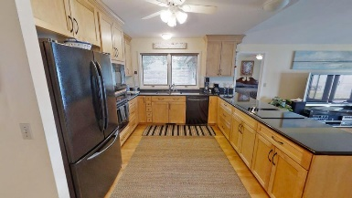
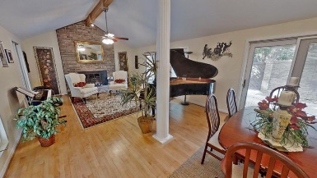
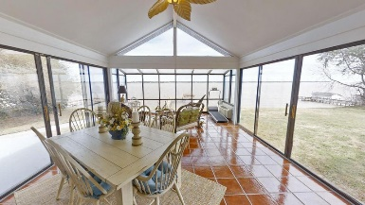
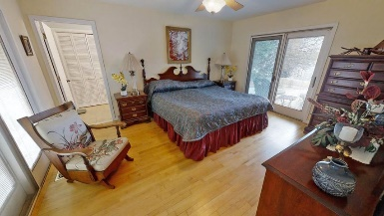
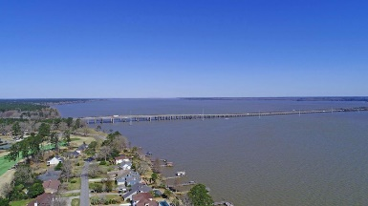
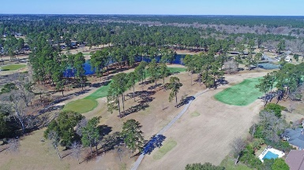

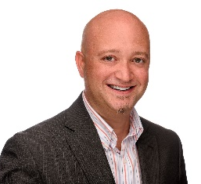
497 Santee Drive
Santee Cooper Resort | Santee, SC 29142
MLS# 21005748 | $499,900
On the Big Water of Lake Marion!
SCHEDULE YOUR SHOWING TODAY!
Imagine awakening every morning on 'Big Water' in the serene Santee Cooper Resort, a gated golf community on Lake Marion, South Carolina's largest lake! This beautiful brick ranch home is the definition of "The Lake Life." The home contains 3 bedrooms with an additional room for flex space, 2 full bathrooms, and 2382 sq.ft. of living space. A brand new roof was just installed in 2020 and the home took on a complete remodel in 2006. Lake homes are a magnet for guests and your new home is well-equipped for entertaining! The front tiled foyer exits to an open living room and dining area. Set the ambiance throughout the rooms with the wonderful brick fireplace which offers a propane connection.
Open and airy, tall vaulted beamed ceilings are over the central common areas as well as low maintenance hardwood floors throughout. Two sliding glass doors open onto a spacious private courtyard (770 sq ft), perfect for family gatherings or the 19th hole for your golf gang. The kitchen, with its tasteful black granite countertop contrasting the blond cabinetry is the hub of this home. It overlooks the private courtyard, family room, solarium and a panoramic view of the lake, dock and boathouse for your fishing boat or runabout. You are immediately drawn to the large solarium with its glistening tiled floor, encased in glass which basks in the morning sun. This is the perfect spot for a quiet breakfast watching the ducks float down the lake. The spacious master suite, adjacent to the family room, has stunning views of the lake and an en suite with dual vanities. The sliding glass doors in the master bedroom lead to both the private courtyard and the patio overlooking the lake. Across the family room is the hallway leading to the other two bedrooms, both with breath taking views of the lake. An additional full bathroom with dual vanities is shared with the two bedrooms. A flex room is located at the end of the hall that could serve as an alternative 4th bedroom, office, studio, or whatever fits your lifestyle.
Virtual Tour: https://my.matterport.com/show/?m=GzjEWBa9iWm
Brandon Ray
(843) 499-1928
brandon.ray@carolinaone.com
www.therightrayhome.com
Carolina One Real Estate
900 N Main St
Summerville, SC 29483

