Slide 1
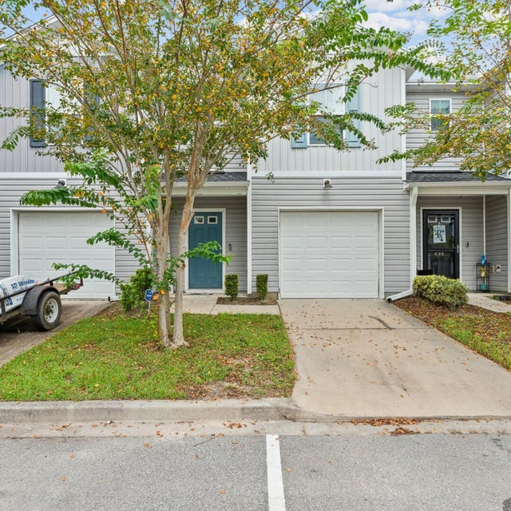
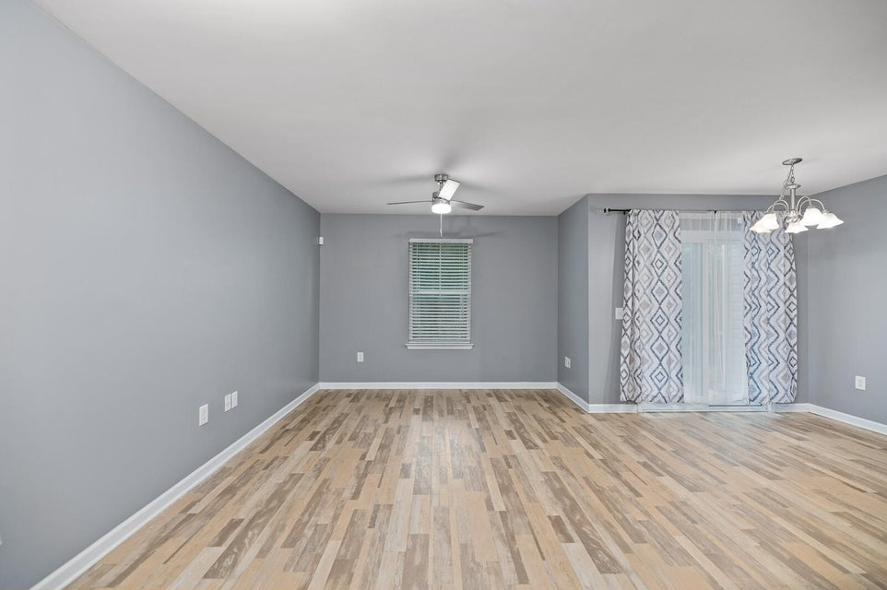
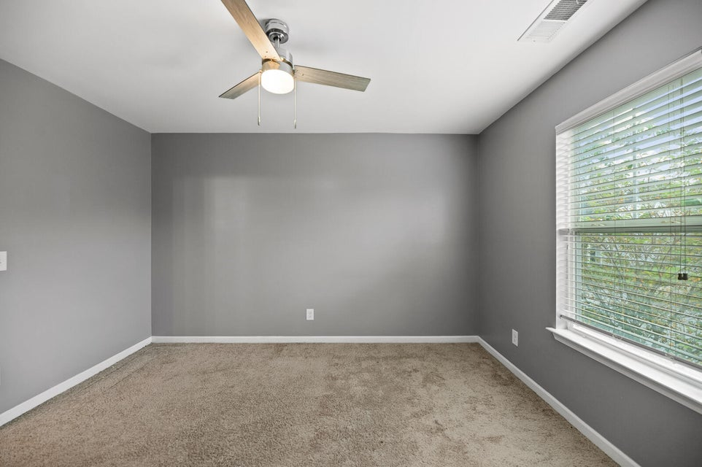


OPEN HOUSE SUNDAY SEPT 28th 12-2PM
497 Truman Drive
Lakeview Commons | Goose Creek, SC 29445 | MLS# 25022978 | $247,000
Welcome to 497 Truman Drive, a move-in ready, low maintenance townhome in the desirable Lakeview Commons community, with fantastic amenities. Whether you're a first time homebuyer looking for a smart investment, an investor in search of a strong rental potential, a downsizer ready for easy living, or simply someone seeking a peace of mind in a friendly neighborhood with a welcoming environment, this home checks all the boxes. Inside features include an open concept layout, 3 bedrooms, 2.5 bathrooms, and a one car garage. Upstairs, you'll find the owner's suite which includes a private bath and walk-in closet. As well as two additional bedrooms, a full bath, and a laundry room. Community perks include a pool and play park. Don't wait!! Schedule your private showing today!
Gabrielle Wilkins
843-330-7306
gabrielle@clfhomesolutions.com
gabriellewilkins.clfhomesolutionsteam.com
Changing Lives Forever Home Solutions

