Slide 1
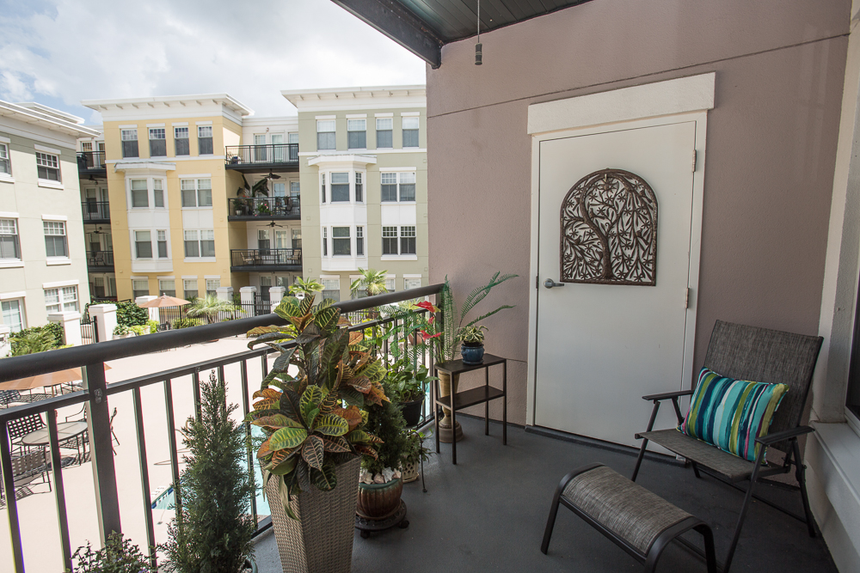
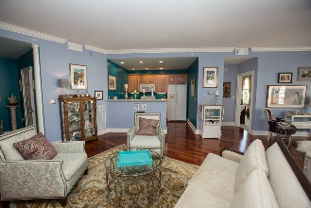
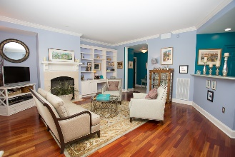
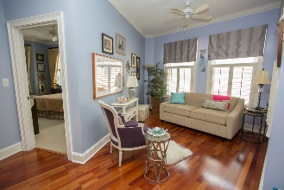
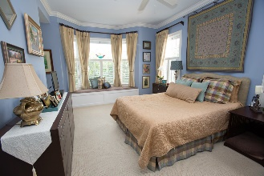
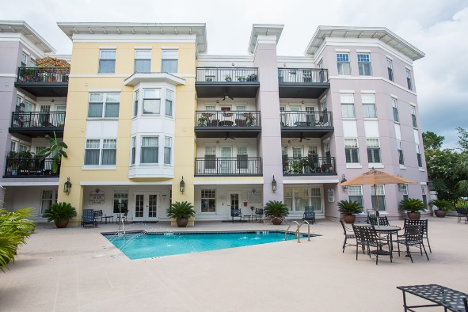
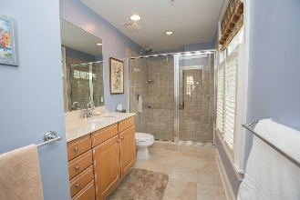


Gorgeous home!
Must See!
Just reduced!
498 Albemarle Road #314
Albemarle Point · Charleston · MLS# 16020054 · $315,000
Michael Dew
O (843) 870-7000
M (843) 870-7000
michaeledew@gmail.com
www.michaeldewrealestate.com
This is a fantastic condo only minutes from Marinas, Downtown shopping, and Fabulous Restaurants! Live near it all, and have parking, exercise and sauna facilities, pool and a Club Room to have a social gatherings. Exceptionally clean and very well maintained end unit with lots of natural light. Freshly painted with custom colors. Plantation shutters on all of the windows. Hard wood floors through out main living areas. Built ins in living room. Spacious master suite with window seat with storage and walk in closet with shelving. Beautiful master bath with massive tiled shower and custom vanity. Relax on your private balcony. Assigned roomy parking space near elevator. HOA includes: Pool, fitness center, club house, water, gas, outdoor maintenance, and flood insurance.
AgentOwned Charleston Group
902 Savannah Hwy
Charleston, SC 29407
Real Estate ● Mortgage
Insurance ● Business Brokerage

